Slide 1
SCOPE-CM #10: Atmospheric Motion Vectors (AMV) and Clear/All Sky Radiances (CSR/ASR) from historical meteorological satellites in geostationary and polar orbit
Kenichi Nonaka
Meteorological Satellite Center (MSC)
Japan Meteorological Agency (JMA)
7 Feb. 2019 SCOPE-CM 14th Executive panel meeting (SEP-14)

Slide 2
Objective
The major objective of this project is to provide Atmospheric Motion Vectors (AMV), Clear Sky Radiances (CSR) and All Sky Radiances (ASR) for the use in global and potentially regional Numerical Weather Prediction (NWP) model-based reanalysis.
Furthermore, AMV data provided on regular grids may also be utilised in the analysis of dynamical systems in relation to water vapour transport or monsoon studies.
Partners
ECMWF
EUMETSAT (CF)
JMA (MSC, CPD)
NOAA (NCDC, NESDIS)
University of Wisconsin/CIMSS
Notes:
Purpose is to be a bridge between satellite data reprocessing and NWP reanalysis community.

Slide 3
Project Purpose at Phase II
The major points to work on to reach the goal of this project are:
Analysis of differences in AMV, CSR and ASR product definition, algorithms and processing chains for instruments in geostationary and polar orbit;
Development of a plan for a more coherent product suite for all instruments;
Enhancement of AMV algorithms with a quantitative uncertainty estimate;
Establishment of a validation framework for AMVs by agreeing on a metric, certain quality analysed non-satellite observations and by utilising means from reanalysis centres;
Enhancement of the documentation towards a coherent description of the products

Slide 4
Target Satellite Sensor Record for Geostationary Imagers (2014)
Satellite System | Position Longitude | Period | Image Rate for AMV derivation | Comment
GOES-E | 75°W | 1980 – today | Variable
GOES-W | 135°W | 1980 – today | Variable
Meteosat (2-10) | 0° | 1982 - 2004 2004 – today | 30 min 15 min
Meteosat (5 and 7) | 63°E 57°E | 1997 – 2005 2005 – today | 30 min 30 min | Called Indian Ocean Data Coverage (IODC)
Meteosat 3 | 70°W 75°W | 1991 – 1993 1993 – 1995 | 30 min 30 min | Called Atlantic Data Coverage (ADC) Called eXtended ADC (XADC)
GMS (GOES-9) | 140°E 155°E | 1978 – 2003 2003 – 2005 | 30 min 30 min | GOES-9 was put at the Western Pacific Region
MTSAT | 140°E 145°E | 2005 – 2010 2010 – today | 15min, 30min, 60 min

Slide 5
Duration of the Project and Schedule (5 years from 1 Jan 2014)
Review on the use of AMV and CSR in past reanalysis; Analyze requirement for future reanalysis; Analyze the differences in AMV product definition, algorithms and processing chains and develop a plan for a globally coherent product; Perform feasibility analysis of GOES AMV processing with respect to satellite observation schedule and forward analysis result to reanalysis centres Encourage other space agencies operating geostationary /polar orbital instruments to join the project; Open a project portal site | 2014 | All All JMA, EUM, NOAA, NOAA JMA, EUM JMA
Build common validation framework following agreed metric such as polar orbiting satellites and radiosonde observations; Perform processing of geostationary products; | 2015 | EUM, JMA, NOAA
Perform processing of polar orbit data; Perform processing of geostationary products (continue); Validate products from geostationary satellites; Analyze feedback on early phase products from reanalysis centers | 2016 | EUM EUM, JMA, NOAA All
Update the documentation of all products in coherent style; Validate products from polar orbiting satellites; | 2017 | EUM , JMA, NOAA
Analyze feedback on products from reanalysis centres and other applications and develop a plan for SCOPE-CM phase 3 | 2018 | All

Slide 6
Initial and Targeted Maturity Level
The software used to create AMV, CSR and ASR products is in operational use and can be considered mature. However, as one objective of this project is to present the products in a more coherent way by potentially using a common software.
 | Software Readiness | Meta Data | Documentation | Validation | Public Access | Utility
Initial Maturity Level | 3 | 3 | 3 | 2 | 4 | 5
Targeted Maturity Level | 5 | 5 | 5 | 5 | 5 | 6

Slide 7
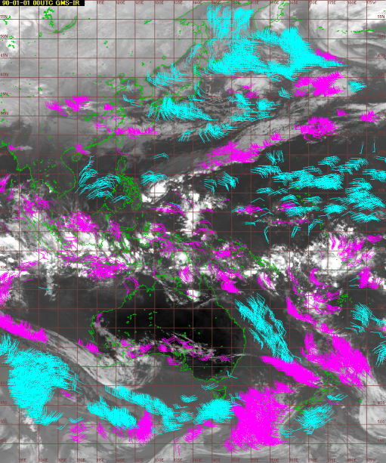
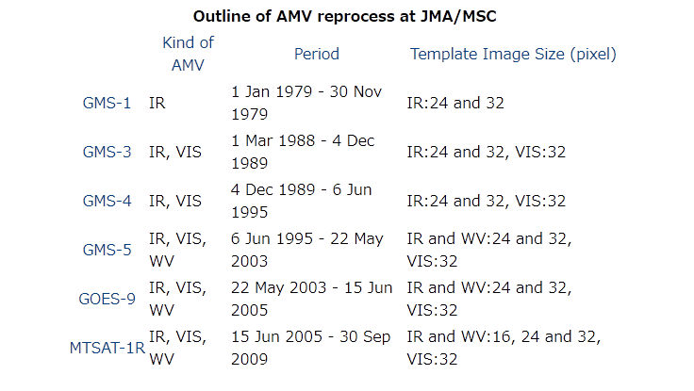
Review of reprocessing AMV for JRA-55
JRA-55
GMS-1,3,4,5,GOES-9,MTSAT-1R:
1979 – 2009 with MTSAT algorithm
 | Software Readiness | Meta Data | Documentation | Validation | Public Access | Utility
initial Maturity Level | 3 | 3 | 3 | 2 | 4 | 5
Upgraded Maturity Level | 3 | 4 | 4 | 3 | 5 | 5
JMA/MSC’s reprocessing for JRA-55 project is deficient in validation information.
- Common validation such as comparison against RAOB, other AMVs, etc.
Reprocessed data for next JMA’s reanalysis project, JRA-3Q, will be provided with the validation information.

Slide 8
Reprocessed AMV/CSR/ASR
EUMETSAT
ERA-CLIM
MSG (Meteosat-8, -9): 2004-03-01/2012-12-31 (2015 released)
AVHRR: 2007-2014, with EUMETSAT & CIMSS algorithm
ERA-CLIM2
MFG/MSG : 1982-2017 with EUMETSAT algorithm
GAC AVHRR: 1982-2016 with EUMETSAT algorithm
MFG/MSG Reprocessing will be repeated in the future with an improved cloud top pressure
AVHRR second release, including NOAA6,8,10 (will release in 2019)
NOAA/NESDIS and CIMSS
AMV GOES East and West (GOES-8 to -15): 1995-01-01/2013-07-10 with NESDIS operational algorithm
AMV AVHRR: 1982 - 2014
Full GOES archive with the latest GOES algorithm
JMA/MSC
JRA-55
AMV GMS-1,3,4,5,GOES-9,MTSAT-1R: 1979-01-01/2009-09-30 with MTSAT algorithm
CSR GMS-5, GOES-9, MTSAT-1R: 1995-06-06/2009-12-31
JRA-3Q
AMV MTSAT-1R/2 to Himawari-8: 2005 - 2015 with the latest Himawari-8 algorithm (ongoing)
AMV GMS-5, GOES-9 with the latest Himawari-8 algorithm (planned)
by IWW12 (2014), IWW13(2016), IWW14(2018)

Slide 9
Latest Maturity Level
The software used to create AMV, CSR and ASR products is in operational use and can be considered mature. However, as one objective of this project is to present the products in a more coherent way by potentially using a common software.
 | Software Readiness | Meta Data | Documentation | Validation | Public Access | Utility
Initial Maturity Level | 3 | 3 | 3 | 2 | 4 | 5
Targeted Maturity Level | 5 | 5 | 5 | 5 | 5 | 6
Upgraded Maturity Level | 3 | 5 | 5 | 4 | 5 | 5
Reprocessing with the coherent way by using a common software was not fulfilled in the Phase II.
Documentation and Validation were matured (EUMETSAT), but were not enough (JMA).

Slide 10
Learning from the phase-2
Navigation corrections for historical satellite images are necessary for more accurate reprocessing AMV, though it is challenging in resources and method.
The products are reprocessed using the latest algorithm as often as each reanalysis project requesting. It makes difficulty linking connection between agencies.
It was difficult to succeed a project lead especially at JMA, because a person in charge of the project were frequently changed due to personnel changes. It makes lack of communication among providing members.

Slide 11
Next Step for Project / Desired Role
Cal/Nav corrections reprocessing for historical images are necessary to more coherent reprocessed dataset .
The objective will be focused on creating common method of validation and comparison between the products.
More active interaction with CGMS International Winds Working Group (IWWG) is important for next step.
SCOPE-CM (Phase II) have provided an opportunity to recognize the requirements of reanalysis users. Promotion of interaction between users and providers is desired and makes motivation.

Slide 12
Related projects
SCM-06 (IOGEO)
SCM-10 would seek close interaction with SCM-06: Inter-calibration of imager observations from time-series of geostationary satellites (IOGEO) through the experience from Global Space-based Inter-calibration System (GSICS) for reprocessing AMVs and CSRs/ASRs long term records.
GSICS
GSICS provides bias corrections through the inter-calibration of satellite sensors with respect to selected references that can be applied to generate reprocessed CSR and ASR products as Fundamental Climate Data Records (FCDRs) and related Thematic Climate Data Records (TCDRs).
IWWG
The project would seek close interaction with the CGMS International Winds Working Group (IWWG) to benefit from ongoing comparison activities that might need to be enhanced to cover the temporal dimension of the AMVs long term records.
Reanalysis communities
The project would exchange information with reanalysis communities on their calculation plans and the quality. The best forum identified for discussion of data issues is the WCRP Data Advisory Council that has representation from reanalysis centres.

Slide 13
Thank you for your attention

Slide 14
Final Maturity Matrix
Software readiness |  | Metadata |  | User documentation |  | Uncertainties Characterisation |  | Public access, freedback and update |  | Useage
Coding Standards |  | Standards |  | Formal description of scientific methodology |  | standards |  | Public access/Archive |  | Research
Software Documentation |  | Collection level |  | Formal validation report |  | Validation |  | Version |  | Decision support system
Numerical reproductibility and portability |  | File level |  | Formal product user guide |  | Uncertainty quantification |  | User feedback mechanism
Security |  |  |  | Formal description of operations concept |  | Automated quality monitoring |  | Update to record
Legend
 | 1 |  | 2 |  | 3 |  | 4 |  | 5 |  | 6

