Slide 1
RO-CLIM (SCM-08) Radio Occultation based gridded climate data sets Hans Gleisner & the RO-CLIM Project Team

Slide 2
Contents
0. GNSS-RO intro: what is measured, FCDRs, TCDRs, ECVs, satellite missions
1. Starting point for the SCM-08 project. Project purposes.
2. Project activities. Advances and developments.
3. Summary of project state at end of Phase II
4. Difficulties and challenges
5. Way forward. Role within SCOPE-CM Phase III.
Notes:
These are the techniques available for monitoring the global troposphere. They have different advantages and disadvantages, but one thing they all have in common is calibration. Time and money is spent on calibration to make the data useful for climate purposes, derivation trends, etc.
Radiosondes: + high vertical resolution + long data set, since the 1950s – few data, sparse sampling – calibration issues
Microwave sounding: * bulk temperatures in thick layers of the atmosphere + long dataset, since 1979 – calibration issues – troposphere: contamination from surface & strato, issues at high latitudes & high terrain
Infrared sounding: + better vertical resolution – calibration issues – only cloud-free areas, risk of contamination – inversion dependent on a priori information
Radio occultation: + high vertical resolution + fundamentally calibration-free + global coverage, independent of clouds – short data set, since 2001

Slide 3
Atmospheric sounding with GNSS-RO – what is measured –
i. Measurements of phase and amplitude that gives a vertical atmospheric profile at the ray’s tangent point. ii. Position and velocity of the satellites.
t₂
Metop
t₁
t₃
GNSS
GPS signals:
L1: ≈19 cm
L2: ≈24 cm
Important for climate: based on measuring time differences (phase shifts), not radiances, makes this technique intrinsically stable. No need for inter-calibration between instruments/missions.

Slide 4
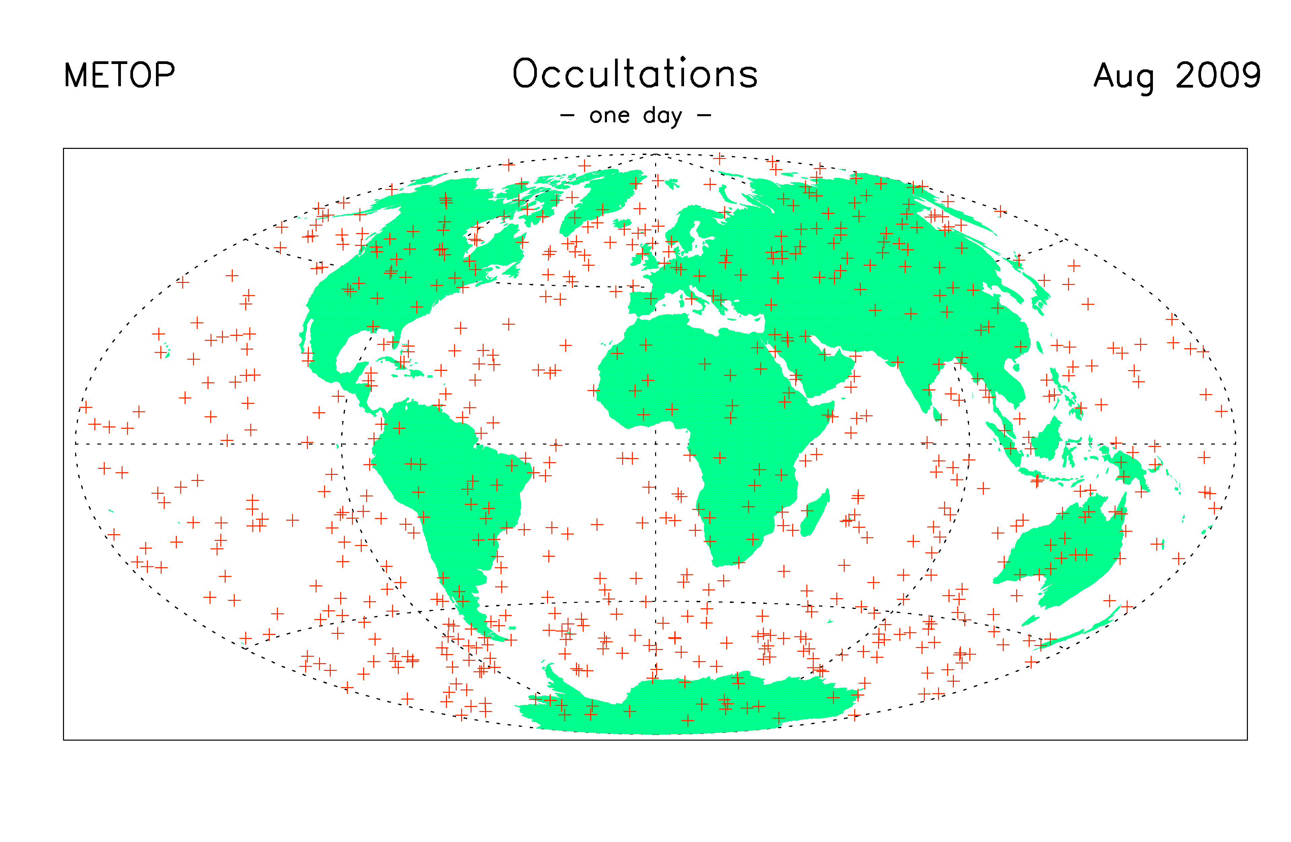
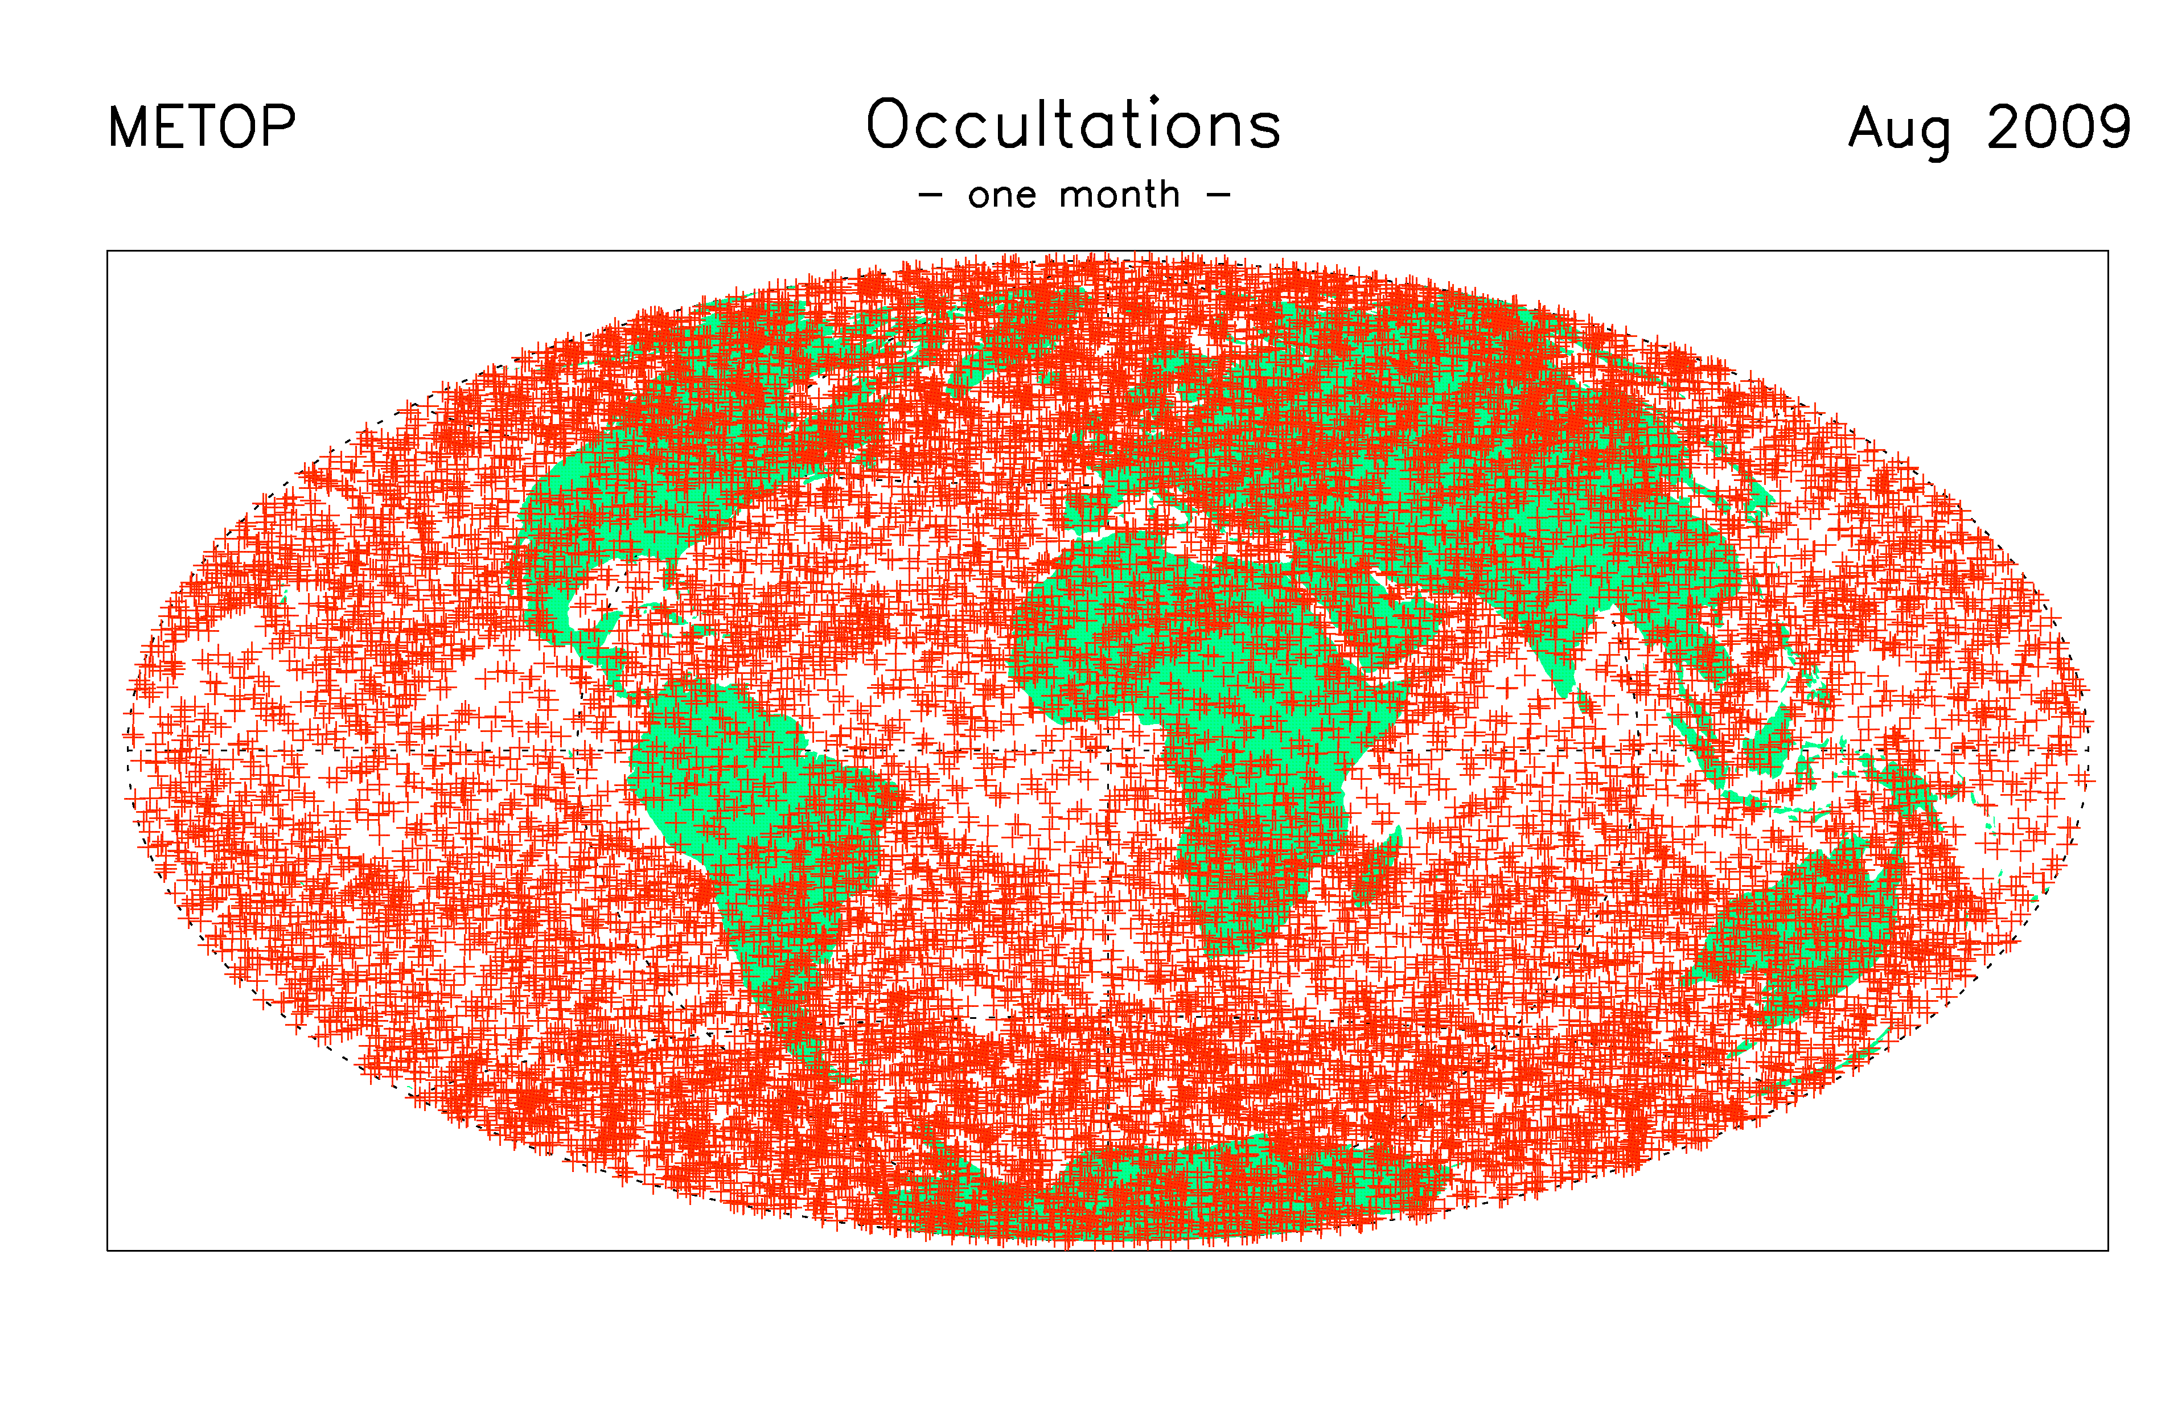
Sampling the atmosphere with GNSS-RO – distribution of profiles from a single mission –
The technique is based on active sounding at microwave frequencies. Independent of clouds, surface, day/night. Overall sampling distribution governed by satellite orbits.

Slide 5
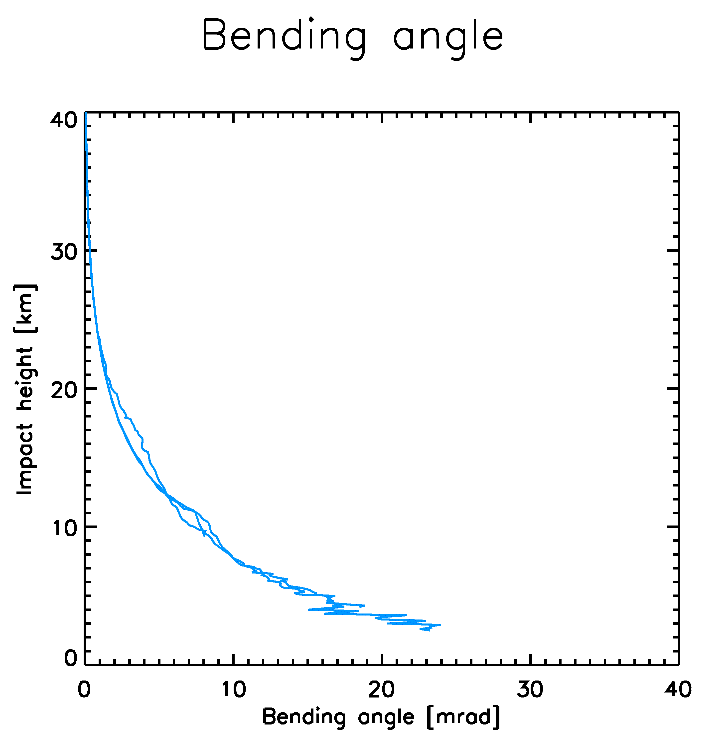
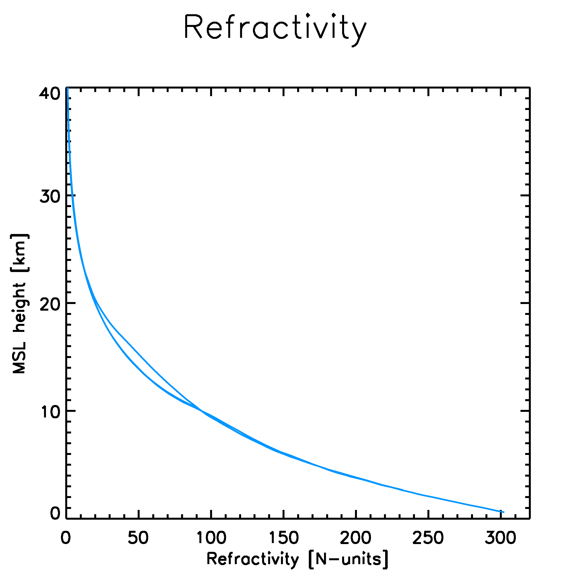
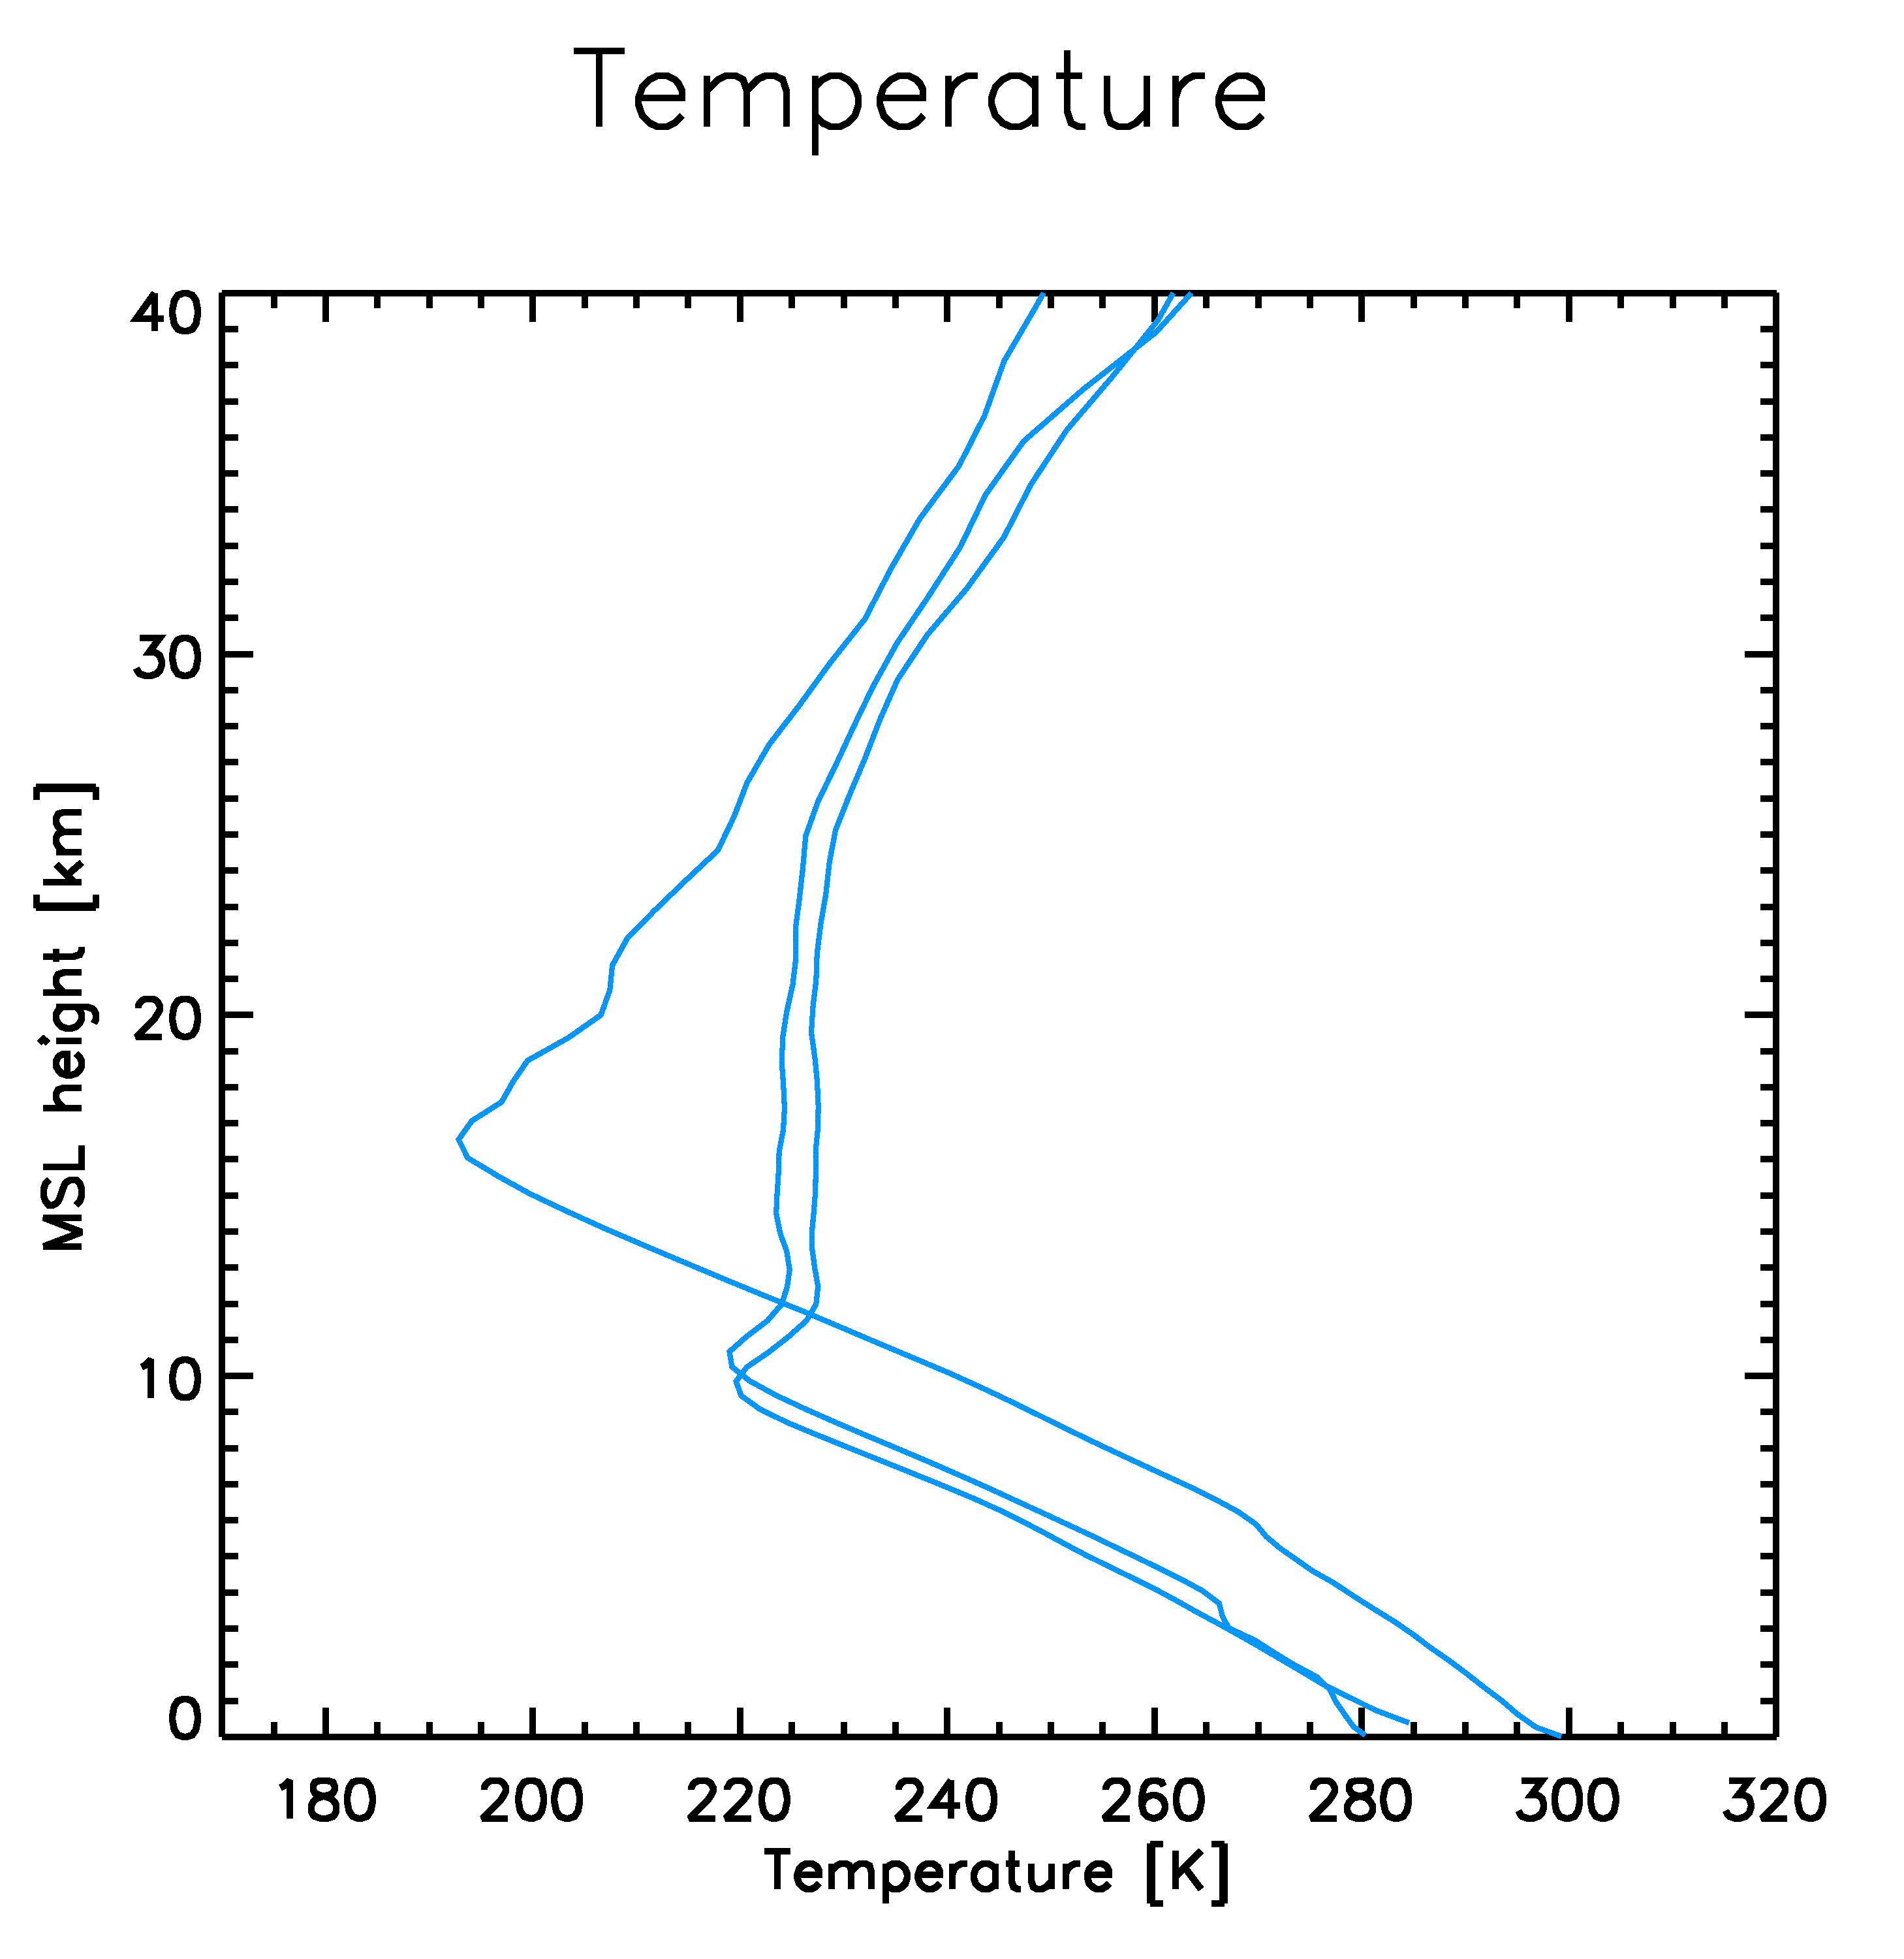
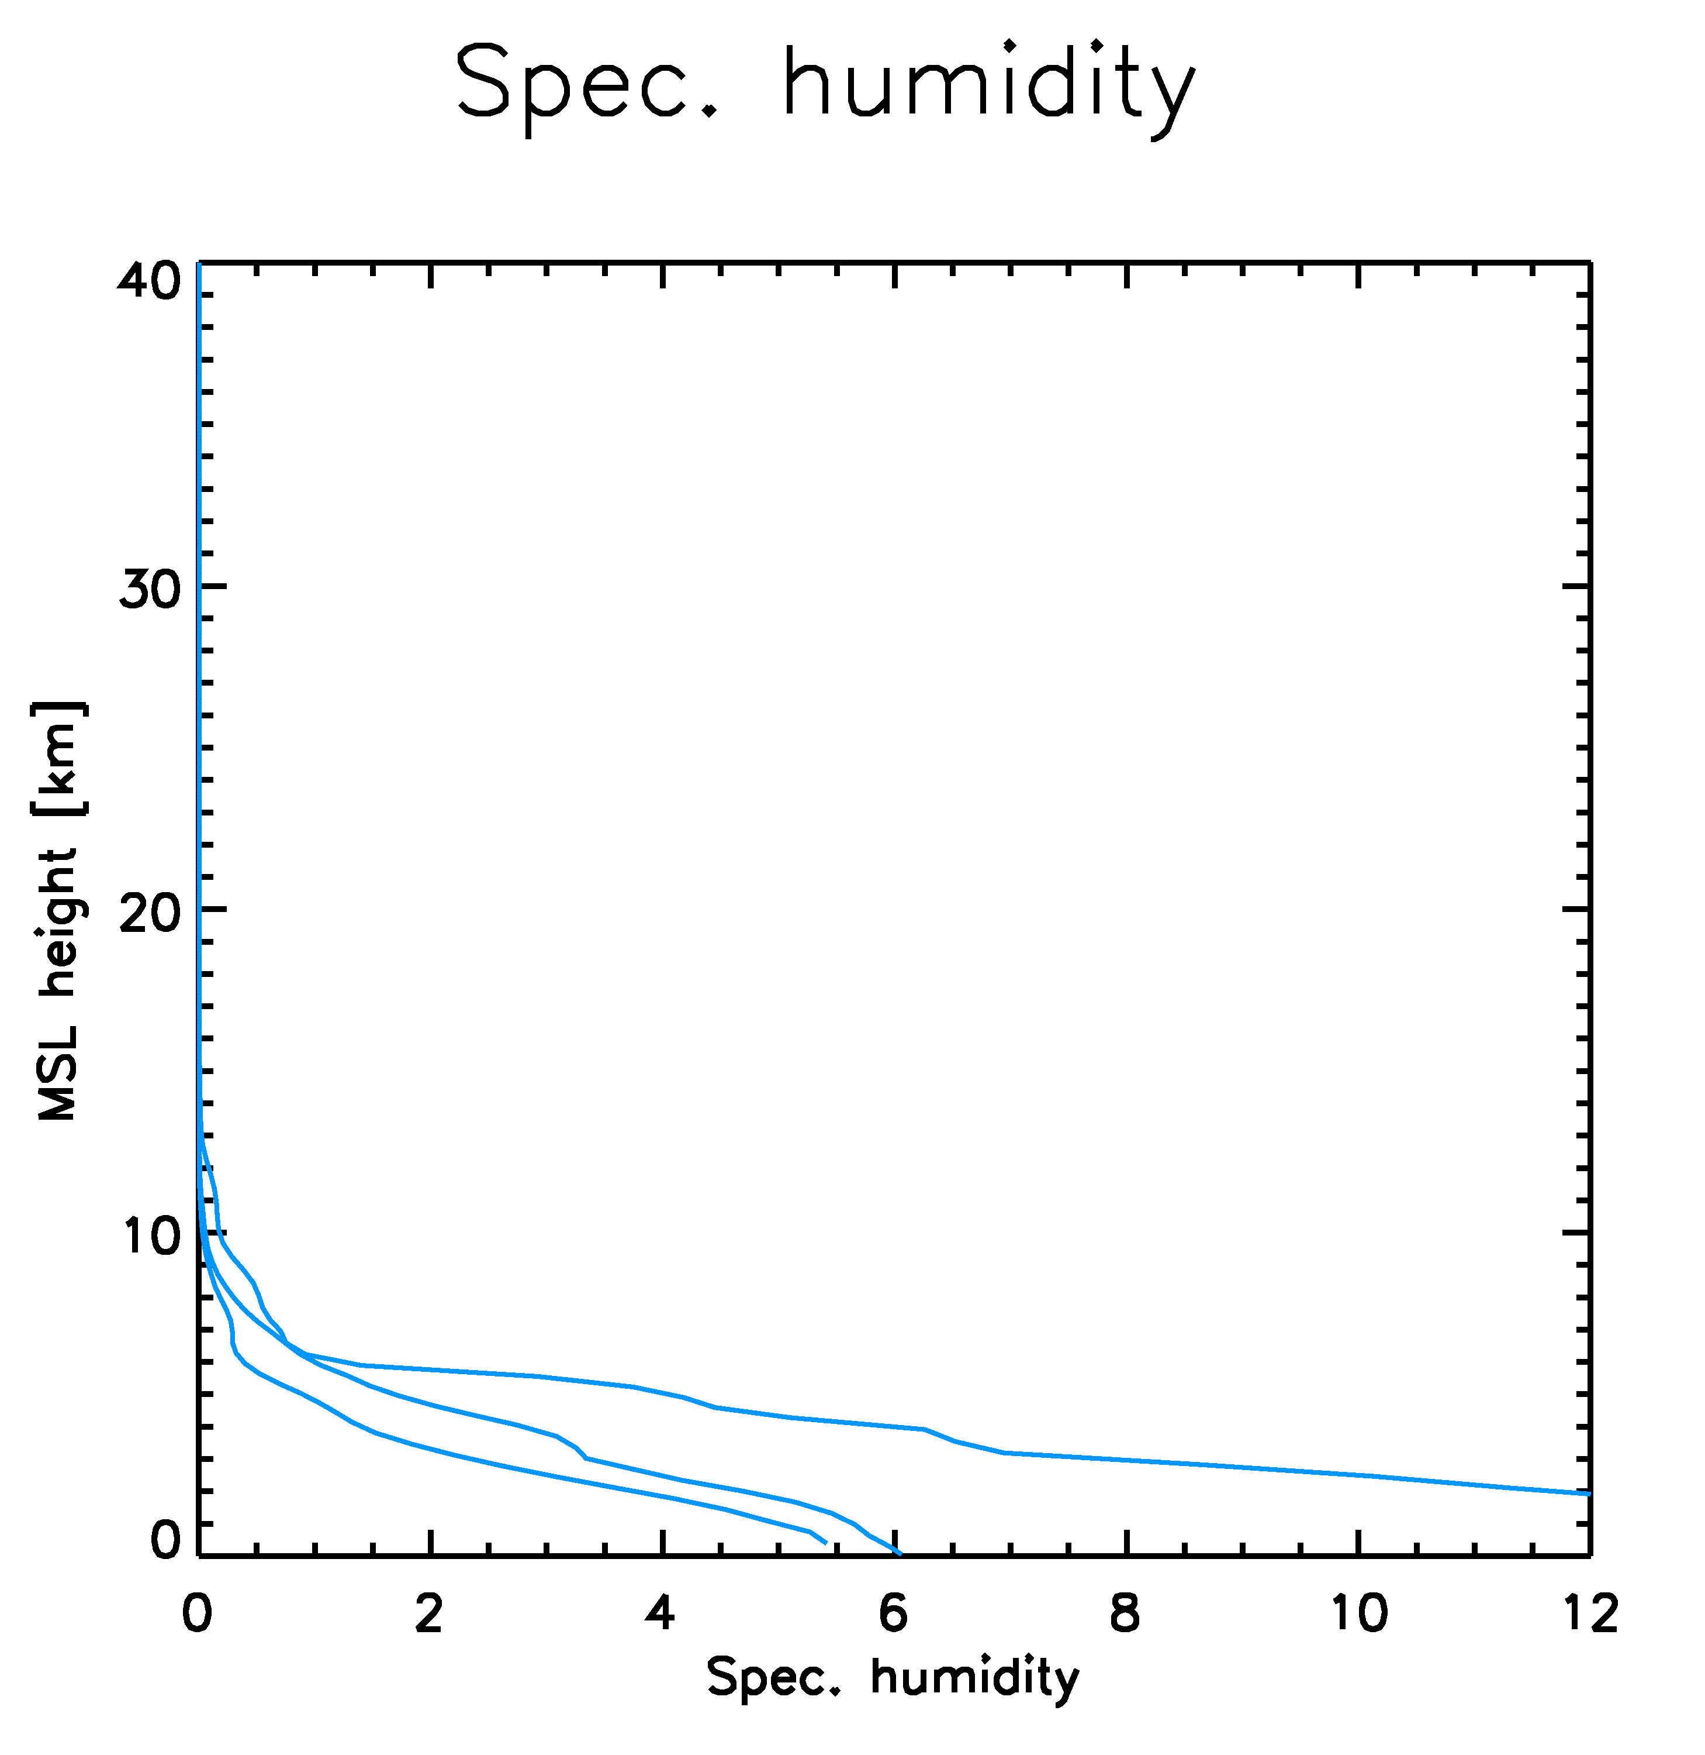
Atmospheric sounding with GNSS-RO – atmospheric profiles –
FCDR
TCDR
L ~ 300 kilometers
Z ~ 100 meters – 1 kilometer
TCDR ECV
TCDR ECV

Slide 6
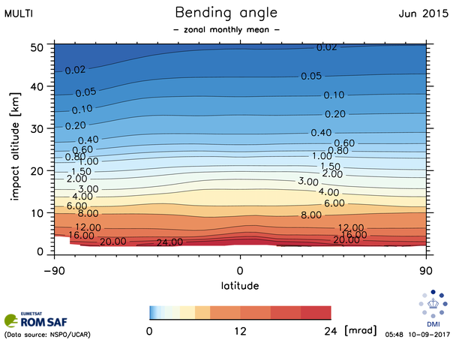
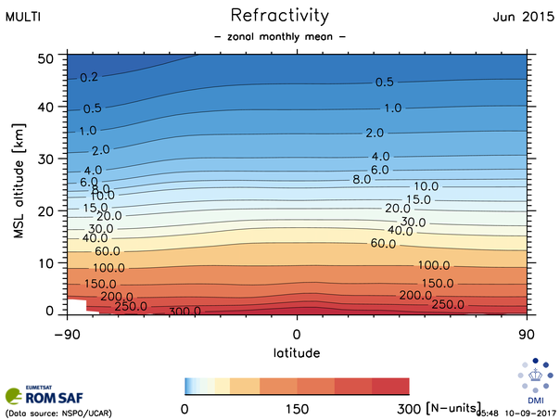
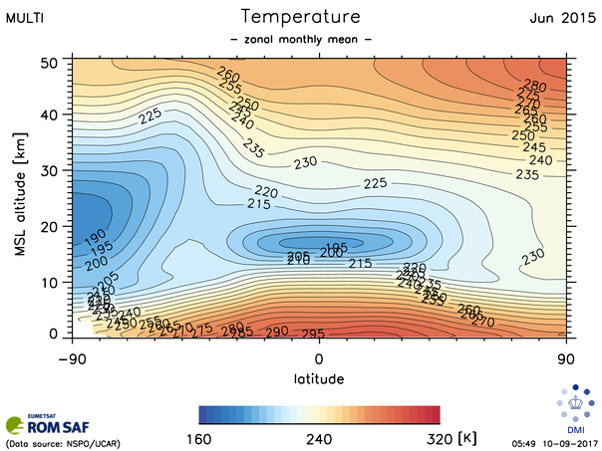
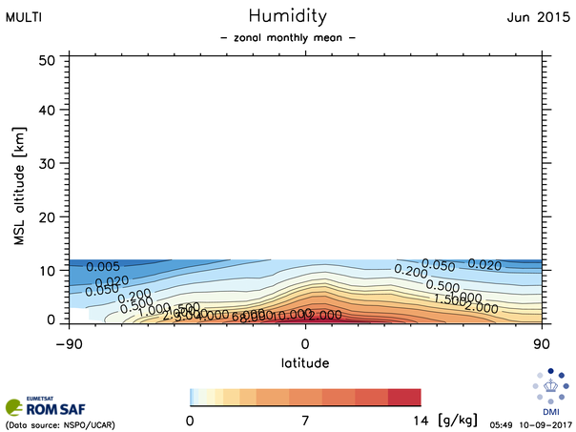
RO climate data records – gridded monthly means –

Slide 7
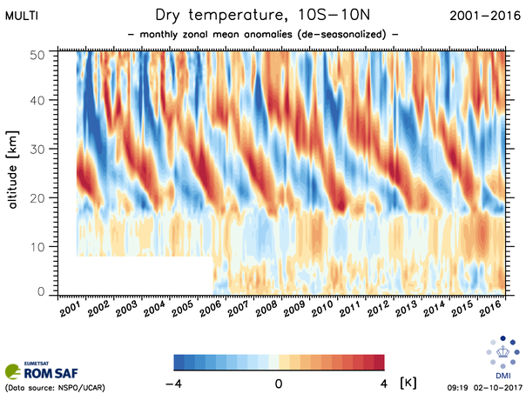
RO climate data records – time series of monthly mean data –
Dry temperature
Near-equatorial means
De-seasonalized
Semi-annual variability dominated by QBO in the stratosphere, and ENSO in the troposphere. Low-latitude tropopause clearly visible. We also see the altitude where humidity starts to play a role for the refractivity.

Slide 8
Satellite missions with RO capacity ––
Extended RO-CLIM Focus
Initial RO-CLIM Focus

Slide 9
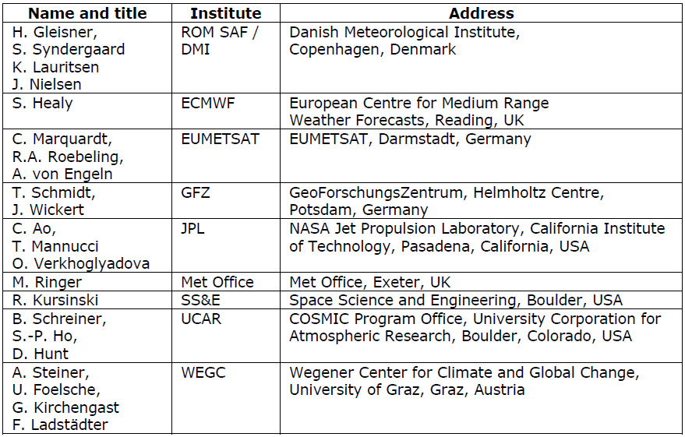
The RO-CLIM project – project team –

Slide 10
The RO-CLIM (SCM-08) project – starting point –
In 2007, the RO community started inter-comparisons of RO data records from different processing centers In 2014, this informal collaboration was formalized as the RO-CLIM project under SCOPE-CM. The main aim of RO-CLIM has been to support the generation and successive improvement of RO climate data records, by better understanding of differences between processing centers, and by identifying potential problems with the retrievals.
RO-CLIM partners: ROM SAF, JPL (NASA), WegC (Univ. of Graz), GFZ, UCAR, EUMETSAT
The 6 processing centers use independent processing chains. We do not agree on common algorithms – independence is regarded as an advantage.
The structural uncertainty – i.e. the impact of different assumptions, algorithmic choices, and unknown errors – is characterized through comparison between processing centers using common input data. The project partners can improve their methods and get a better error characterization.
As a result of this process, we get up to 6 (quasi)-independent CDRs;

Slide 11
The RO-CLIM project – planned activities –
The RO-CLIM project incorporate two main activities:
A multi-mission, multi-center intercomparison, leading to better error characterization and establishment of gridded monthly mean data records available to users: a) Coordinated generation of data records (time series of RO data), followed by detailed analyses of differences (led by WegC, with support from the other processing centers) b) Establishment of a 6-member ensemble of gridded monthly mean Climate Data Records, with a certain degree of documentation (user manual, web links to document repositories).
Build capacity for climate-model usage of RO data: a) Generation of an Obs4MIPs RO data set in the form of a 4-member ensemble (led by JPL, funded by NASA, with support from ROM SAF, UCAR, and WegC) b) Implementation and application of an RO module for the COSP simulator tool (led by Met Office Hadley Center, supported by ROM SAF)

Slide 12
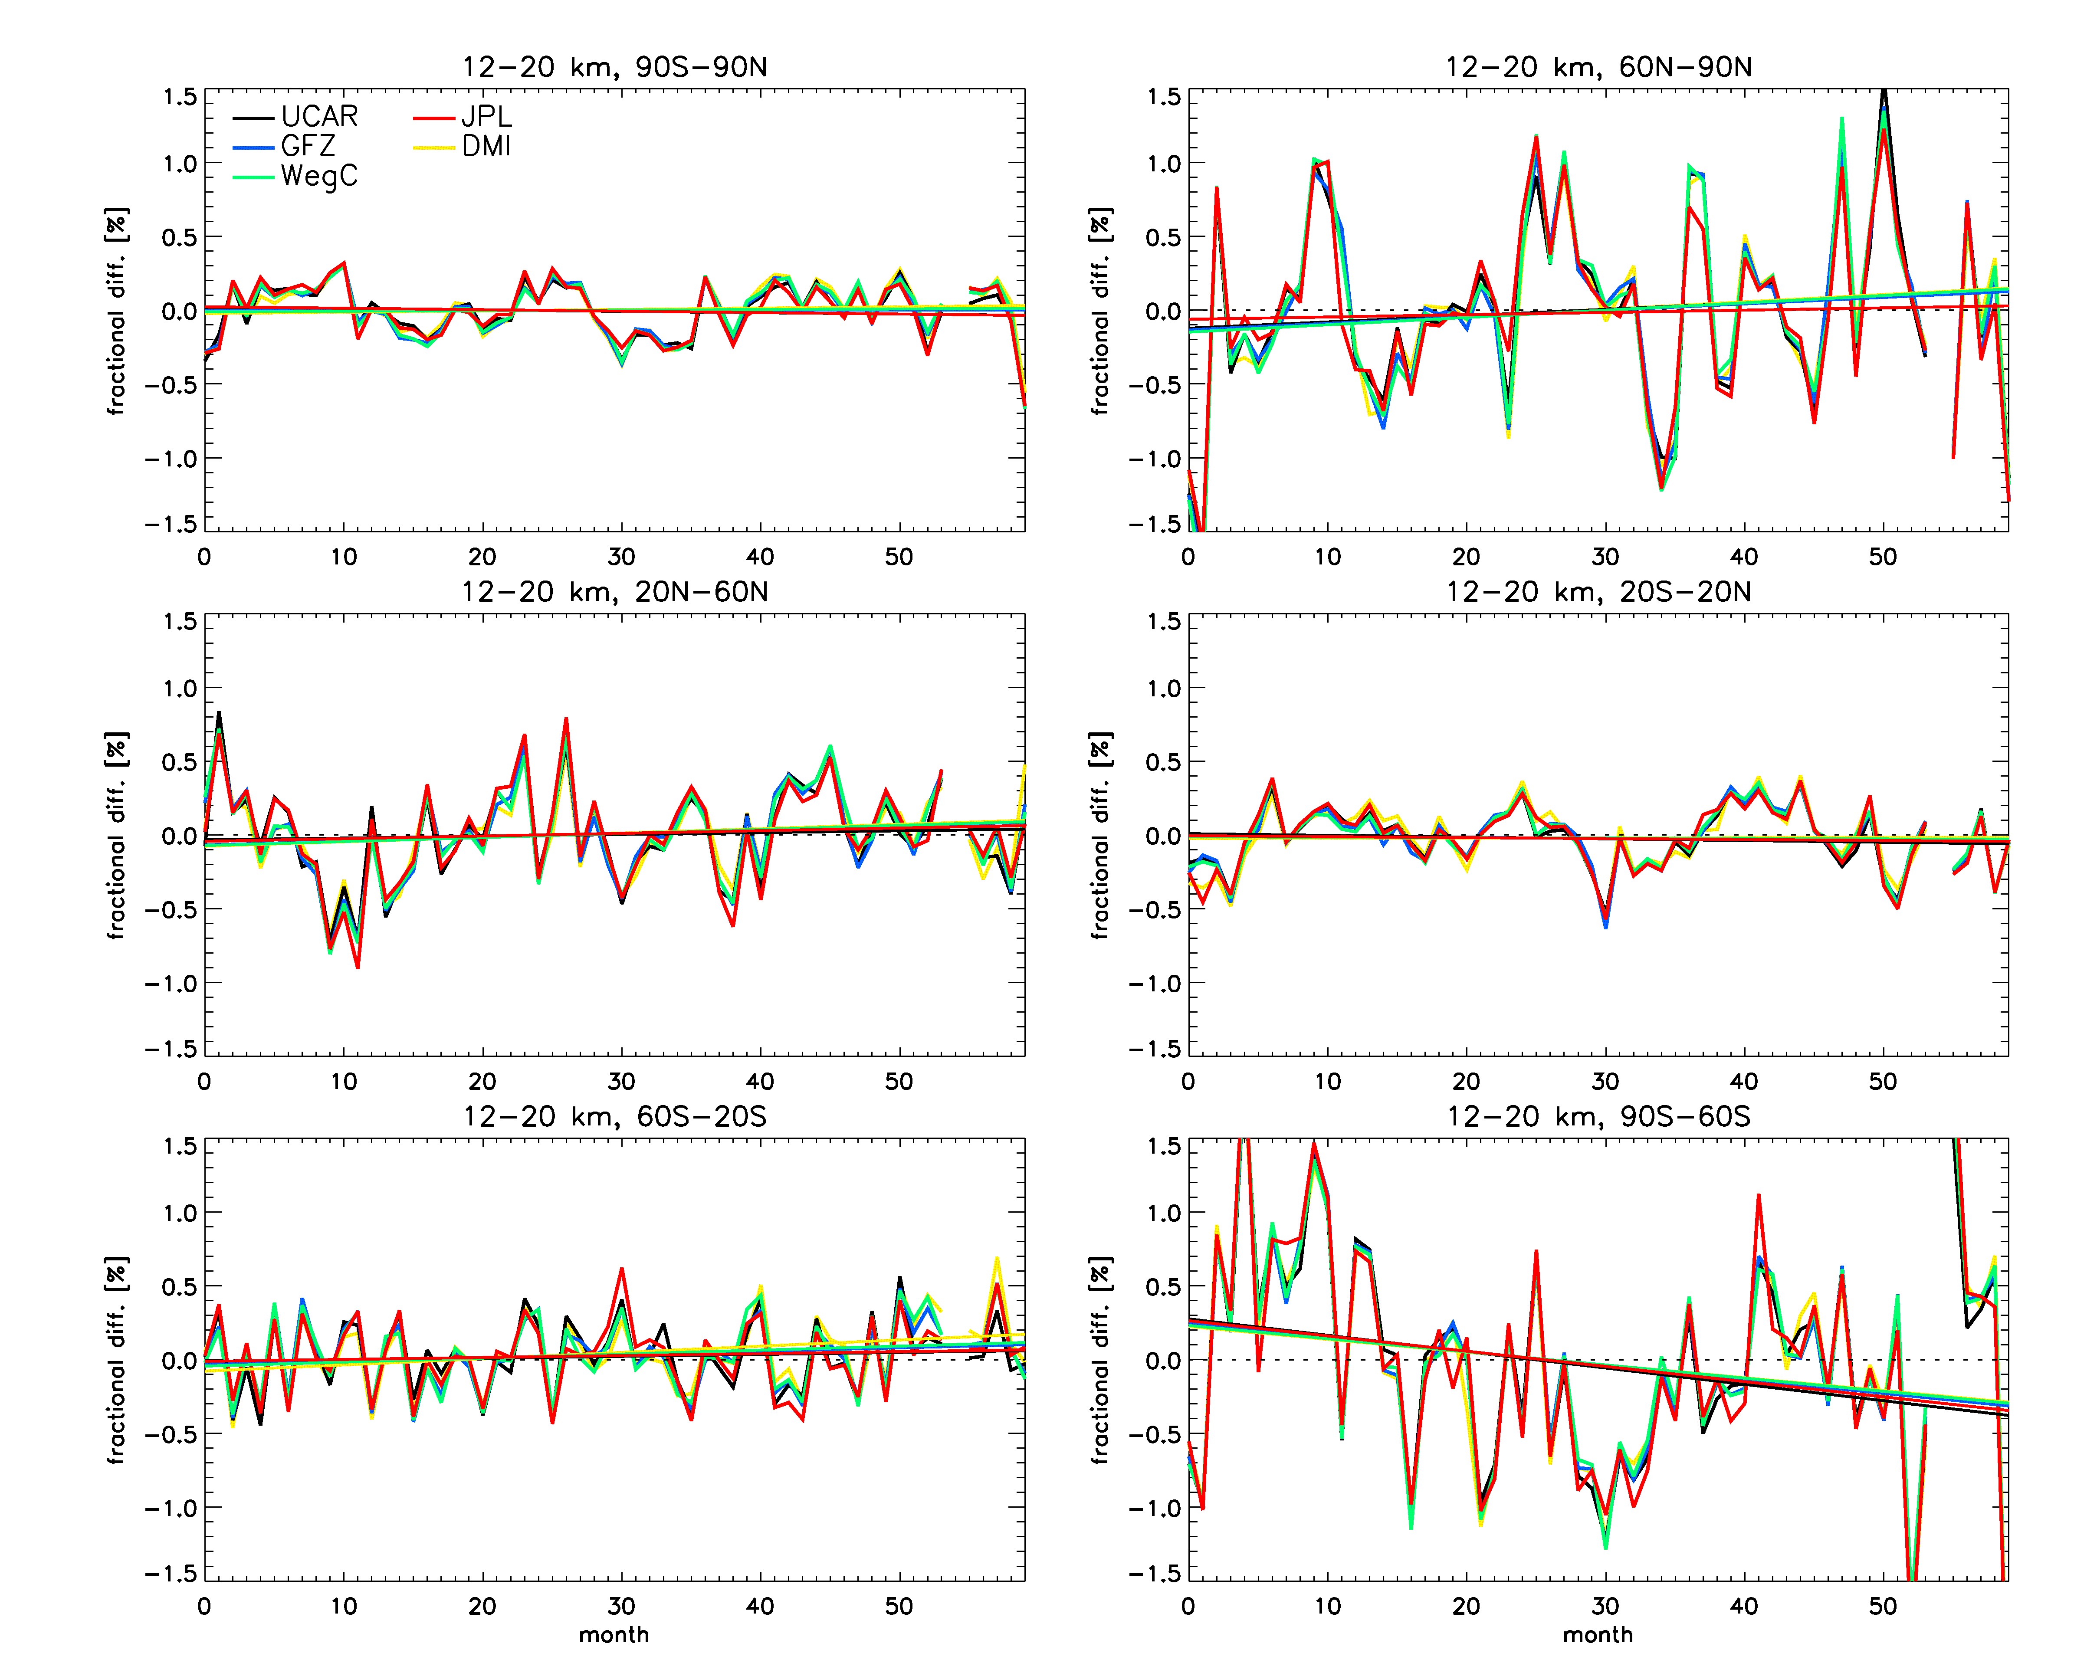
RO-CLIM project activities 1a. Inter-comparison studies
Common CHAMP data
DMI, WEGC, UCAR, JPL, GFZ
Refractivity anomalies
12-20 km
6 latitude bands
Data within +/- 0.2%
Trends within +/- 0.02%/10yr

Slide 13
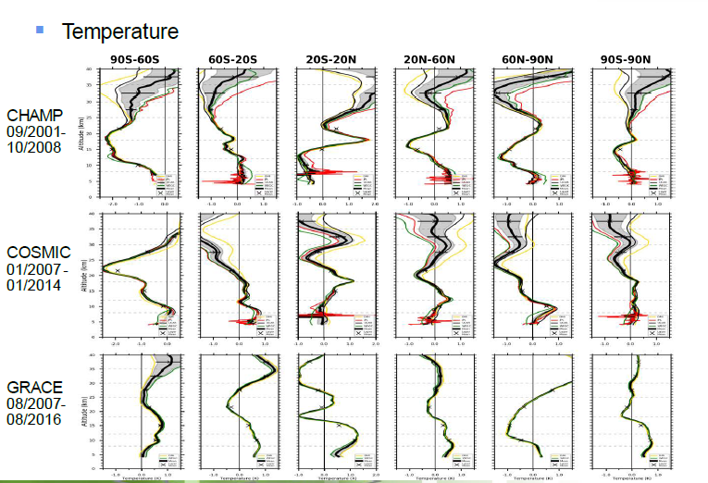
RO-CLIM project activities 1a. Inter-comparison studies

Slide 14
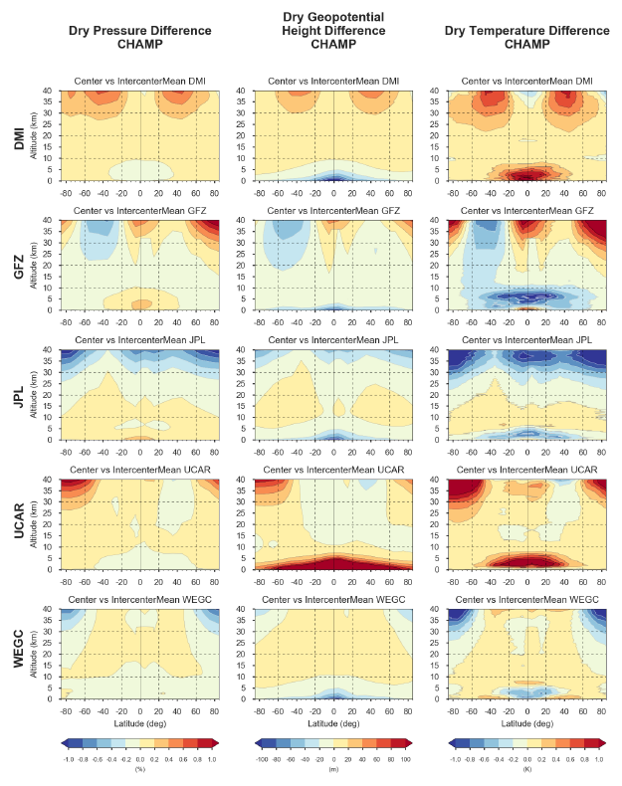
RO-CLIM project activities 1a. Inter-comparison studies

Slide 15
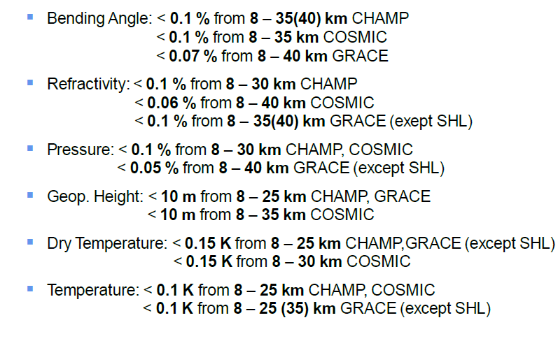
RO-CLIM project activities 1a. Inter-comparison studies

Slide 16
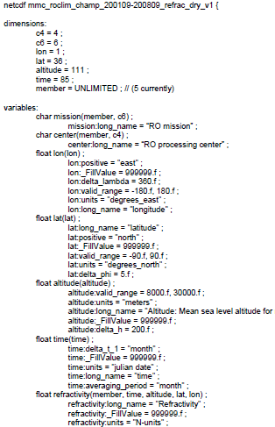
RO-CLIM project activities 1b. Gridded monthly mean Climate Data Records
Collection of gridded monthly mean data in netCDF files, provided together with a User Guide. From the initial study based on CHAMP data.
At http://www.scope-cm.org/projects/scm-08/

Slide 17
RO-CLIM project activities 2a. Generation of an RO–based Obs4MIPs data set
Obs4MIPs (Observations for Model Intercomparisons Project) are observational datasets produced for climate model intercomparison activities (CMIP5, CMIP6, etc.).
Few years ago, JPL was funded by NASA to produce monthly averaged dataset based on RO. JPL generated a gridded geopotential height and temperature data set from the CHAMP and COSMIC missions.
In 2017, JPL was funded by NASA to extend the existing dataset to include more observables (refractivity), with higher vertical resolution, more missions, and data from multiple processing centers.
The RO-CLIM partners JPL, ROM SAF, UCAR, and WegC participate in the project, with the aim to make a 4-member ensemble of RO-based Obs4MIPs data available to users.

Slide 18
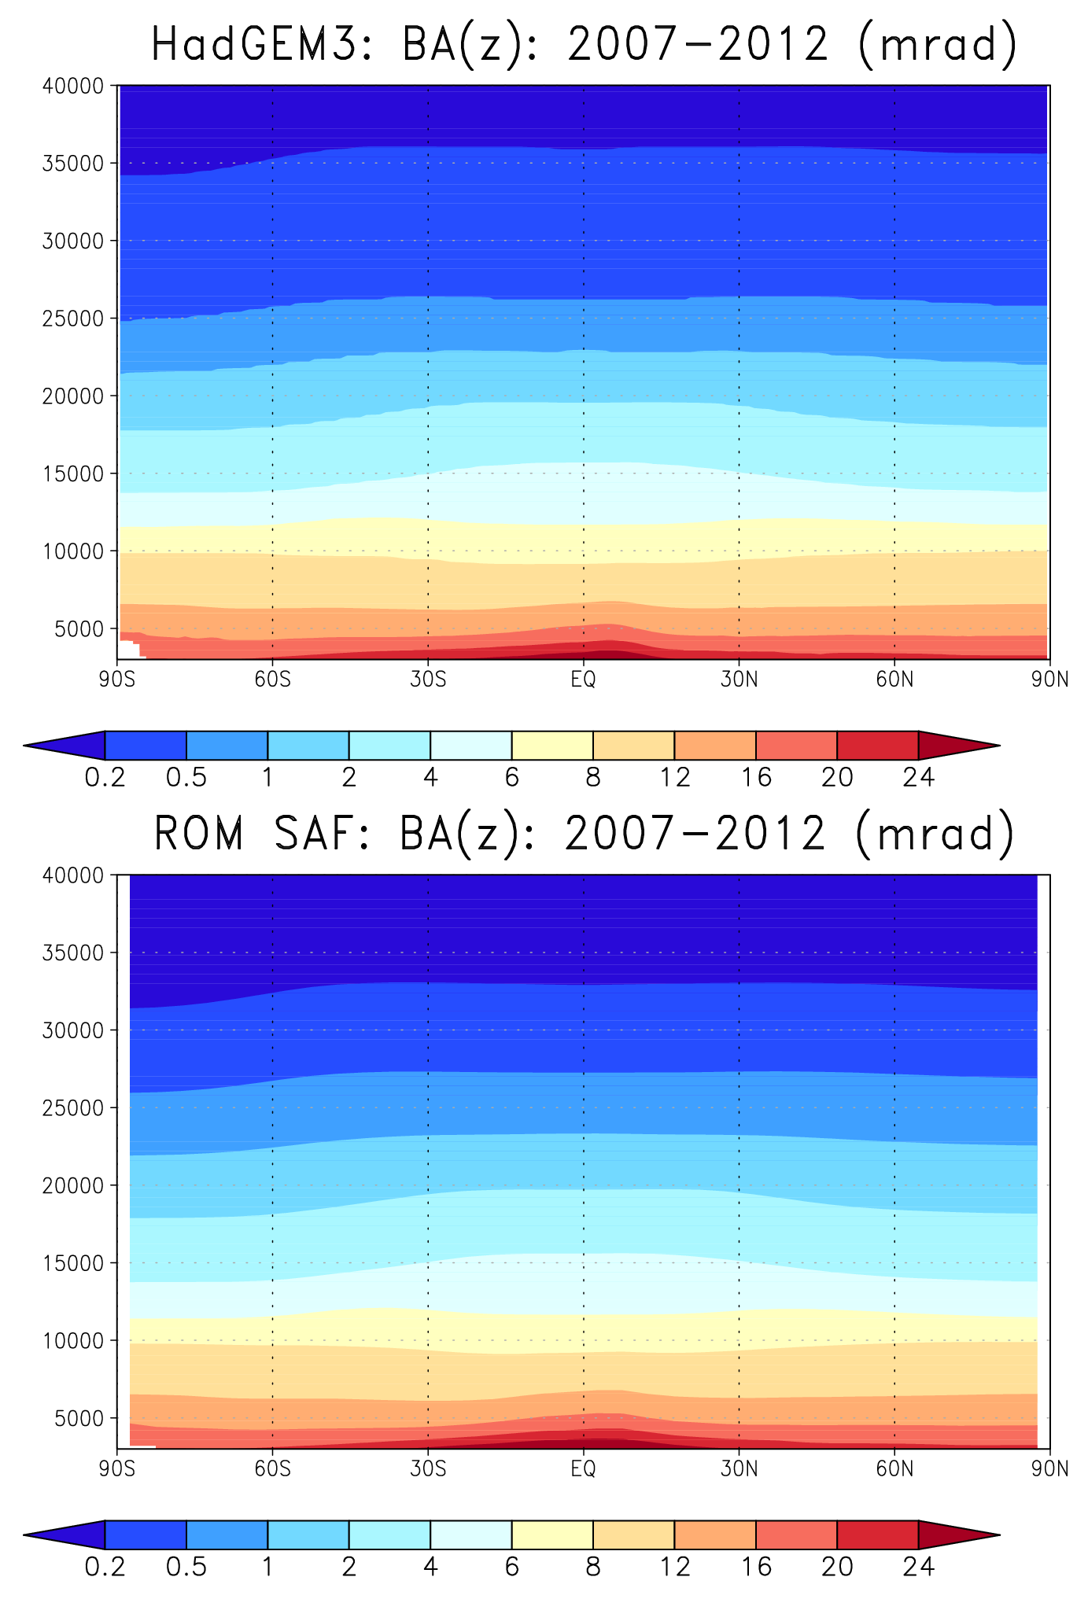
The RO-CLIM project activities 2b. Forward modelling, “simulators”, and COSP
Collaboration between ROM SAF & Met Office;
Based on ROM SAF forward model, including bending angle, refractivity, and dry temperature;
Integrated into COSP, which is used by almost all major climate modelling centres;
Facilitates inclusion of RO parameters in Obs4MIPs, encouraging modellers to use RO data;
Initial HadGEM3 climate model simulation, forced with observed SSTs and Sea Ice;
Comparison of mean states, trends, variability, etc., with a focus on parameters relevant for reducing uncertainty in climate predictions.

Slide 19
Maturity assessment ––
From the initial project plan:
ROM SAF self-assessment, following CORE-CLIMAX guidelines. Note that maturity is here quantified by ranges, rather than single numbers.

Slide 20
Project state at end of Phase II
A CF compliant netCDF file format for monthly mean gridded RO data have been defined, and an ensemble data set based on the CHAMP RO data has been developed. The data are made available together with a User Guide. This is short data series (~7 years) and should be seen as an experimental data set, an example of what is feasible.
5 processing centers reprocessed nearly all CHAMP, GRACE, COSMIC, and Metop(-A,.B) data up to end of 2016. Different type of inter-comparison studies have been undertaken over the last 2 years (led by WegC). Results presented at meetings and conferences. A paper on structural uncertainty of multi-mission RO data is currently being co-authored by RO-CLIM project team.
Work is ongoing at JPL to generate Obs4MIPs compliant gridded RO data, primarily from JPL’s reprocessed data, but also from ROM SAF, WegC, and UCAR reprocessed data. The work aims at generation of latitude-longitude gridded data from global spherical-harmonics fit to RO data. Funded by NASA.
A “simulator” tool, based on ROM SAF forward-modelling software, has been developed at the Met Office Hadley Center, with the intention of using it in a study involving HadGEM3 data and a suitable monthly mean gridded RO data set.

Slide 21
Difficulties and challenges
Some thoughts:
Unfunded projects (may) mean slow progress.
Uncertain data ownership of an ensemble data set with contributions from several organizations. An alternative is simply to agree on common standards for file formats, but to have separate distribution channels.
Different priorities amongst project partners: Operational commitments vs. scientific research. RO data processing is undertaken by satellite operators and space agencies, but also by research institutes and universities.
Uncertainty as to how the stated goals of SCOPE-CM (Phase II) should be translated into concrete project activities for our particular set of data.

Slide 22
Next steps, SCOPE-CM Phase III
Some conclusions for way forward:
Not too ambitious project goals.
Ensure clear connection between project goals and the stated goals of SCOPE-CM (Phase III).
Options currently under discussion within the project team
Continue the two main activities (CDR generation/inter-comparison studies, and building capacity for climate usage) as SCOPE-CM activities.
Limit and re-focus to the generation of an Obs4MIPs data set with 4 contributing data centers. This work is already started at JPL within Phase II, funded by NASA.
Way forward depends on SEP decisions and priorities within the project team.

Slide 23
STOP ––

