Slide 1
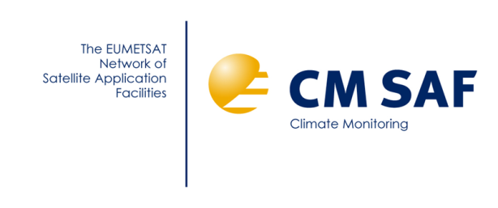
SCM-05: Advancing the AVHRR FCDR – a SCOPE-CM cooperation project between EUMETSAT, ESA, NOAA and NASA Close-out project presentation SEP-14, Geneva, Switzerland 7-8 February 2019
Karl-Göran Karlsson
SMHI, Norrköping, Sweden

Slide 2
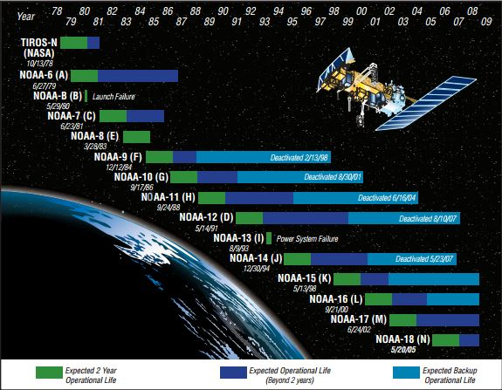
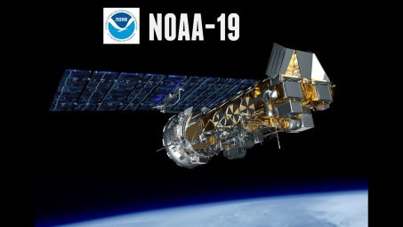
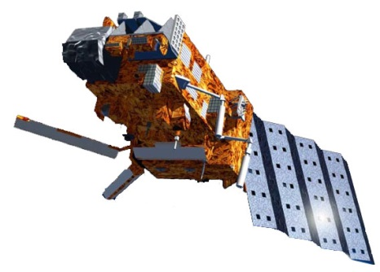
AVHRR observations
The historic AVHRR GAC dataset (1978➔present➔2025+ (?) ➔∞) offers the longest data record of observations from a single high resolution multispectral passive sensor ➔ Highly interesting for climate change studies!
2009 - present
Metop-A:
2007 – present
Metop-B:
2013 – present
Metop-C:
2018 – present (commissioning phase)

Slide 3
AVHRR FCDR status in 2013
Complete AVHRR GAC record (Level 1b) residing in NOAA CLASS archive (data from October 1978 until present time)
Copies existing (partial or complete) at a few places (e.g., SSEC Madison and CM SAF/ECMWF).
Reading interfaces/packages developed locally with varying degree of sophistication (e.g., in terms of quality control of data, orbit overlap corrections and procedures for infrared calibration)
First TCDRs using homogenised visible calibration (Heidinger et al., 2010, MODIS C5 as reference) released: PATMOS-x V4 and CLARA-A1

Slide 4
Identified problems and needs
Lack of common AVHRR GAC pre-processing software packages suitable for TCDR generation (i.e., taking care of missing/corrupt data, removing orbit overlaps, making accurate infrared calibration and provision of uncertainties)
Need for updated visible calibration utilising MODIS C6 as reference + choosing best method (several exists)
Problems identified with the standard AVHRR infrared calibration method using onboard blackbody references (Mittaz et al., 2009, JAOT)
Earlier NOAA satellites (Tiros-N – NOAA-14) show problems of varying degrees with AVHRR image navigation and noise in AVHRR channel 3b (3.7 µm). This may lead to artificial trends and increased uncertainties in TCDRs.

Slide 5
Components of AVHRR FCDR project
Upgraded visible calibration corrections (MODIS Collection 6) (+ fusion technique merging AVHRR and HIRS data) (Andrew Heidinger) (+ Dave Doelling/NASA LaRC joining 2015)
Revised infrared calibration (new physical model) (Jon Mittaz)
Development of advanced Level 1c processor, revised navigation based on image-retrieved (coast-line matched) adjustments and AVHRR ch3b noise reduction method (Karl-Göran Karlsson)

Slide 6
Achievements
Upgraded visible calibration corrections (2014, MODIS C6)
Responsible partner: NOAA (A. Heidinger)
An upgraded visible calibration was provided by NOAA in 2014. The basic method was the same as in Heidinger et al., 2010 (IJRS) but now based on MODIS Collection 6 data and extended from 2009 to 2014.
It was used for the creation of the PATMOS-x V5, CM SAF CLARA-A2 and ESA-CLOUD-CCI climate data records
Publications: PATMOS-x V5: Heidinger et al., 2014, BAMS CLARA-A2: Karlsson et al., 2017, ACP ESA-CLOUD-CCI: Stengel et al., 2017, ESSD

Slide 7
Achievements
Development of pre-processing software PyGAC (2015)
Responsible partners: SMHI (K-G Karlsson)
The Python-based AVHRR-GAC pre-processing module PyGAC was developed in the ESA-CLOUD-CCI project gaining from previous experiences in the CM SAF project.
PyGAC includes upgraded visible calibration from NOAA, careful quality control from existing quality flags, more accurate treatment of the infrared calibration procedure and clock-error corrections from image-matching for satellites up to NOAA-14
In addition to PyGAC, a method for AVHRR ch3b noise reduction was developed + an orbit definition database for removing orbit overlaps. PyGAC:Devasthale et al., 2017, Summer 2017 GSICS Quarterly Newsletter Special Issue on Reprocessing CH3b noise filter: Karlsson et al., 2017, Rem. Sens.

Slide 8
Achievements
2nd version visible calibration corrections (2018, MODIS C6.1)
Responsible partner: NOAA (A. Heidinger)
A revised visible calibration was provided by NOAA in 2018. Still basically the same method as in Heidinger et al., 2010 (IJRS) but now utilising Spectral Band Adjustment Factors (SBAFs, from SCIAMACHY) for transfering MODIS channel data to AVHRR over invariant Earth targets. New version is extended from 2014 to 2018.
Calibration information is updated and disseminated annually.
NOAA method is now closer to corresponding method developed by NASA (Bhatt et al, 2016).
References: NASA AVHRR calibration: Bhatt et al., 2016, J.A.O.T. SBAF concept: Scarino et al., 2012, SPIE Proc.,Vol. 8510 Doelling et al., 2012, IEEE Geosci. Remote Sens. Lett.

Slide 9
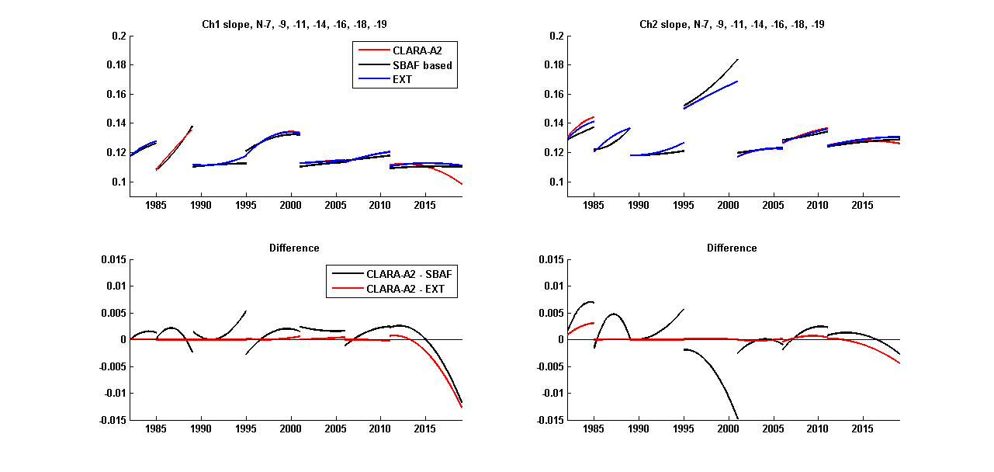
Update of the AVHRR FCDR: Visible information PyGAC is now updated with both extended CLARA-A2 calibration and with new PATMOS-x (SBAF-based) calibration (shown below)

Slide 10
Achievements
New AVHRR infrared calibration from FIDUCEO (2019)
Responsible partner: University of Reading (J. Mittaz)
Beta version of AVHRR FCDR released in 2018 but content not scientifically useful (just format and orbit demonstrations). New orbit model: Orbits defined from Equator.
Final dataset (NOAA-6 to NOAA-18) to be delivered by August 2019 (FIDUCEO ends)
Dataset from NOAA-11 and onwards to be ready by end of February 2019
PyGAC and CM SAF orbit (blacklist) database is used by FIDUCEO

Slide 11
Reasons for FIDUCEO delay
Still no solution of the 12 micron channel problem for NOAA-07 and NOAA-09 were there is no overlap with a later sensor with a 12 micron channel. HIRS data planned to be used instead.
NOAA-08 has very few matchups due to its spotty availability/length of data
Significant manpower problems (original plan: 1.25 full time scientists to work on AVHRR) (realised: 0.25-0.5 full time scientists)

Slide 12
Unforeseen theoretical problems
The Harmonisation process turned out to be a lot harder than initially foreseen and took significantly more time and manpower to do.
The sources of error now being identified turned out to be more complex than first hoped – especially the error on the ICT temperature

Slide 13
Achievements
Fusion of AVHRR and selected HIRS channels (2019)
Responsible partner: NOAA (A. Heidinger)
Method for creating AVHRR-resolution HIRS channel data developed (Weisz et al., 2017, J. App. Rem. Sens.)
Fusion bands for WV and CO₂ channels under generation for entire GAC data record
To be used in next PATMOS-x version (Version 6)
Preliminary results (ICWG-2, Madison, Nov. 2018) show cloud detection improvements over Antarctica and some improved cloud top height results (though, different methods under investigation)

Slide 14
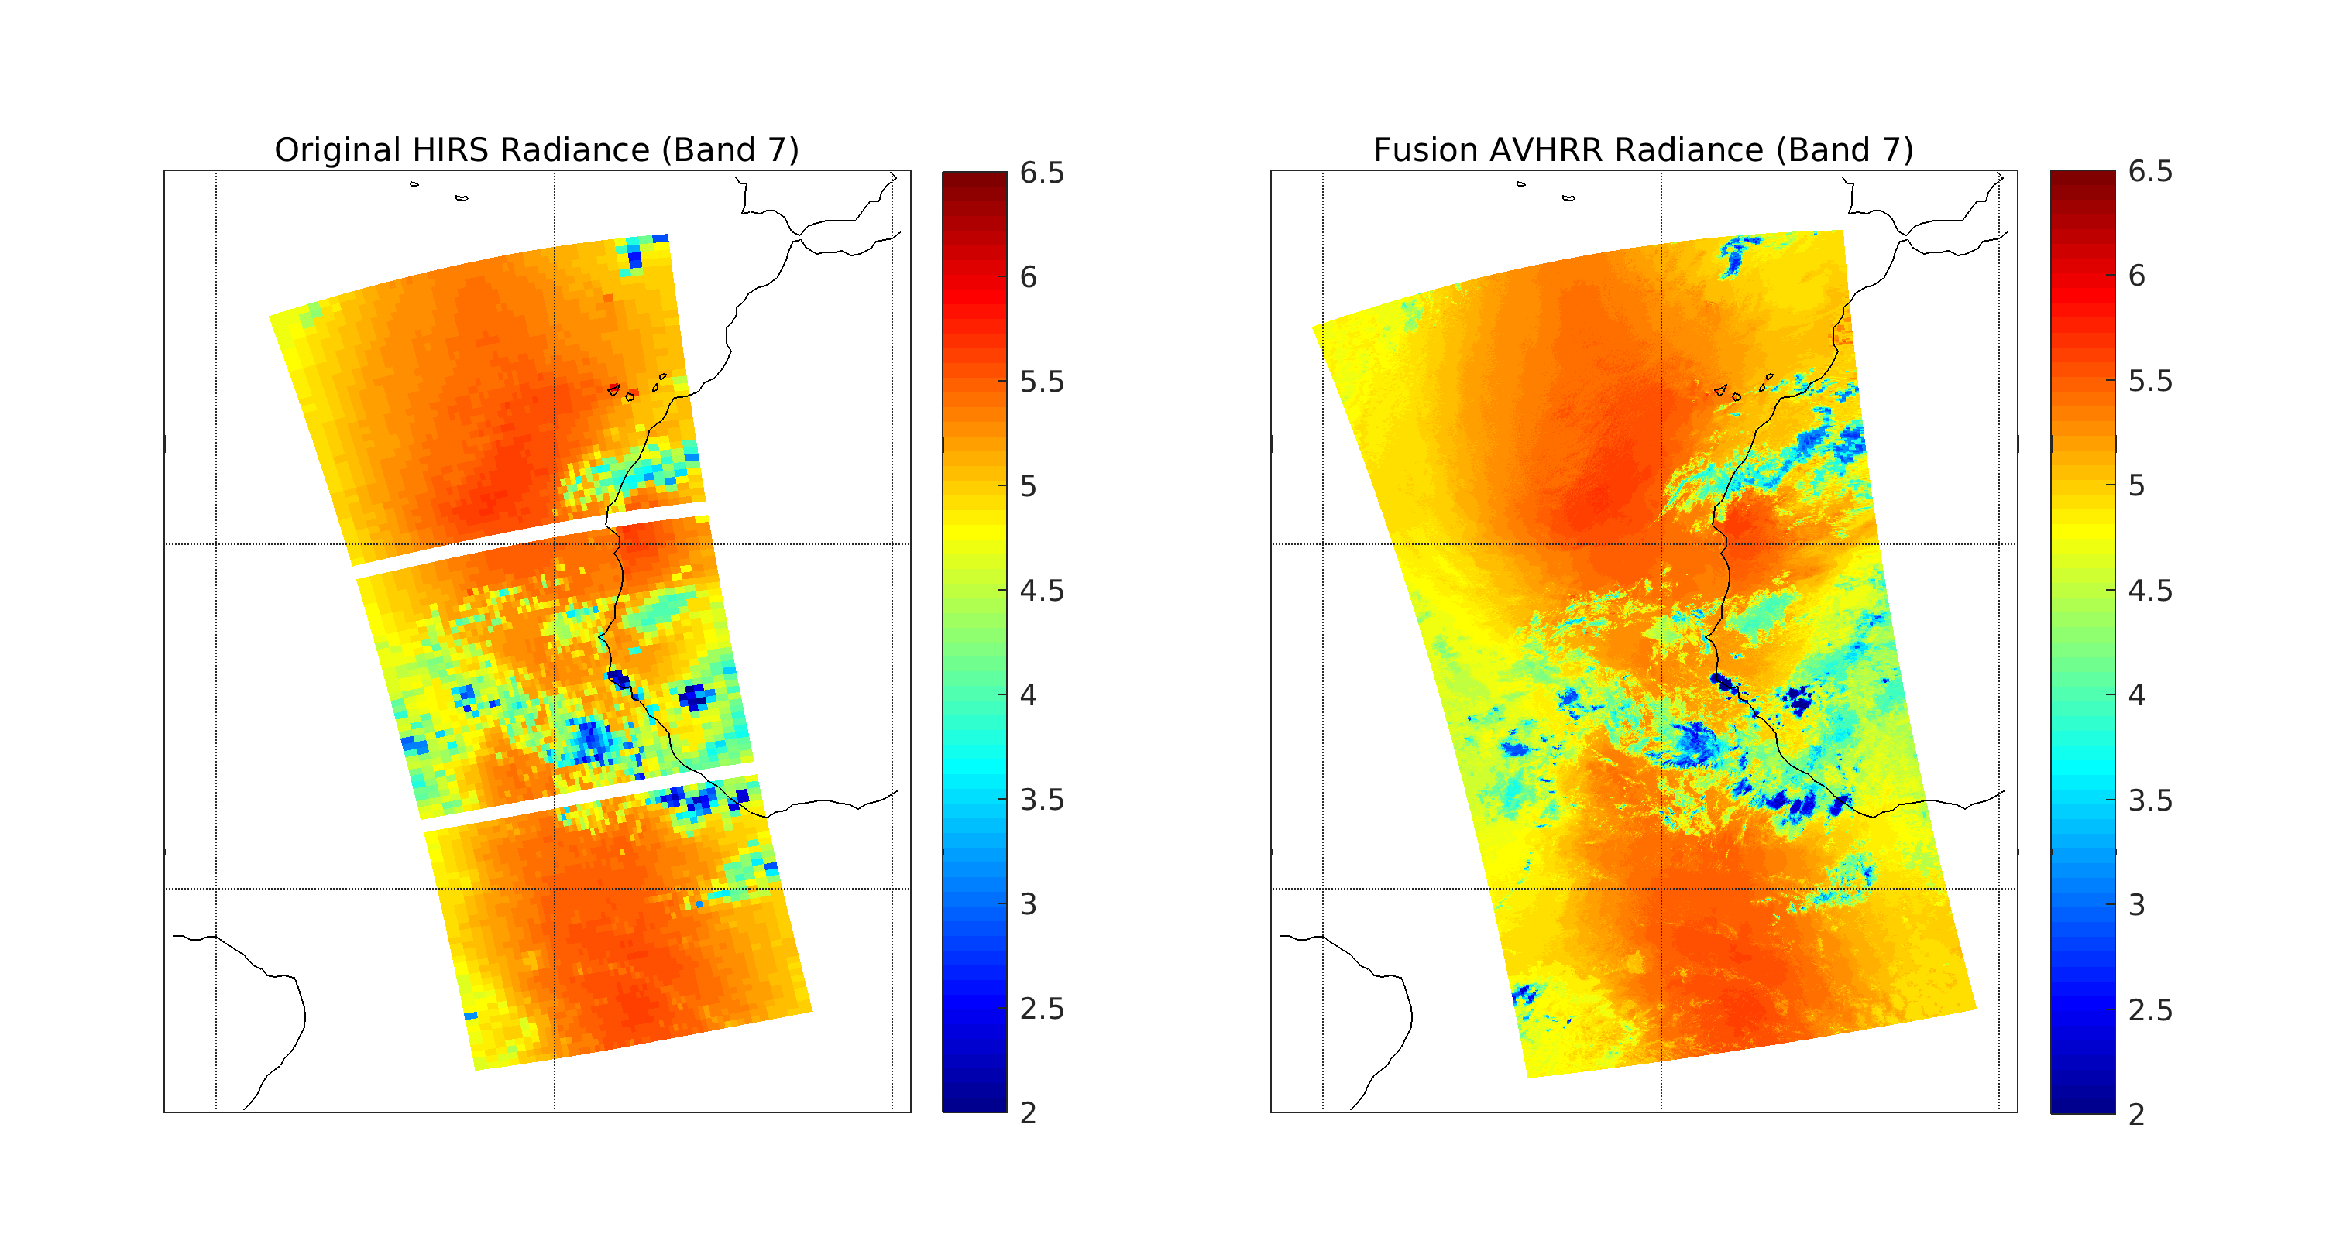
Fusion Examples
Collocated HIRS and AVHRR granule taken from NOAA-19 shows HIRS band 7 at 13.3 µm (left) and the resulting fusion band (right) generated after the k-d tree method is applied.
From Foster, ICWG-2, Madison, Nov. 2018

Slide 15
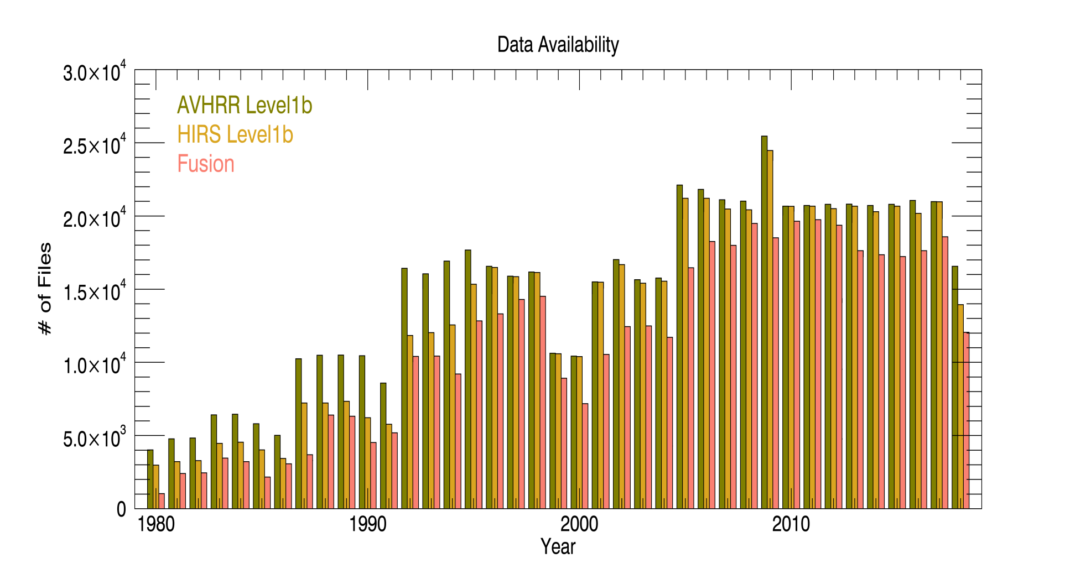
Data Availability
From Foster, ICWG-2, Madison, Nov. 2018

Slide 16
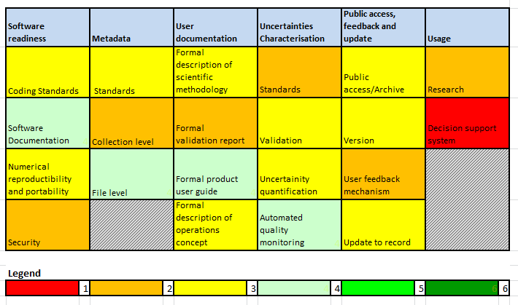
Maturity Matrix 2019
Few changes (mostly on software and quality control/uncertainty characterisation) compared to first estimate in 2015.
Awaiting completeness of FCDR (mainly infrared part)

Slide 17
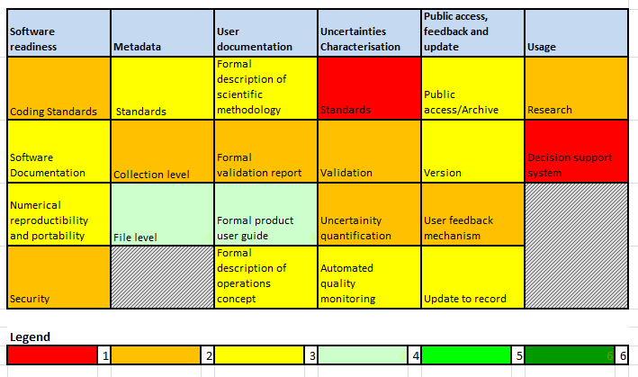
Maturity Matrix 2015

Slide 18
Remaining SCM-05 tasks (post-SCM-05)
Final evaluation of new visible calibration (e.g., closer comparison with NASA’s and other calibration datasets)
Finalisation of FIDUCEO infrared AVHRR calibration
Compilation of complete FIDUCEO FCDR (e.g. including visible information and uncertainties including quality control)
Attempt to correct for attitude errors for early satellites (e.g. NOAA-12)

Slide 19
Ideas and needs for the future
In the absence of a FIDUCEO IR calibration, we can use the AVHRR + HIRS PATMOS-x dataset to explore AVHRR calibration issues and pursue empirical corrections. More work on fusion method also needed.
Prolongation of TCDRs based on AVHRR series of observations (a m + p m satellite approach) using AVHRR heritage sensors (VIIRS + MetImage) is highly motivated. May give 70 years of data instead of 45. This requires: - Addressing MODIS/VIIRS visible channel inconsistency (since current calibration corrections are based on MODIS SNOs). Collaboration with GSICS? - Corresponding studies required also for MetImage. - GAC-type resampling efforts by NOAA and EUMETSAT applied to VIIRS and MetImage data appear crucial to realize these ideas!

