Slide 1




SCM-03:Land Surface Albedo from geostationary satellites
SEP14: 7/8 of February 2019

Slide 2


SCM-03: the project team
EUMETSAT (Darmstadt, Germany) | A. Lattanzio | Project Leading, algorithm development and METEOSAT Processing
NOAA’s NCEI (Asheville, NC, US) | J. Matthews | SW for daily/NetCDF4 products and GOES processing
JMA (Tokyo, Japan) | M. Takahashi | GMS/MTSAT Processing
MeteoSwiss (CMSAF) (Zurich, Switzerland) | Anke Duguay-Tetzlaff | GEO Cloud mask
KMA/NMSC (Gwanghyewon, Korea) | Eunha Sohn | Albedo from COMS and interest in applying GSA on COMS data

Slide 3

Project Team around the World

Slide 4
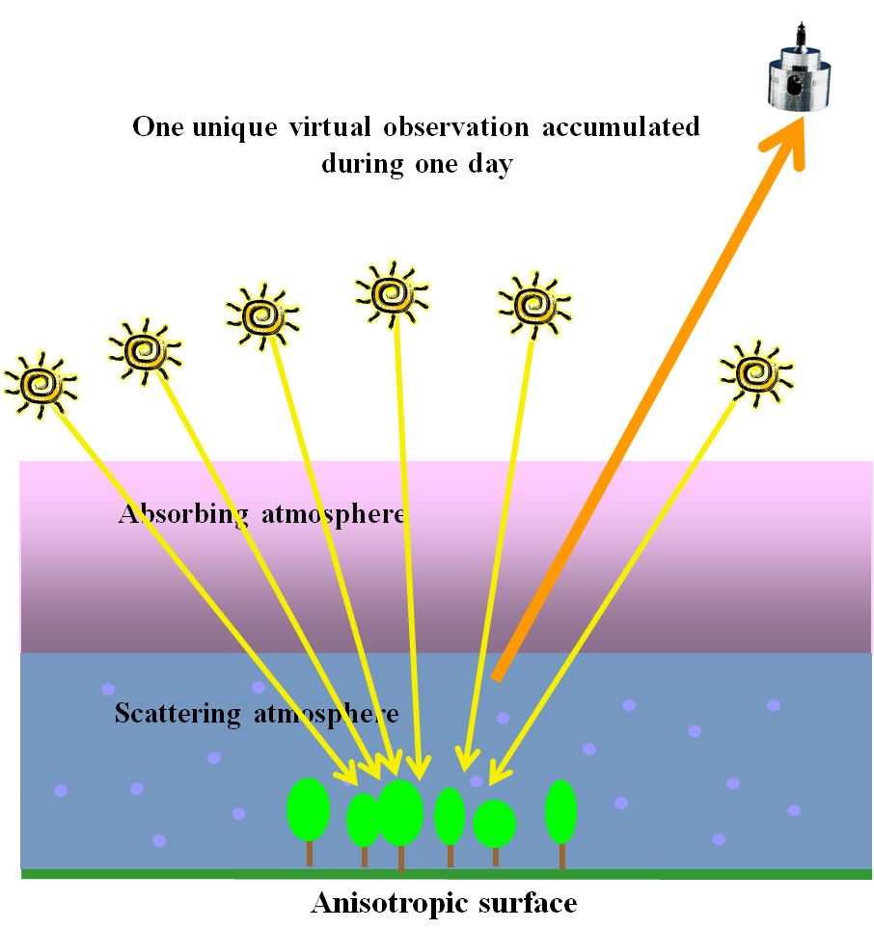

GSA Retrieval Scheme
The Geostationary Surface Albedo (GSA) is based on a method proposed by Pinty et al. in 2000 which:
  - relies on a daily sampling of clear sky radiances
  - assumes applicability of the reciprocity principle
  - performs the inversion with a fast RTM
  - ingests TCWV and TCO3 as input parameters
GSA retrieves jointly albedo and aerosol load
GSA processes single VIS band images
Spatial resolution 2-3 km (instrument pixel size)
Run time Assessment of measurement error
Estimation of the retrieval uncertainty
Final product: 10-days composite (minimizing the impact of cloud coverage)

Slide 5
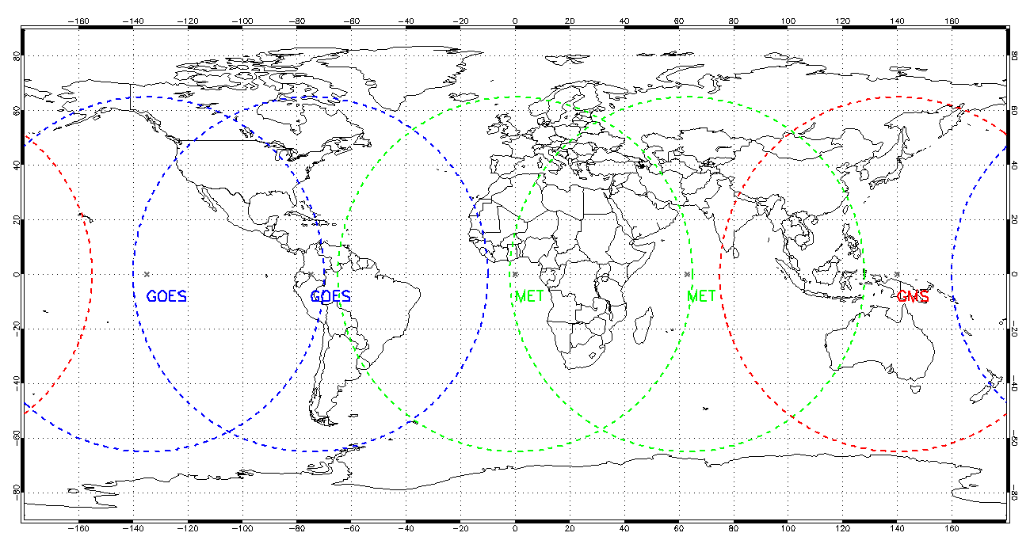
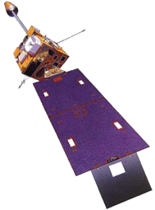
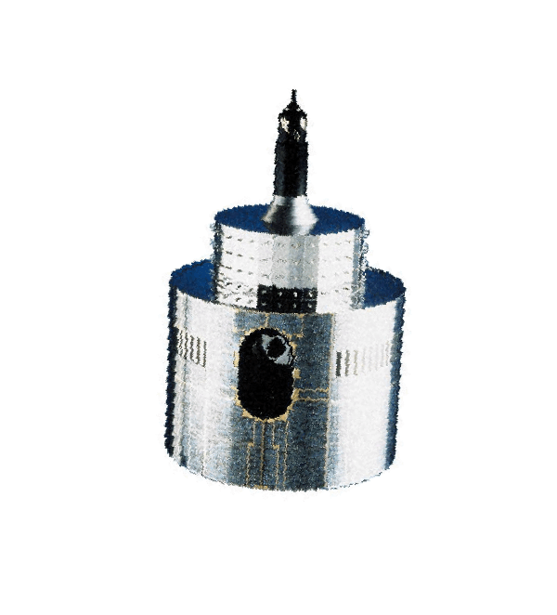
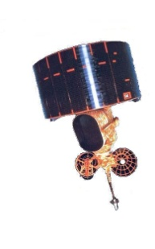
GEO Ring – Spatial Coverage

Slide 6
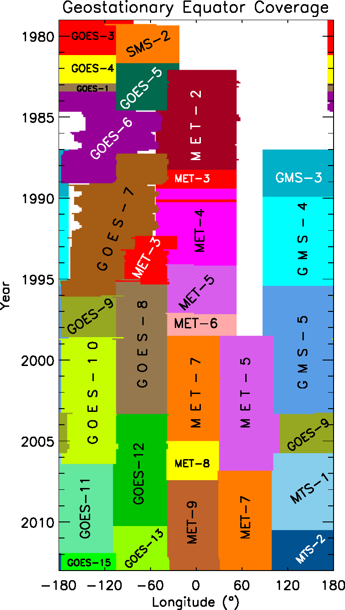
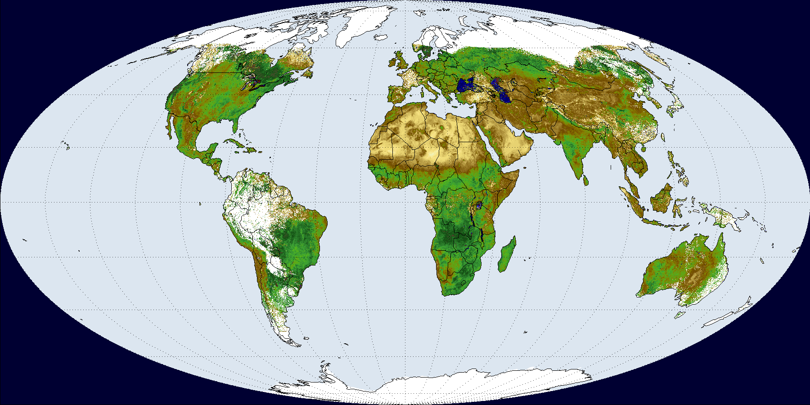




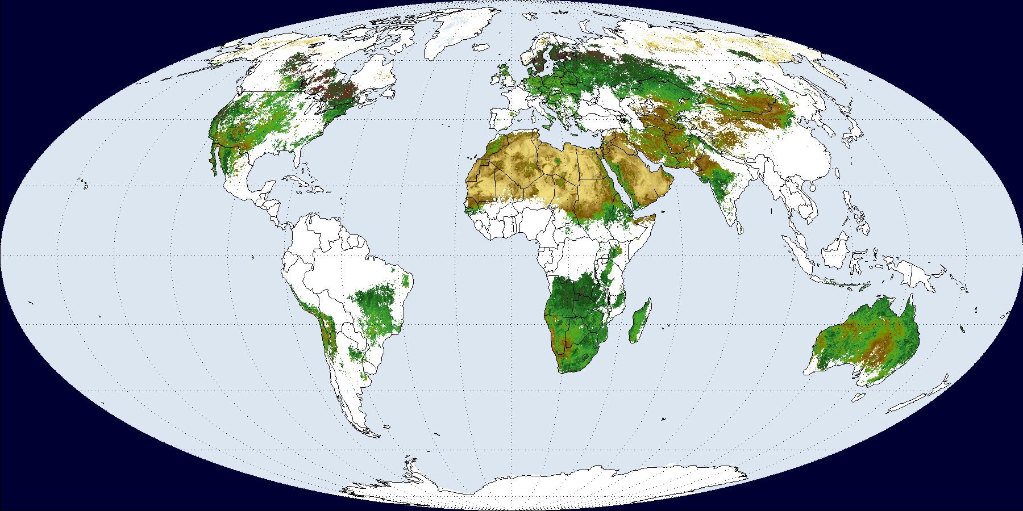
GEO Ring: Temporal Coverage
GEO DATA GAP
Lattanzio, A.; Schulz, J.; Matthews, J.; Okuyama, A.; Theodore, B.; Bates, J.J.; Knapp, K.R.; Kosaka, Y.; Schüller, L. Land Surface Albedo from Geostationary Satelites: A Multiagency Collaboration within SCOPE-CM. Bull. Amer. Meteorol. Soc 2013, 94, 205–214.
MODIS
GSAL3 DHR30 (or black sky albedo BB (0.3-3.0 μm)
Grid: 0.25 deg - Period: 1-10 of May 2001 (Prob > 80%)
Satellites: GMS-5, MET-5,MET-7,GOES-8 and GOES-10
MODIS: MCD43C3 0.05 deg quality flag 0,1 (min 75% full
inversion retrieval)

Slide 7
Project Plan: 2014-2018
Task | Year | Actors
Updates to retrieval scheme including inclusion of common cloud mask approach, utilization of common method of inter-calibration, e.g., DCC method, implementation of common NWP data; Adaptation of retrieval scheme to the SEVIRI and other instruments; Set up of validation procedures for Level-2 product. | 2014 | EUM EUM EUM, JMA, NOAA
Technical assessment of the improved retrieval scheme; Implementation of updated retrieval scheme at all three agencies; Validation of test products. | 2015 | EUM EUM, JMA, NOAA EUM, JMA, NOAA
Adaptation and re-implementation of algorithm following validation exercise; Processing of Level-2 data product for GEO tapestry; Establish user documentation and prepare for public distribution; Development of Level-3 product inclusive of user consultation. | 2016 | EUM EUM, JMA, NOAA EUM, JMA, NOAA EUM, NOAA
Produce and validate Level-3 product and redistribute to partners; Perform user driven studies on usage of the product to increase utilization; Arrange distribution of L2 and L3 products from European, Japanese and US sites. | 2017 | EUM EUM , JMA, NOAA EUM, JMA, NOAA
Update common calibration with results from SCOPE-CM inter-calibration project and rerun full data record; Study product improvements with respect to utilization aspects. | 2018 | EUM, JMA, NOAA EUM, JMA, NOAA
LEVEL2
LEVEL3
Notes:
L3 prototype in C++ available since 2012

Slide 8
Level 2 Dataset generation strategy
Same retrieval algorithm | Joint retrieval of surface albedo and Aerosol load with per-pixel uncertainty. Method proposed by Pinty et al.
Same Re-analysis data | ECMWF ERA-Interim.
Validation studies run by EUMETSAT show that the remaining cloud contamination is the most relevant factor impacting the dataset quality
Same external cloud masking | CMSAF Retrieval scheme applicable to all GEO with a VIS and IR band. Based on a Bayesian approach applied to a set of scores.
Same calibration approach | SCM-06 IOGEO and/or GSICS.
Notes:
This is a kind of data fusion. In these cases there are always 2 ways: use different algos on each data (Meteosat, GOES,…) and then fuse the L2 output or use a single algorithm on all L1 data. WE decided for the second but with the further decision to bring the algo where the data are to avoid moving of huge amount of L1.

Slide 9
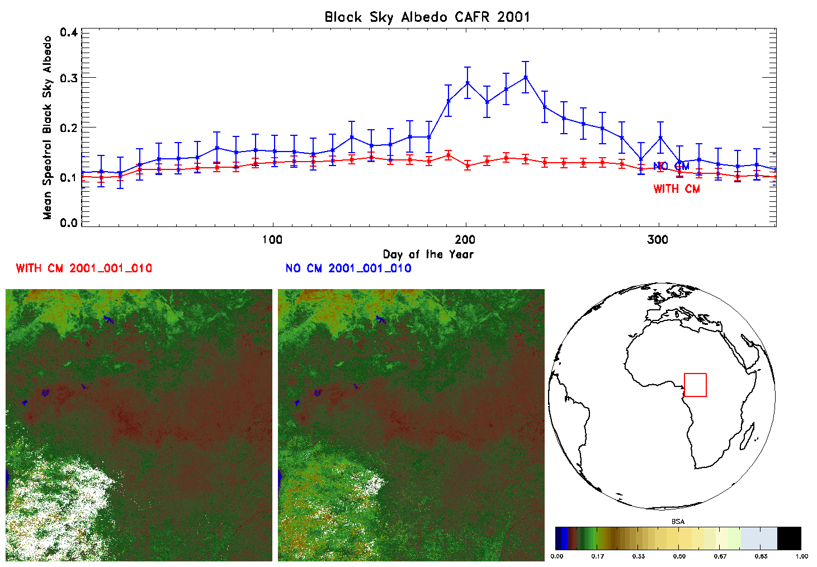
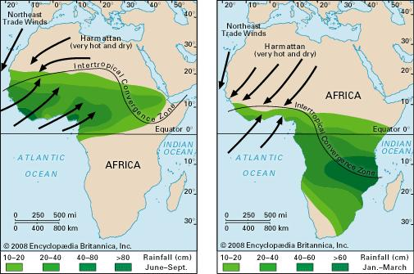
Cloud Mask Impact: North of the Equator
From: http://www.clivar.org/african-monsoon
Notes:
The DHR error:
It is represented with the Standard deviation of the pixel based estimated uncertainty for all pixels in the ROI.
About African Monsoon
The main two components of the African Monsoons are the West African Monsoon, which prevails during the Northern Hemisphere Summer (June through September), and the East African Monsoon with rains during spring (MAM) and autumn (OND). The precipitation and atmospheric circulation patterns are shown in the adjacent figure. Combined influence of the Indo-Pacific and the Atlantic Oceans drive the inter-annual and the decadal monsoon variability over these regions.
The East African Monsoon is associated with the ITCZ moving south of the equator. The so-called long rains prevail during spring (MAM) and the short rains during autumn (OND). Thus the transition (equinox) seasons bring most rainfall to East Africa (Figure right panel).

Slide 10
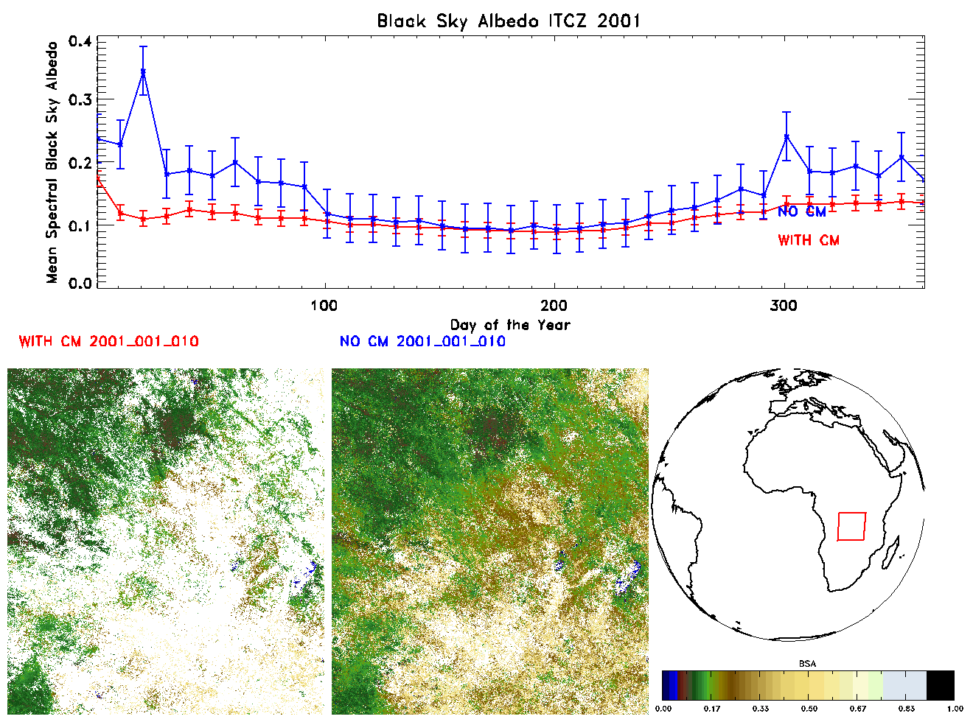
Cloud Mask Impact: South of the Equator
From: http://www.clivar.org/african-monsoon

Slide 11
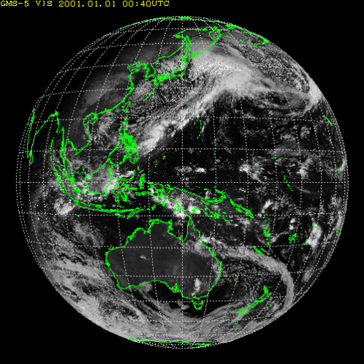
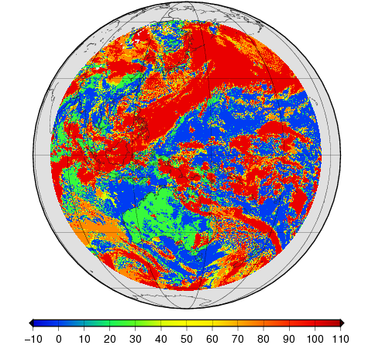
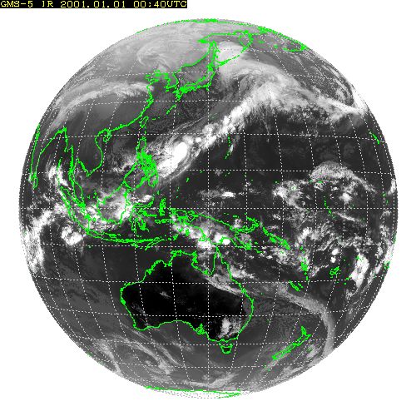
Cloud Mask for Himawari series
VIS
Original GMS-5/VISSR data
2001-01-01 01UTC
CFC
IR (10.8 um)
Projected on 8800 x 8800 pixels grids (1.25 km horizontal resolution at SSP)
Cloud Fractional Cover (0-100%)

Slide 12
Level 2 Dataset generation strategy
Same retrieval algorithm | Joint retrieval of surface albedo and Aerosol load with per-pixel uncertainty. Method proposed by Pinty et al. (Not yet with KMA)
Same Re-analysis data | ECMWF ERA-Interim.
Same external cloud masking | CMSAF Retrieval scheme applicable to all GEO with a VIS and IR band. Based on a Bayesian approach applied to a set of scores.
Same calibration approach | SCM-06 IOGEO and/or GSICS.

Slide 13
Project Status
Item | Planned | Status
Level 2 Processing | Processing of Level-2 data product for GEO RING | MET2-10 GOES 1995-2015 GMS5 1997-2003 (only consider 2000-2003) No Cloud Mask, No common VIS calibration, No Common NPW
Cloud Mask | Implementation and usage for GEO RING | Meteosat integrated and running in the new CDR Env Integrated at NCEI and JMA. Running at JMA but not fully processed. Planned to be used at NOAA this year
Daily product in NetCDF4 | Change the code to generated daily products in NetCDF4 | NCEI proposed a new NetCDF4 format used in their recent processing (1995-2015) EUM planned for next Release + Cloud Mask JMA will integrate for the Himawari imagery next processing
Validation | Set up of validation procedures for Level-2 product. | Stand By. ALBEDOVAL guidelines and/or CEOS LPV Validation Protocol (when ready) can be used
Calibration | Utilization of common method of inter-calibration, e.g., DCC method | JMA working on re-calibration for GMS/MTSAT in SCM6. Waiting for update from GSICS and IOGEO (SCM6)
Data Availability | Arrange distribution of L2/L3 products from European, Japanese and US sites. | METEOSAT: DOI GMS5: contact JMA helpdesk GOES: DOI as of Oct 2017

Slide 14
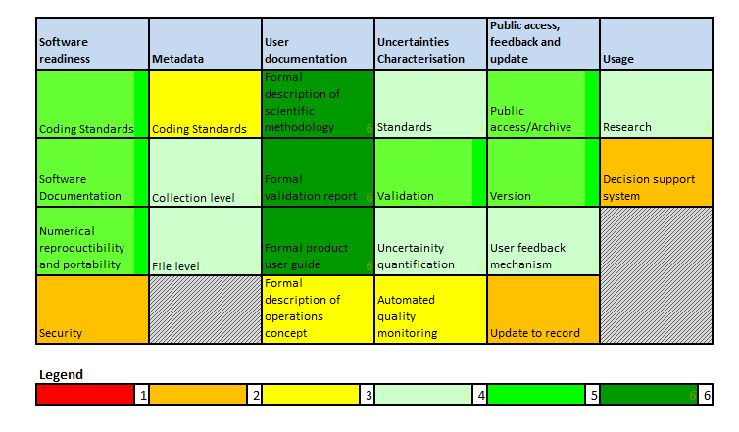
Maturity Matrix (MFG)
No change to report in the MM since September 2016.

Slide 15
Ongoing and planned work
Agency | Cloud Mask | GSA L2 | GSA L3
EUMETSAT | SEVIRI done MVIRI ongoing | SEVIRI ongoing MVIRI stand by | Stand by
NOAA/NCEI | Q2/Q3 2019 | Q3/Q4 2019 | N.A.
JMA | 2019 or 2020 | 2019 or 2020 | N.A.
MeteoSwiss | Update SW 2019 | N.A. | N.A.
KMA/NMSC | N.A. | 2019 | N.A.

Slide 16
Lesson learnt from SCM-03
Best-effort basis (no budget) works if: (1) there is a clear interest, not necessary linked with SCOPE-CM, in generating a certain data record, (2) the data record was already foreseen w/o any SCOPE-CM cooperation;
SCOPE-CM can get very low priority and be put on hold for months;
Due to previous points Planning is sometimes just an academic exercise. Even with the best motivation at the time of planning, there is no real mean to assure that the planning will be respected;
SCOPE-CM framework was very useful in allowing sharing of retrieval knowledge and software (GSA, CLM) and in facilitating the cooperation among agencies in three continents;

Slide 17
Way forward for SCM-03
The real objective of the project was a Level 3 GEO ring. This is still possible but very difficult to assess a realistic date for data record availability for users (see previous slide). It should also be considered if such data record is still useful, considering the number of already available albedo data records (ECV inventory);
Proposal of the SCM-03 project team would be to work on a GEO/LEO fusion. Both LEO and GEO albedo retrieval present weaknesses. The good thing is that such weakness are complementary. LEO/GEO fusion is probably the best way to go;
Keeping the current SCOPE-CM structure, this would mean to join SMC-02 and SMC-03 as first possible solution. SCM-03 is ready to leave the lead of such new project to SCM-02. Of course member availability cannot be assured at this moment and it will depend on how SCOPE-CM will evolve and it is pending on the corresponding Agency’s decision;
SCM-03 also would like to highlight that all newer and best rated algorithms perform a joint albedo/aerosol retrieval and this approach should be pursued also for this LEO/GEO fused data record;
Notes:
2 ways: fusion of albedo (what about aerosol) or fusion of TOA BRF (QA4ECV) to feed a unique algorithm. Questions: if following nr 2 what about cloud mask? Calibration? Uncertainty?
General: how to fuse? There are available techniques?

Slide 18
THANK YOU!
http://www.scope-cm.org/projects/scm-03/

Slide 19
Validation of Albedo generated from MFG
Two Studies performed by independent researchers in Europe and the US.
ALBEDOVAL-1 (2012)
The analysis focussed on :
    temporal consistency
    Inter-comparison with other satellites
    Validation against in-situ
    uncertainty assessment
ALBEDOVAL-2 (2015)
The analysis focussed on:
    Definition of a Validation Reference Database
    Anisotropy assessment (RPV)
    Behaviour on snow covered surface
    Comparison with GLASS Albedo
Final Reports available here:
http://www.eumetsat.int/website/home/Data/ClimateService/index.html
Or
http://www.scope-cm.org/projects/scm-03/

