Slide 1





SCOPE-CM phase II project SCM-02:
Multiplatform surface albedo demonstrator from polar-orbiting satellites
Terhikki Manninen, FMI (PI)
Aku Riihelä, FMI
Jeffrey R. Key (NOAA/CIMSS)
Andrew Heidinger (NOAA/CIMSS)
Crystal B. Schaaf (Umass-Boston)
Qingsong Sun (Umass-Boston)
Alessio Lattanzio (EUMETSAT)
Melanie Sütterlin (formerly UBern)

Slide 2
Review of project purpose at the Phase II start
State of the community/science/CDR at the start
  Only single satellite instrument based albedo products for polar orbiters
  GEO-ring calibration for geostationery satellites (SCM-03) going on for land albedo retrieval
Desired SCOPE-CM role and purpose for collaborating
  SCOPE-CM visibility enables not funded co-operation with AVHRR and MODIS calibration, processing and advice from land cover albedo experts
  Learning from other SCM projects and SEP
The initial maturity of the project
  This is a completely new project, thus the starting maturity is zero
28.1.2019 FMI/TM & AR

Slide 3
Key findings and advances in Phase II
Maturity upgrades:
CDR data and science improvements:
  New intercalibration method developed and validated
  Existing kernel based albedo retrieval method applied to new multi-instrument satellite data
  Smaller temporal window (10 days) for practically gapfree albedo retrieval achieved
Process and production improvements
  A processing chain for combined MODIS-AVHRR land surface albedo retrieval was built from scratch
  Particular acknowledgments to the MODIS team at Umass-Boston and M. Sütterlin (formerly Univ. Bern) for sharing their production code to serve as templates
Maturity | SOFTWARE READINESS | METADATA | USER DOCUMENTATION | UNCERTAINTY CHARACTERISATION | PUBLIC ACCESS, FEEDBACK, UPDATE | USAGE
Start | 0 | 0 | 0 | 0 | 0 | 0
End | 2 | 1 | 3 | 2 | 2 | 0
28.1.2019 FMI/TM & AR

Slide 4
Key findings and advances in Phase II
Development of an intercalibration method for AVHRR and MODIS ToA reflectances
Development of a processing framework which integrates AVHRR and MODIS observations to derive global land surface albedo
Provision of a proof-of-concept study and associated journal paper on the performance of the new processing algorithm, based on 6 months of processed MODIS-AVHRR combined albedo data (June-December 2010)
28.1.2019 FMI/TM & AR

Slide 5
The algorithm
AVHRR
GAC
MODIS@ 5km
Spectral Matching
Retrieved albedo from best-fit model parameters
Reprojection to common grid
Inversion of RossThick-LiSparse BRDF model
Joint atmospheric correction (6S)
28.1.2019 FMI/TM & AR

Slide 6
Intercalibration method
Statistical fitting of reflectance data covering the same area during the same period, but not simultaneously.
  The entire range of TOA reflectance values and sun/ satellite angles is the basis for the intercalibration
  Binning by observations’ viewing/illumination angular geometry
  No cloud masking
  No assumption that the calibration derived for nadir viewing will apply also for other satellite angles
  Can be used as an additional test for the angular reliability of the SNO based calibration
  Possibility of dedicated calibration for target type of interest
  Radiances instead of TOA reflectance values can be used, if all images are first normalized to a reference earth-sun distance
  Possible extension of the method to completely non-overlapping temporal/spatial data sets of the past, if some ancillary data exists to prove that the calibration sites have not been changed markedly during the time in question
28.1.2019 FMI/TM & AR

Slide 7
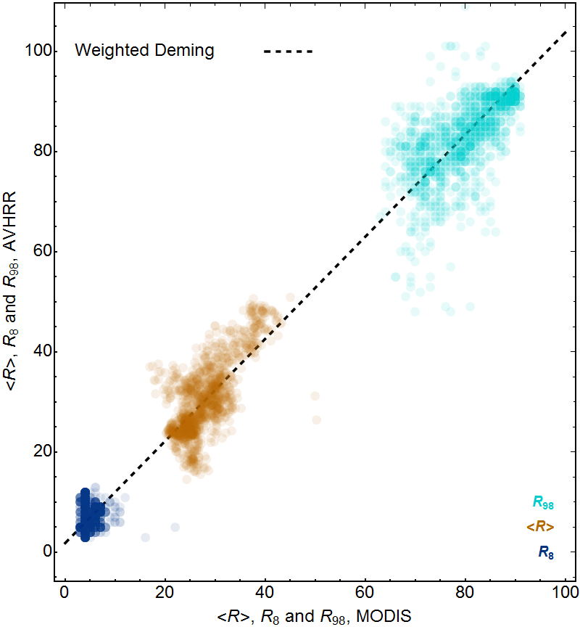
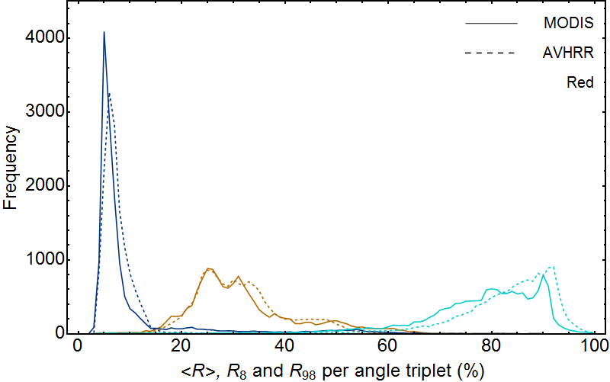
Intercalibration of AVHRR vs. MODIS
Variation range of the mean, 8 % and 98 % quantile values of the red channel TOA reflectance values corresponding to the same angle triplets for all MODIS and AVHRR data of June 29, 2010–July 19, 2010 covering the same area covering latitudes 0° N … 75° N and longitudes -130° E … 45° E. Clouds cause the high tails of the mean and 8 % quantile distributions and the low tail of the 98 % quantile distribution.
Weighted Deming regression of mean, 8 % and 98 % quantile values of the red channel TOA reflectance values for the AVHRR data set versus the combined MODIS Terra and Aqua data sets for distributions containing at least 4000 observations. The lowest values correspond to cloud free ocean and the highest values correspond to cloud free snow.
28.1.2019 FMI/TM & AR

Slide 8
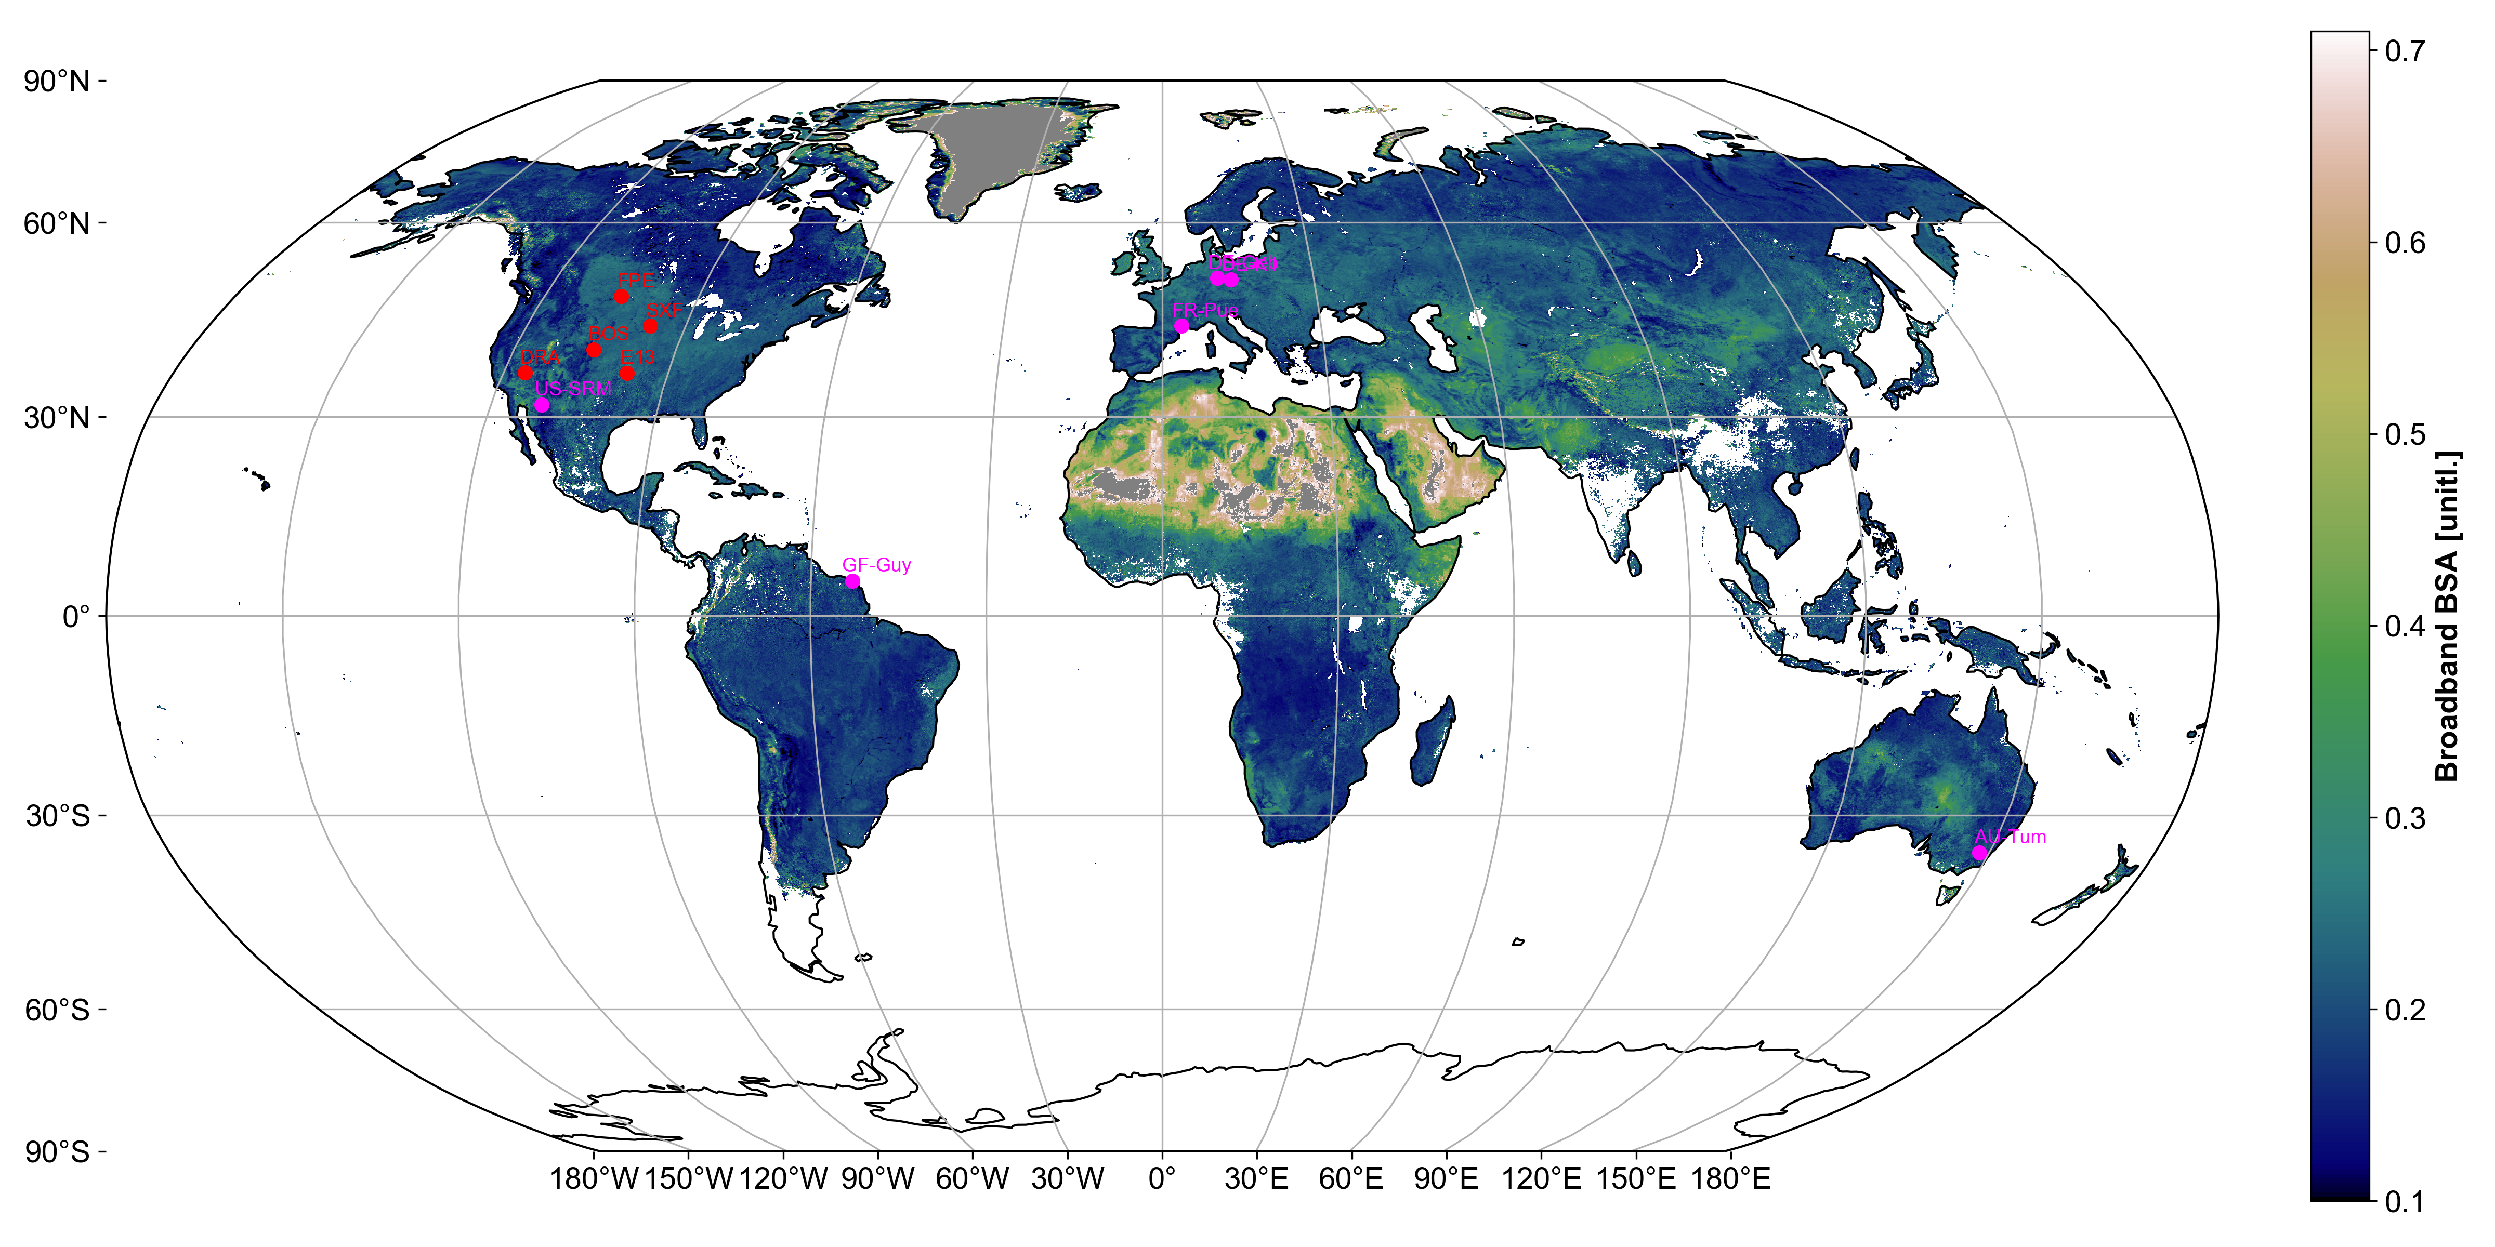
An example of the multisensor albedo demonstrator
Achieves near-global land surface coverage with an aggregation period of 10 days
(for comparison: MODIS-only aggregation period is 16 days)
28.1.2019 FMI/TM & AR

Slide 9
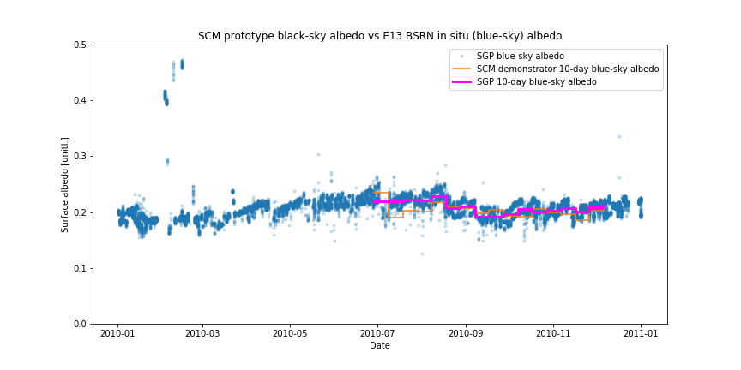
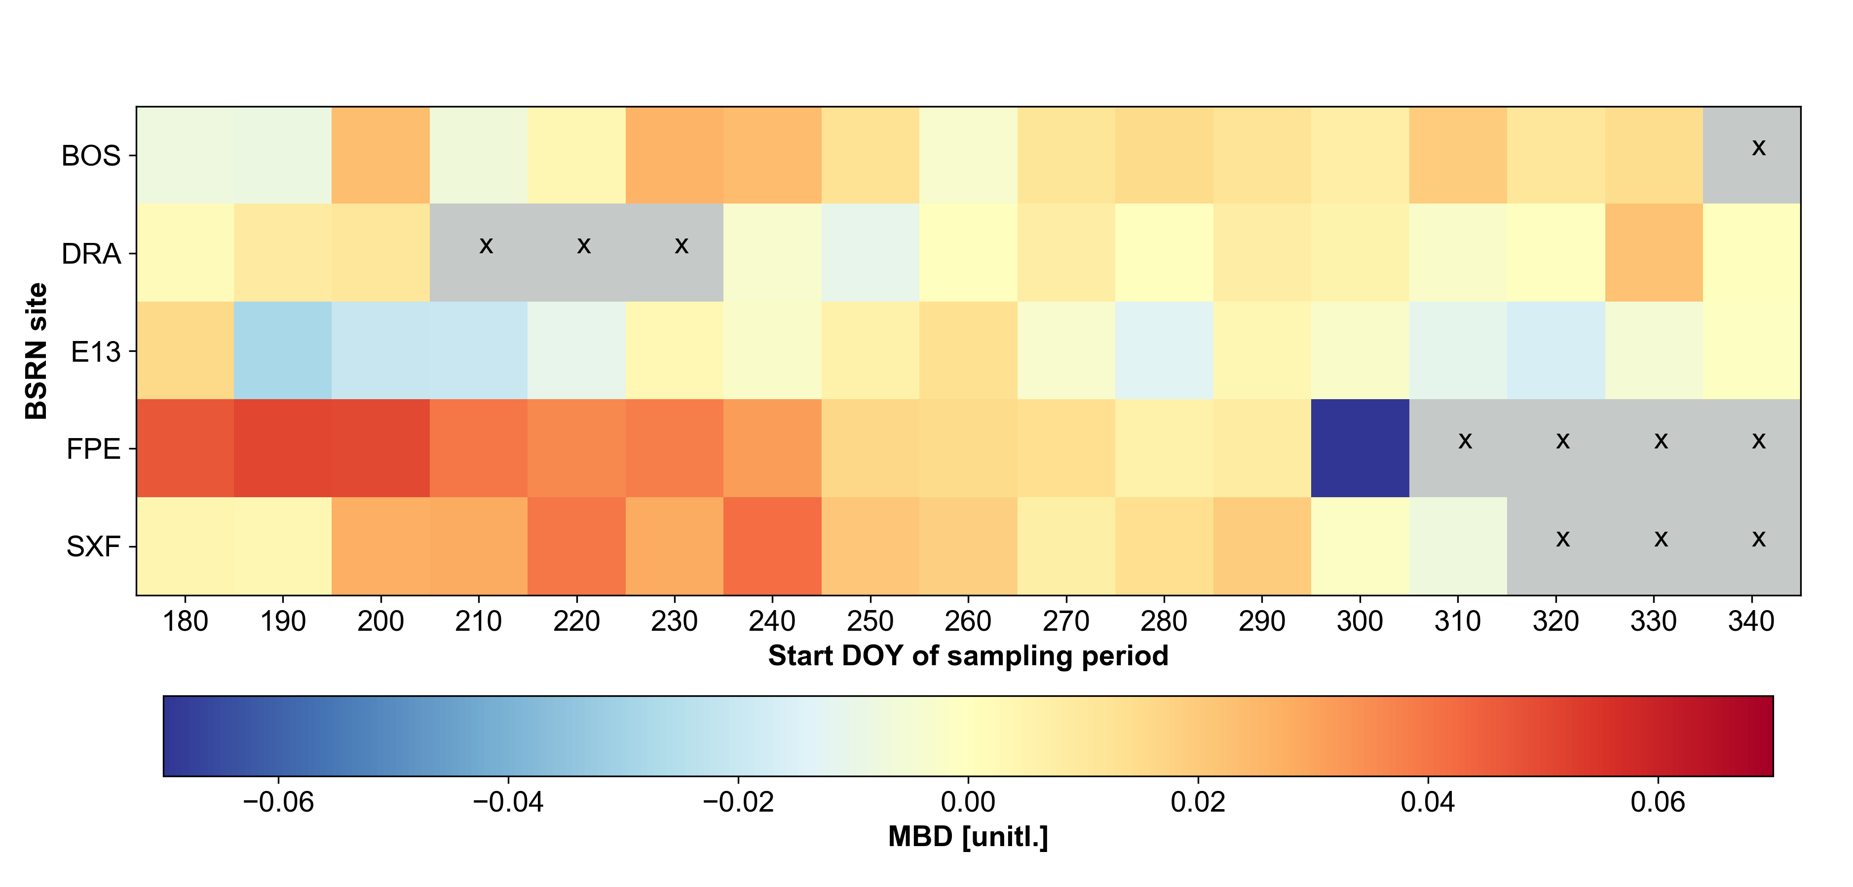
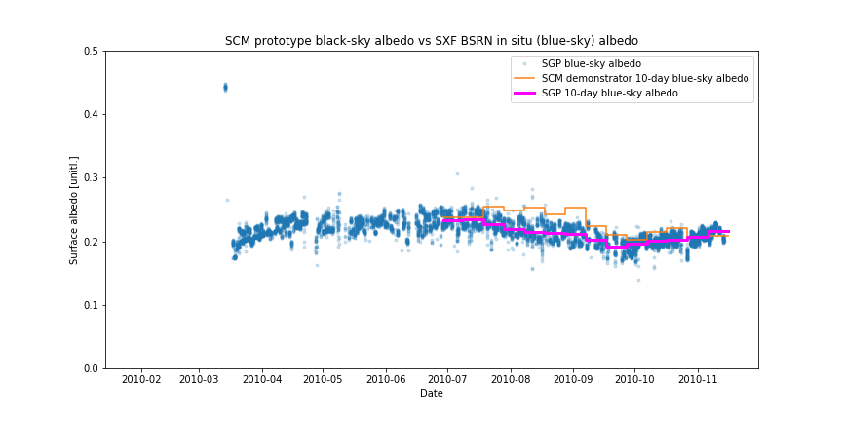
Achieved quality wrt. Reference in situ observations (I)
Albedo retrieval bias at spatially representative reference sites from the BSRN network is comparable to state-of-the-art single-sensor retrievals.
28.1.2019 FMI/TM & AR

Slide 10
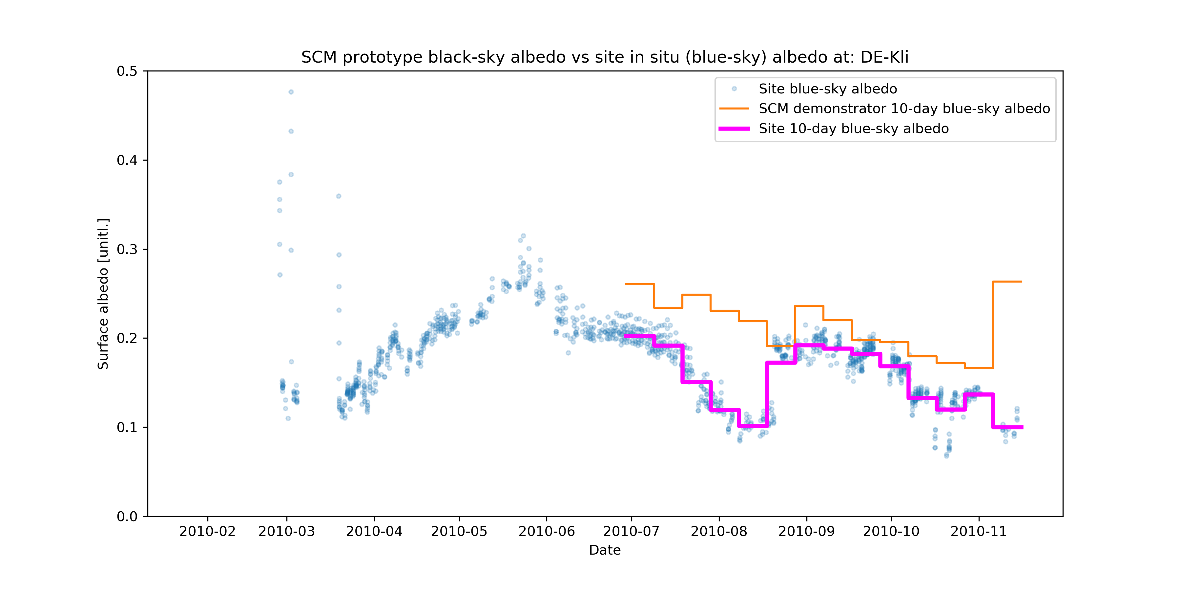
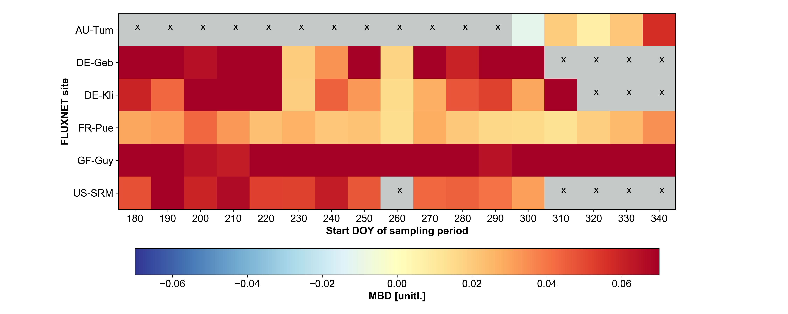
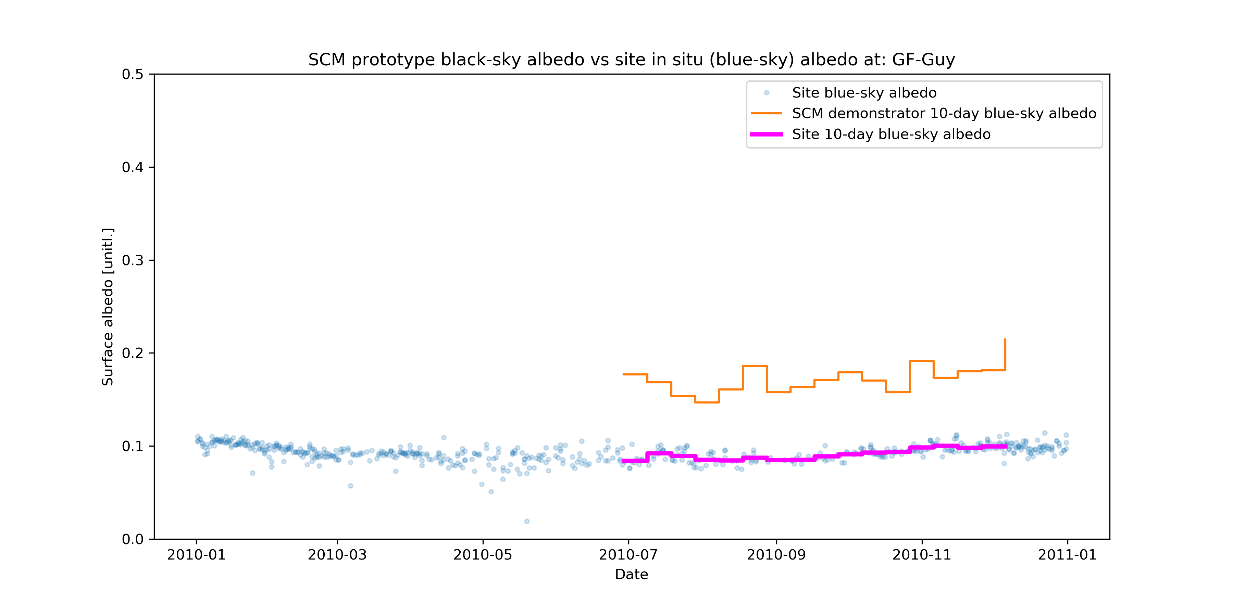
Achieved quality wrt. Reference in situ observations (II)
Albedo retrieval bias at additional FLUXNET sites (unknown spatial representativeness) shows highly variable retrieval bias. At the rain forest site in Guyana (GF-Guy), the retrieval bias is traceable to challenging atmospheric correction conditions. At others (DE-Kli), the cause appears to be large variation in the in situ measurements.
28.1.2019 FMI/TM & AR

Slide 11
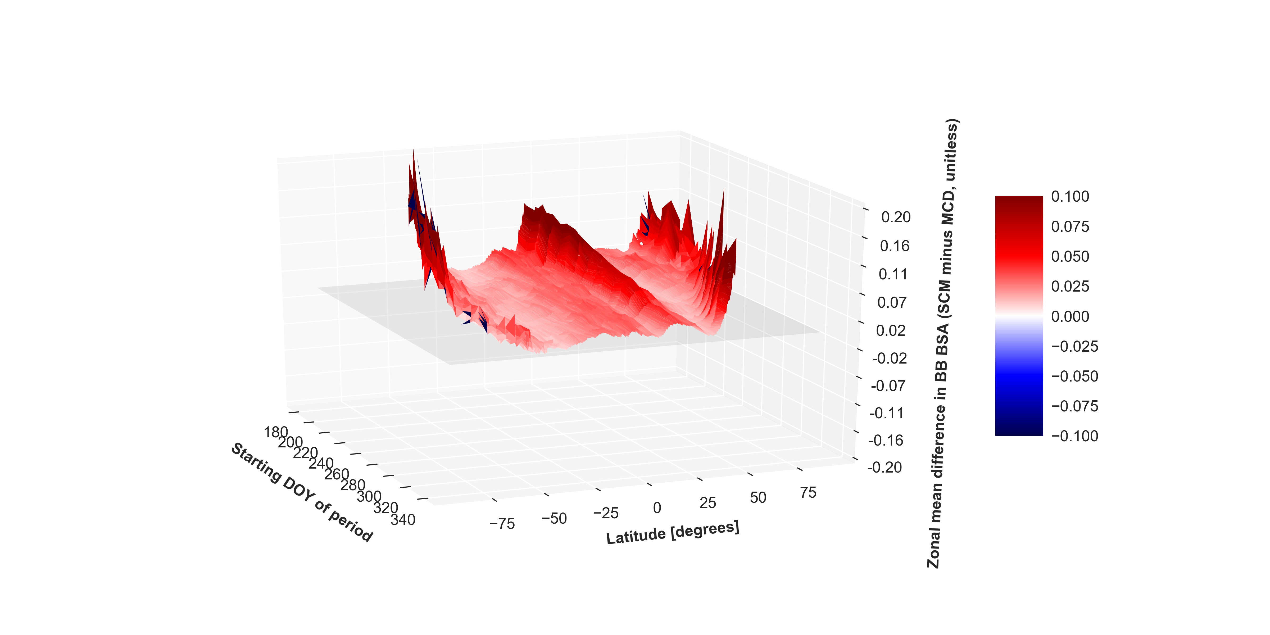
Achieved quality wrt. State-of-the-art single-sensor satellite estimates (MCD43)
Differences against MODIS albedo (MCD43D3) arise from desert regions and from areas with residual uncorrected snow effects and/or challenging illumination geometry (i.e. high latitudes)
28.1.2019 FMI/TM & AR

Slide 12
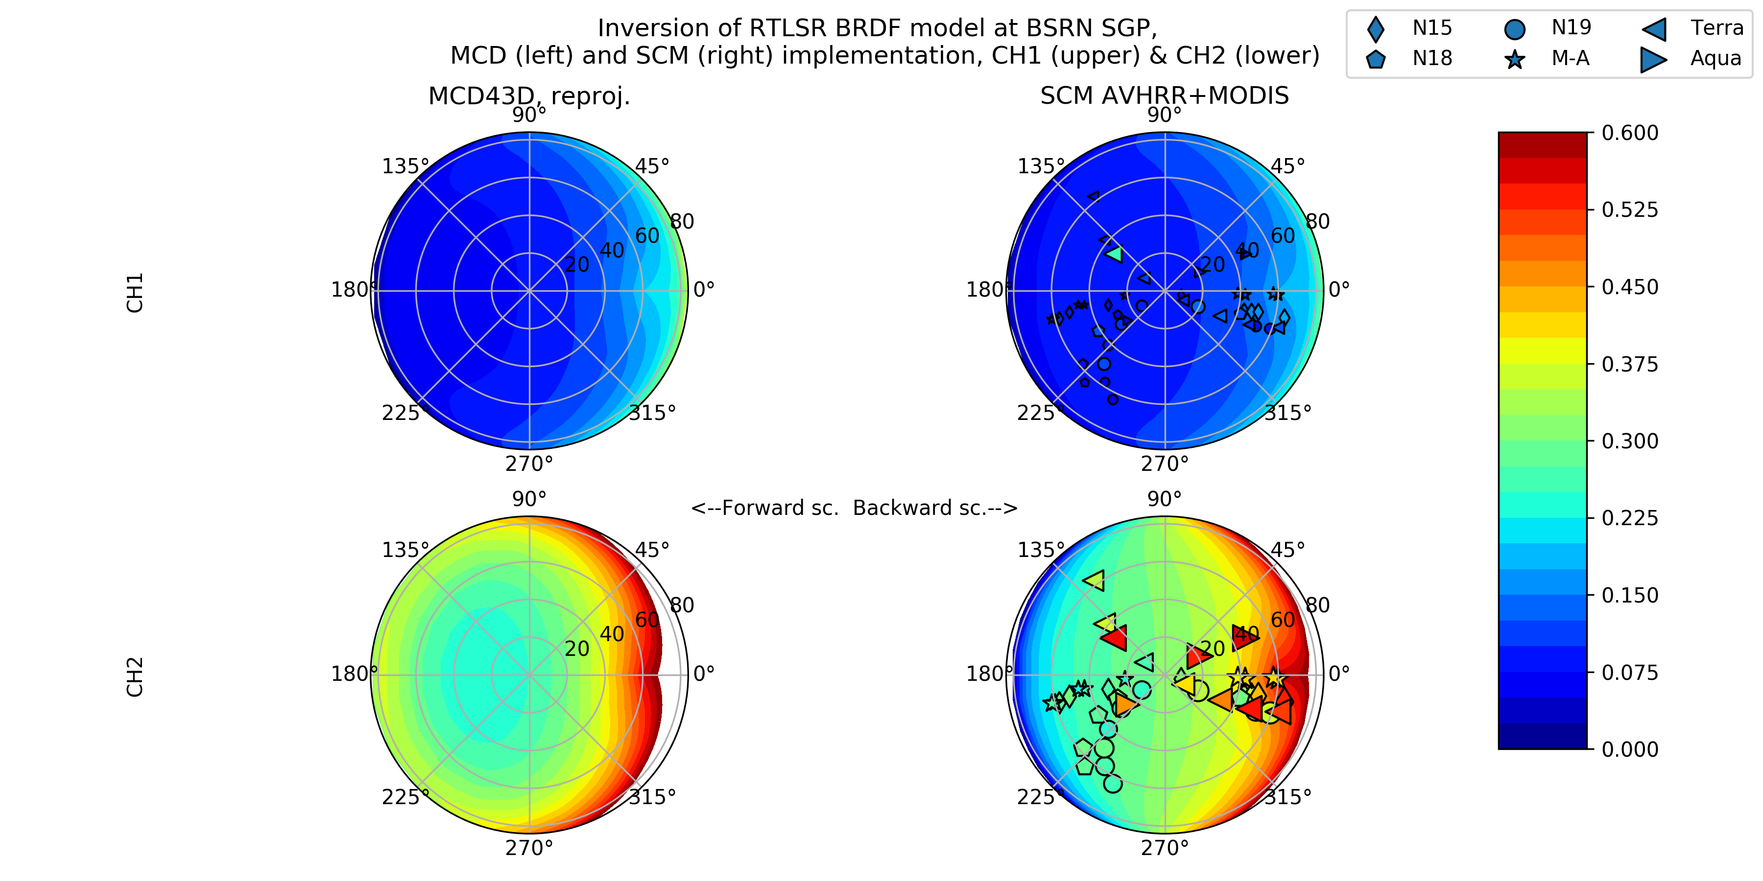
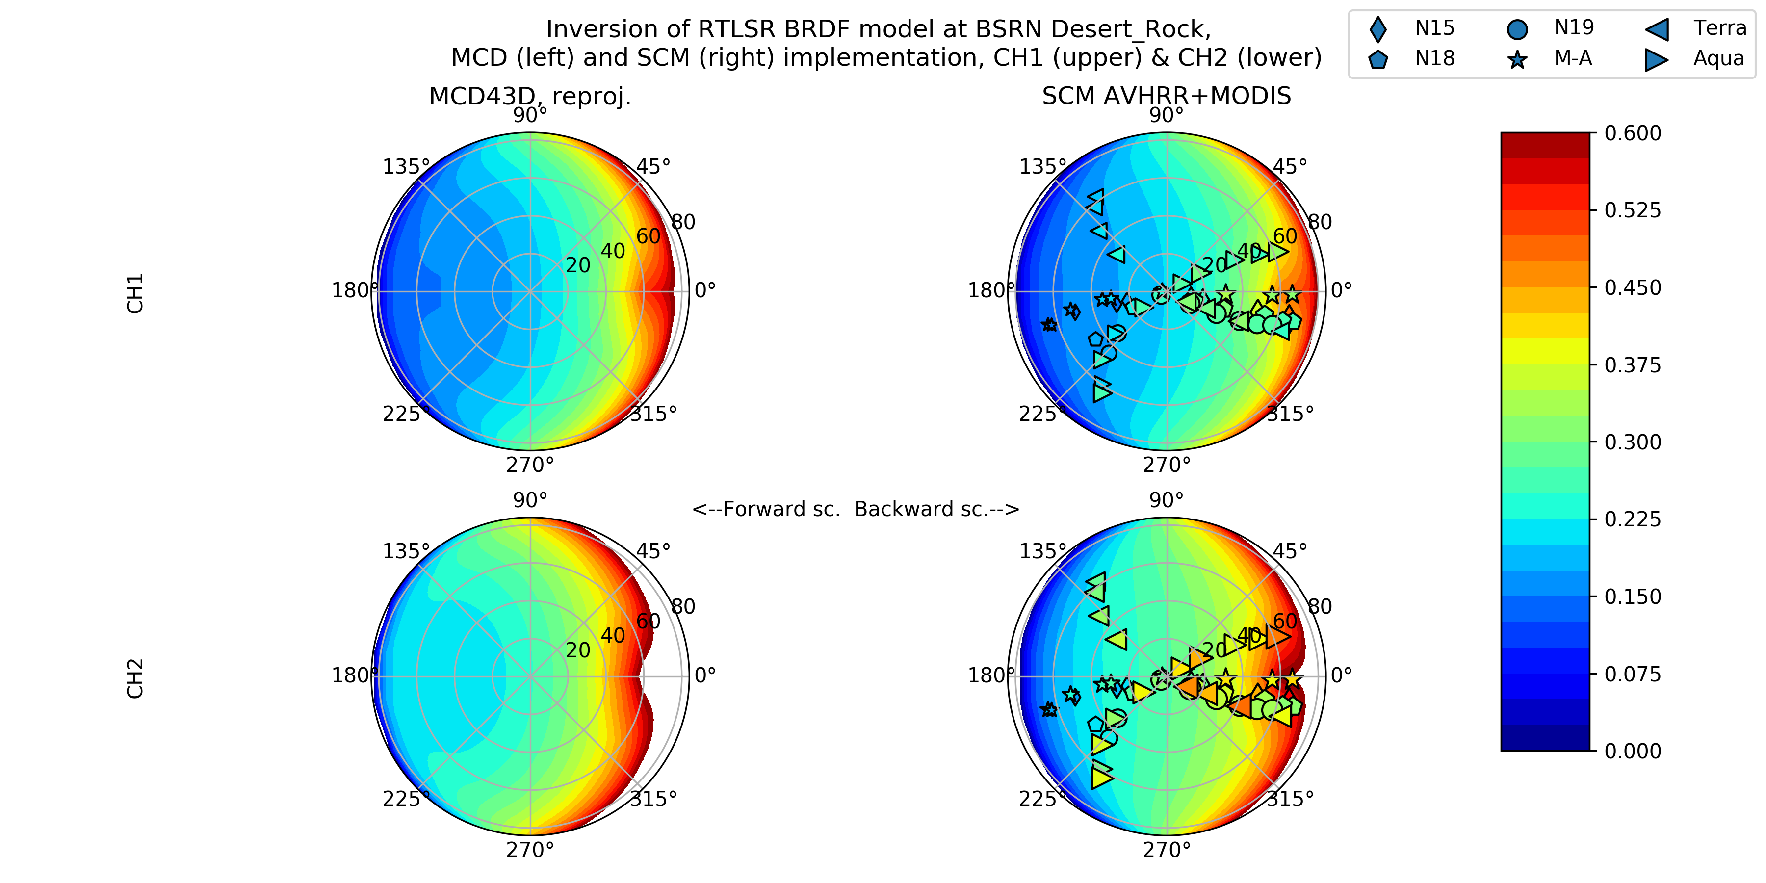
Achieved quality wrt. State-of-the-art single-sensor satellite estimates
The multisensor demonstrator retrievals essentially replicate the BRDF obtained from the single-sensor MODIS algorithm for the visible waveband (~0.6 micron), but some differences in the forward scattering direction remains in the near-infrared waveband (~0.8 micron). The cause appears to be traceable to residual AVHRR-MODIS differences existing after the ToA reflectance intercalibration.
28.1.2019 FMI/TM & AR

Slide 13
Known limitations of the algorithm at end of Phase II
As shown, atmospheric correction requires work over bright surfaces
Residual AVHRR-MODIS reflectance level differences apparent over the near-infrared waveband
Variability in evaluation results vs. reference in situ measurements
  Partly traceable to ’natural causes’, i.e. spatial representativeness and retrieval difficulties in complex atmosphere and/or challenging viewing/illumination conditions
28.1.2019 FMI/TM & AR

Slide 14
Summary of project state at end of Phase II
Period of record: 6 months
Geographic coverage: Global land
Data sources: AVHRR & MODIS TOA reflectances, cloud masks; AOD and total water vapour column from the aerosol-cci and CM SAF ATOVS climatologies, respectively
Spatiotemporal resolution: 0.01 degrees, 10 days
Data volumes: ~3000 AVHRR and ~5000 MODIS overpass files per period of 10 days
Archiving: FMI
Distribution and users: Interested parties will get the data set from FMI
Validation: Validated using BSRN and FLUXNET network data, results published in Riihelä et al., 2018.
Publications:
  T. Manninen, A. Riihelä, A. Heidinger, C. Schaaf, A. Lattanzio and J. Key, "Intercalibration of Polar-Orbiting Spectral Radiometers Without Simultaneous Observations," in IEEE Transactions on Geoscience and Remote Sensing, vol. 56, no. 3, pp. 1507-1519, March 2018.
  doi: 10.1109/TGRS.2017.2764627
  Terhikki Manninen, Aku Riihelä, Andrew Heidinger, Crystal Schaaf, Alessio Lattanzio, and Jeffrey Key, 2017, Intercalibration without simultaneous nadir observations, GSICS Quarterly Newsletter, Vol. 11, No. 4, (March 2018): DOI: 10.7289/V5/QN-GSICS-11-4-2018.
  Aku Riihelä, Terhikki Manninen, Jeffrey Key, Qingsong Sun, Melanie Sütterlin, Alessio Lattanzio, and Crystal Schaaf, “A multisensor approach to global retrievals of land surface albedo”, Remote Sensing, 10(6), 848, 2018; https://doi.org/10.3390/rs10060848, 2018.
  + 1 Proceedings paper in ESA Living Planet Symposium
28.1.2019 FMI/TM & AR

Slide 15
Summary of project state at end of Phase II
Maturity level (compared to start): On the average 0 -> 2
Readiness for sustained production: No
State of CDR ownership: FMI/NOAA? Not well defined at present
Member coalition: The team is interested in continuing forward on the topic
State of user community -- applications and communities requesting this CDR: This CDR was meant to be a demonstration, no target users
The project is most aligned and responsive to: Models and GFCS
28.1.2019 FMI/TM & AR

Slide 16
Summary of project state at end of Phase II
Difficulties, challenges and uncertainties:
Scientific/technical: Temporary data access outage at the center in Madison, challenging to build a multi-sensor processing algorithm from the ground up
Financial: No dedicated funding for all parties
Schedule: A long construction & testing period for a new algorithm plus a computationally intensive product incurred some delays relative to planned schedule
Compute: Limitations in computational resources and schedule constraints limited the length of the final data set
No problems of personnel, data access/distribution, political, etc.
28.1.2019 FMI/TM & AR

Slide 17
Lessons learned
International projects without dedicated funding for all parties should not be expected to move (as) fast (as scheduled)
Multisensor processing is computationally expensive, plan for long processing periods unless funded for supercomputer access (for which case source [satellite] data access may become an issue)
28.1.2019 FMI/TM & AR

Slide 18
Next steps for the project
Interest in the team exists to apply the processing framework to generate joint AVHRR-MODIS retrievals over the Arctic
  High latitudes -> maximum benefit from multi-sensor data
  Chance to work on improving the snow albedo treatment
  Multi-sensor sampling will help in circumventing retrieval difficulties in Arctic summer rising from persistent cloudiness
Aim for multi-year coverage, similar spatial resolution as here, temporal resolution TBD after testing
Proposal prepared on the topic – what is the SCOPE-CM’s future interest for hosting such work?
28.1.2019 FMI/TM & AR

Slide 19
Desired future role with SCOPE-CM
SCOPE-CM continues to sponsor the team in the development of a combined MODIS-AVHRR Arctic surface albedo dataset
A new SCOPE-CM project sees the development and deployment of a fixed-length timeseries (~5-10 years depending on initial resources), with planning for sustained temporal extensions to follow at regular intervals
Investigate the possibility of adding new imagers to the mix
28.1.2019 FMI/TM & AR

Slide 20
Retrieval specifics (I)
Data ingested from Terra & Aqua, as well as NOAA -15, -18, -19, and METOP-A
MODIS and AVHRR CH1 & 2 spectrally homogenized following Manninen et al. (IEEE-TGRS, 2017)
Angular cutoffs for retrieval: 70 degrees for both View and Sun Zenith Angle
All overpass data reprojected to a common 0.1 degree Plate Carree grid for BRDF inversion and albedo production
28.1.2019 FMI/TM & AR

Slide 21
Retrieval specifics (II)
Poor quality MODIS or AVHRR data are discarded according to overpass quality flags.
Imagery with SZA>60°, sun glint, or uncertain cloud mask are accepted but penalized in the BRDF inversion (algorithm allows for individual weighting of overpass grid cells)
To improve comparability with MCD43 (MODIS albedo), we also require 7 valid observations during the 10-day sampling cycle to attempt RTLSR model inversion for BRDF kernels
We have produced a six-month dataset covering the latter half of 2010 as a demonstrator dataset for this proof-of-concept study
28.1.2019 FMI/TM & AR

Slide 22
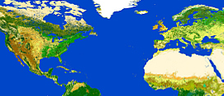
Material for testing the general intercalibration concept
MODIS Terra and Aqua
AVHRR NOAA-15, NOAA-18, NOAA-19 and METOP-A/2, data from NOAA
0°N - 75°N
-130°E - 45°E
TOA reflectance values
      Sun zenith angle <=70°,
      Satellite zenith angle <=60°
June 29 – July 19, 2010 MODIS & AVHRR
June 1 – July 19, 2010, MODIS
28.1.2019 FMI/TM & AR

Slide 23
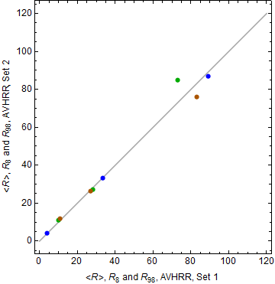
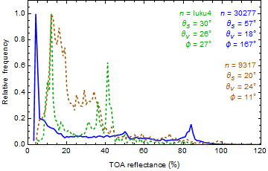
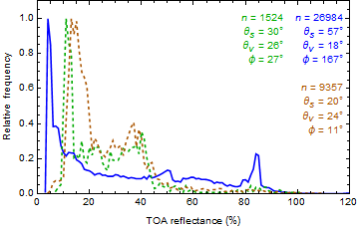
Method
Each image is split in subsets according to the sun zenith angle θ_{s}, satellite zenith angle θ_{v} and the azimuth difference angle φ
For each subset distribution the average value <R> and 8% (ocean) and 98% (snow) quantiles, R₈ and R₉₈ respectively, are derived
The <R> , R₈ and R₉₈ values of two independent data sets are regressed to obtain their intercalibration parameter values (b₀ and b₁)
Deming regression is used with iterated weights
n = 1614
Set 1
R₈ = 4, <R> = 33.3 , R₉₈ = 89
R₈ = 10 , <R> = 28.0 , R₉₈ = 73
R₈ = 11, <R> = 26.9 , R₉₈ = 83
Set 2
R₈ = 4, <R> = 33.0 , R₉₈ = 87
R₈ = 11 , <R> = 27.2 , R₉₈ = 85
R₈ = 12, <R> = 26.4 , R₉₈ = 76
28.1.2019 FMI/TM & AR

Slide 24
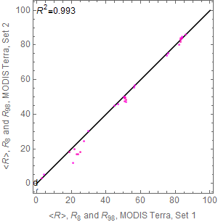
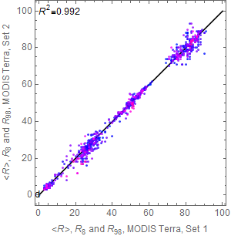
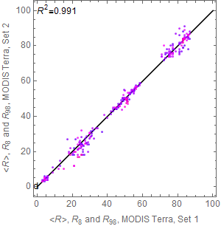
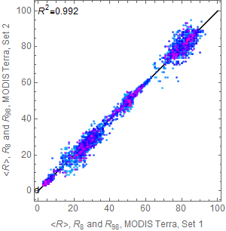
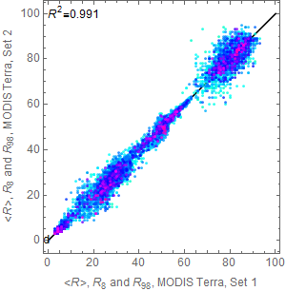
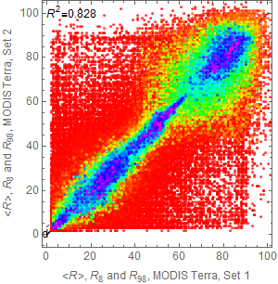
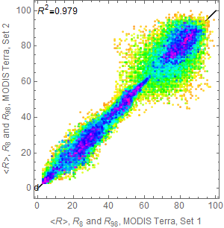
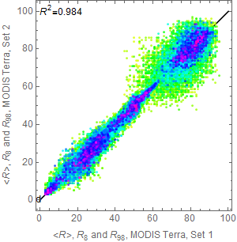
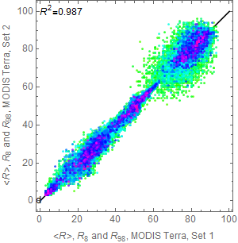

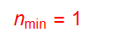
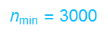
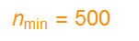
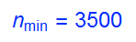
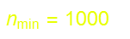
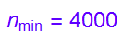
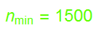
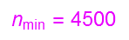
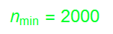
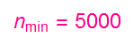
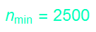
MODIS Terra, Set 2 vs. Set 1
Effect of the minimum number of points in the distributions
28.1.2019 FMI/TM & AR

Slide 25
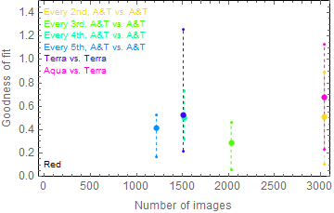
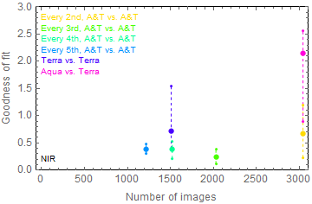
MODIS, effect of choice of images on the goodness of fit
MODIS calibration accuracy in red channel is about 1 %
MODIS calibration accuracy in NIR channel is about 3 %
28.1.2019 FMI/TM & AR

Slide 26
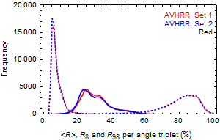
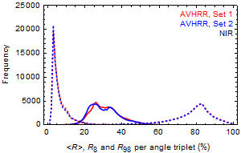
AVHRR vs. AVHRR
One instrument type on four satellites
Every second image of the chronologically arranged data set of all AVHRR images is taken in Set 1 and the rest in Set 2
28.1.2019 FMI/TM & AR

Slide 27
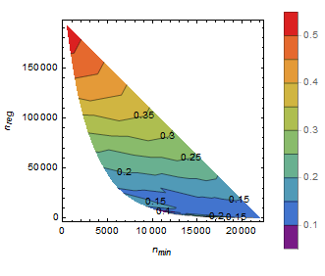
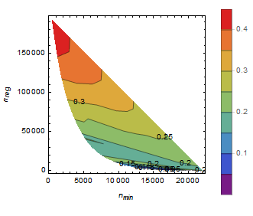
AVHRR vs. AVHRR, goodness of fit
Δ (%) , Red
Δ (%), NIR
28.1.2019 FMI/TM & AR

Slide 28
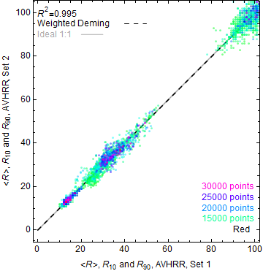
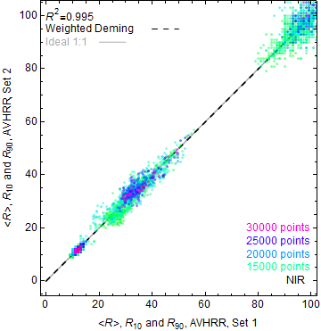
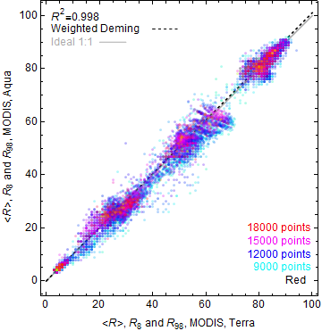
AVHRR vs. AVHRR, fit parameters
 | Channel | b₀ | b₁ | Δ (%)
Set 2 vs. Set 1 | Red | 0.009 | 0.999 | 0.063
 | NIR | -0.013 | 0.999 | 0.073
28.1.2019 FMI/TM & AR

Slide 29
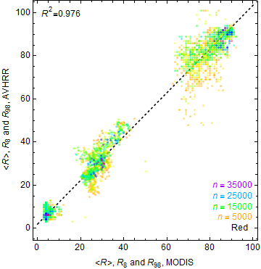
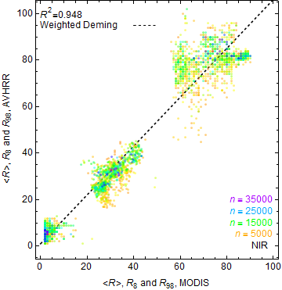
AVHRR vs. MODIS, fit parameters
 | Channel | b₀ | b₁
AVHRR vs. MODIS | Red | 1.866 | 1.018
 | NIR | 0.873 | 1.056
28.1.2019 FMI/TM & AR

