Slide 1
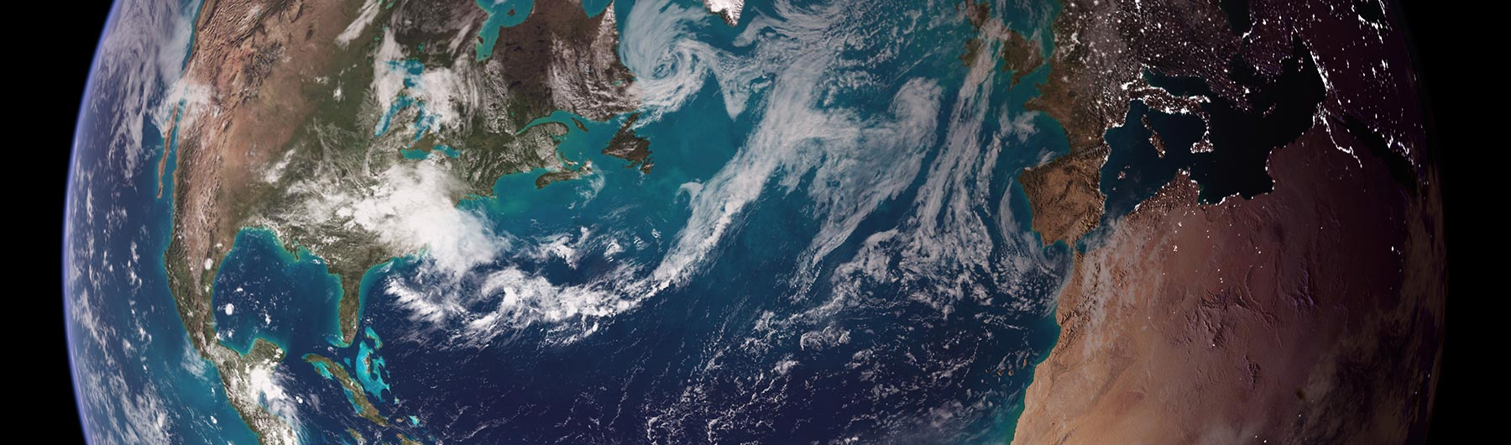
SCOPE-CM Project: UTH
Sustained generations of upper tropospheric humidity Climate Data Records from different sensors with multi-agency cooperation
Presented by
Lei Shi
NOAA National Centers for Environmental Information
Contributions from:
Stefan Buehler, Eui-Seok Chung, Ralph Ferraro, Shu-peng Ho, Viju John, Isaac Moradi, Marc Schröder, Brian Soden, and Carl Schreck
February 2019
National Oceanic and Atmospheric Administration | National Centers for Environmental Information

Slide 2
Multi-agency Team
NOAA NESDIS National Centers for Enironmental Information, Asheville (NCEI), NC, USA
NOAA NESDIS Center for Satellite Applications and Research (STAR), College Park, MD, USA
University of Maryland, College Park, MD, USA
University of Miami, Rosenstiel School of Marine & Atmospheric Science, Miami, FL, USA
Deutscher Wetterdienst, Satellite Based Climate Monitoring, Offenbach, Germany
EUMETSAT and Met Office Hadley Centre, Exeter, UK
Meteorological Institute, University of Hamburg, Germany
IBS Center for Climate Physics, Korea

Slide 3
Project Summary
Sustained generation of upper tropospheric humidity (UTH) (also named as free tropospheric humidity (FTH))
Datasets derived from HIRS since late 1978, from AMSU-B and MHS since late 1998, and from MVIRI and SEVIRI since 1983
Improving satellite records through bias correction and homogenization procedures
Redundancy of records from multiple sensors to facilitate the examination of the homogeneity and stability of each satellite data record and to explain the differences among data records
Cooperation and collaboration among team members
Advancing maturity levels established by the SCOPE-CM Maturity Matrix Model

Slide 4
UTH Data Sources
Both infrared and microwave data sources
  Global High Resolution Infrared Radiation Sounder (HIRS) since late 1978 (polar orbiting)
  Global Advanced Microwave Humidity Unit-B (AMSU-B) and the Microwave Humidity Sounder (MHS) since late 1998 (polar orbiting)
  Meteosat Visible and InfraRed Imager (MVIRI) and Spinning Enhanced Visible and InfraRed Imager (SEVIRI) for the domain 45°N/S/E/W since 1983 (geostationary)

Slide 5
UTH/FTH Data Flow
TB record sources:
HIRS
AMSU-B/MHS
MVIRI/SEVIRI
Documentation,
Metadata,
Software Readiness
Inter-satellite
calibration
UTH/FTH
Sustained
production of
UTH/FTH CDR
Inter-comparison
and
Documentation
Validation with
Other Data
Sources
Re-
Processing
= Data
= Activities

Slide 6
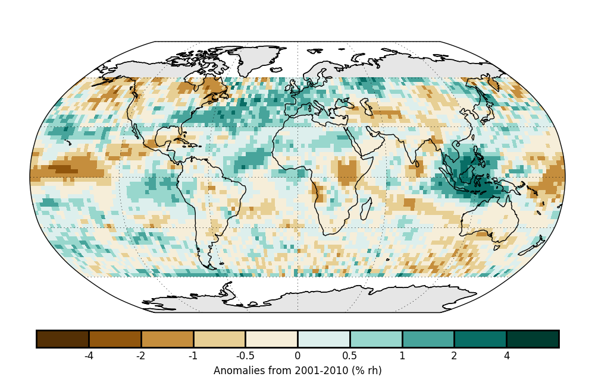
Overview of datasets: HIRS UTH
Specifications
  Global coverage
  Clear-sky HIRS pixels
  Monthly mean on 2.5°x2.5° Grid
  Data Format: NetCDF4
  Nov 1978 – Present
  To be updated monthly
Applications
  Long-term water vapor variability
  Annual state of the climate
  Climate model evaluation
  Large-scale atmospheric circulation study
  Tropical expansion study
  Tropical wave diagnostics and forecast
Annual average UTH anomaly (%; 2001–10 base period) for 2017 based on the clear-sky HIRS UTH dataset. (John et al., 2018, in “State of the Climate in 2017”, BAMS).

Slide 7
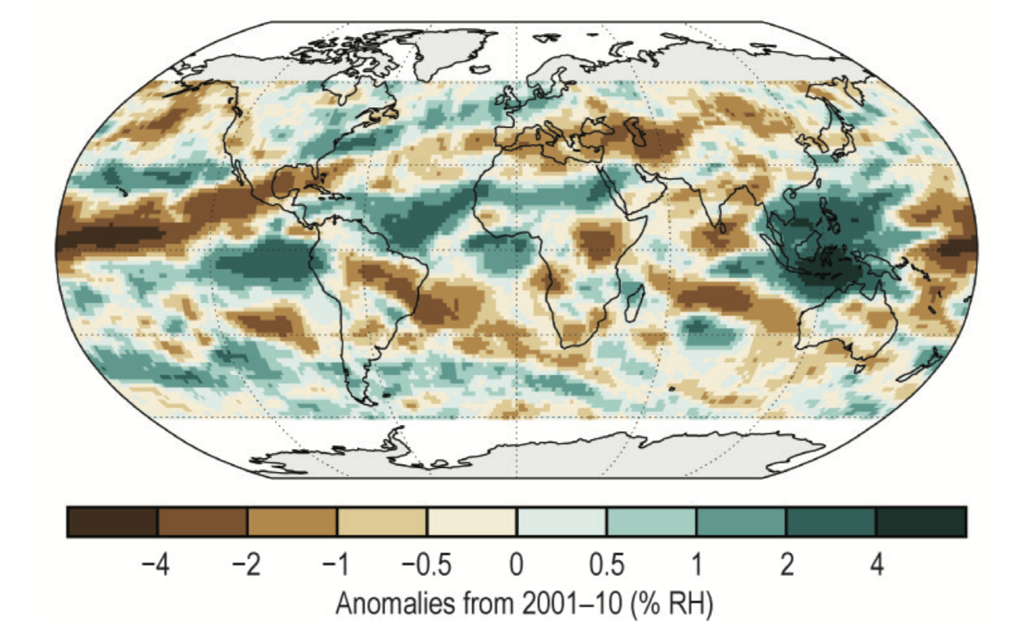
University of Miami MW UTH
Specification
- Monthly-mean UTH and 183.31±1 GHz channel brightness temperatures over the near-globe (60°S-60°N) on a grid with 1.5°×1.5° spatial resolution
- Data period: 1999-2017
- Sensors used: AMSU-B/MHS onboard NOAA/MetOp polar-orbiting satellites
- Pixels affected by deep convective or precipitating clouds are discarded
- Orbital drift correction and intersatellite calibration
Annual average UTH anomaly (unit: % RH, reference period: 2001-2010) for 2017
Application
- Long-term monitoring of upper tropospheric water vapor and large- scale atmospheric circulation
- Evaluation of model-simulated and reanalysis-produced upper tropospheric water vapor variability
- Annual state of the climate

Slide 8
NOAA/University of Maryland FCDR/TCDR
Currently processing data from three satellites (N18, N19, and MetopA) for both FCDR and TCDR with N18 being the reference satellite:
All TCDR and FCDR are processed until Nov 2018 (Dec. 2018 are only partially available due to the government shutdown and the data before September 2018 have already been delivered to NCEI.
The TCDRs included (relevant to the SCOPE-CM) are, Atmosphere water vapor content, Cloud liquid water content, sea ice area fraction and MHS TCDs include rain rate, surface snow area fraction, cloud ice water path and snow liquid water content
A paper on AMSU-B/MHS FCDR was recently published in Atmospheric Measurements Technique entitled “Radiometric correction of observations from microwave humidity sounders”, doi: 10.5194/amt-11-6617-2018, 2018.

Slide 9
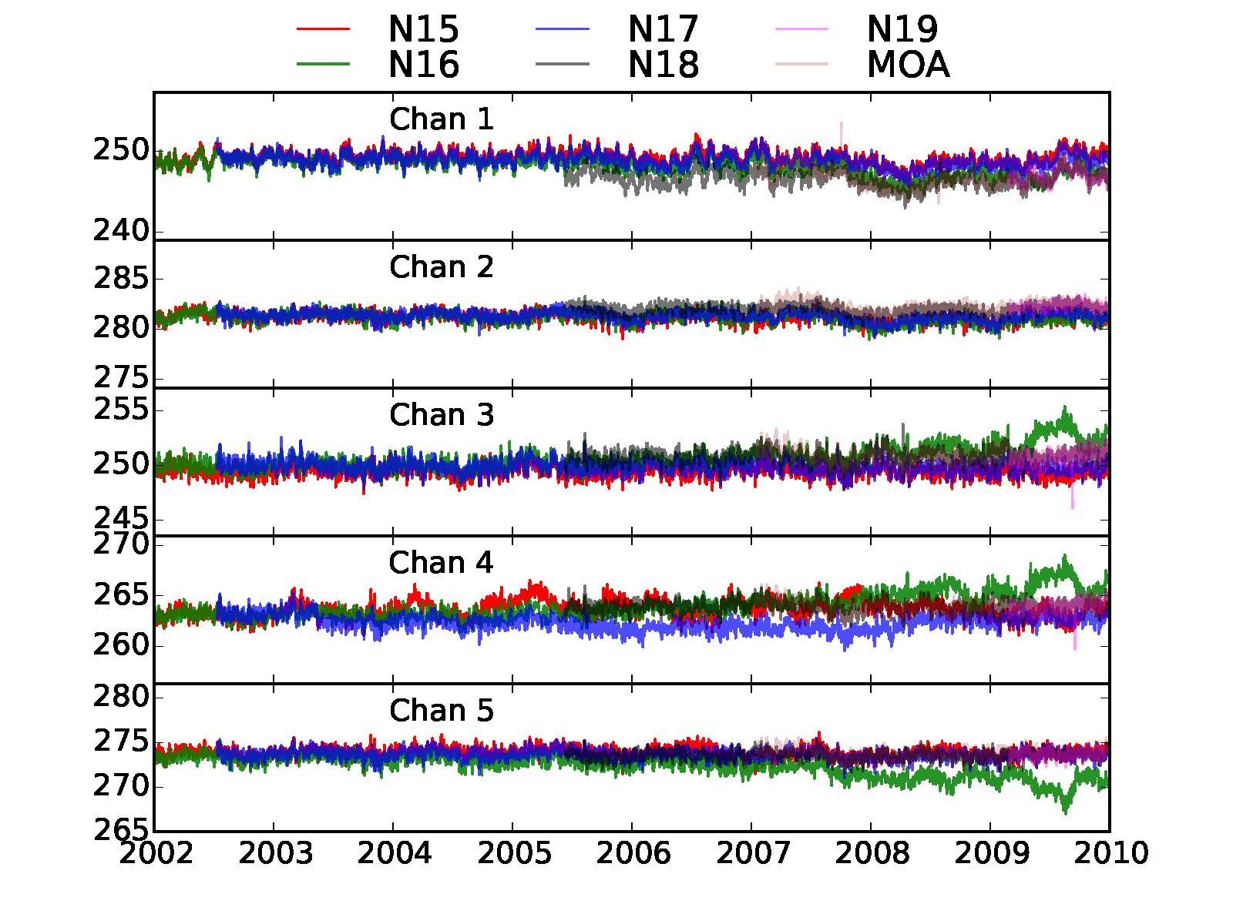
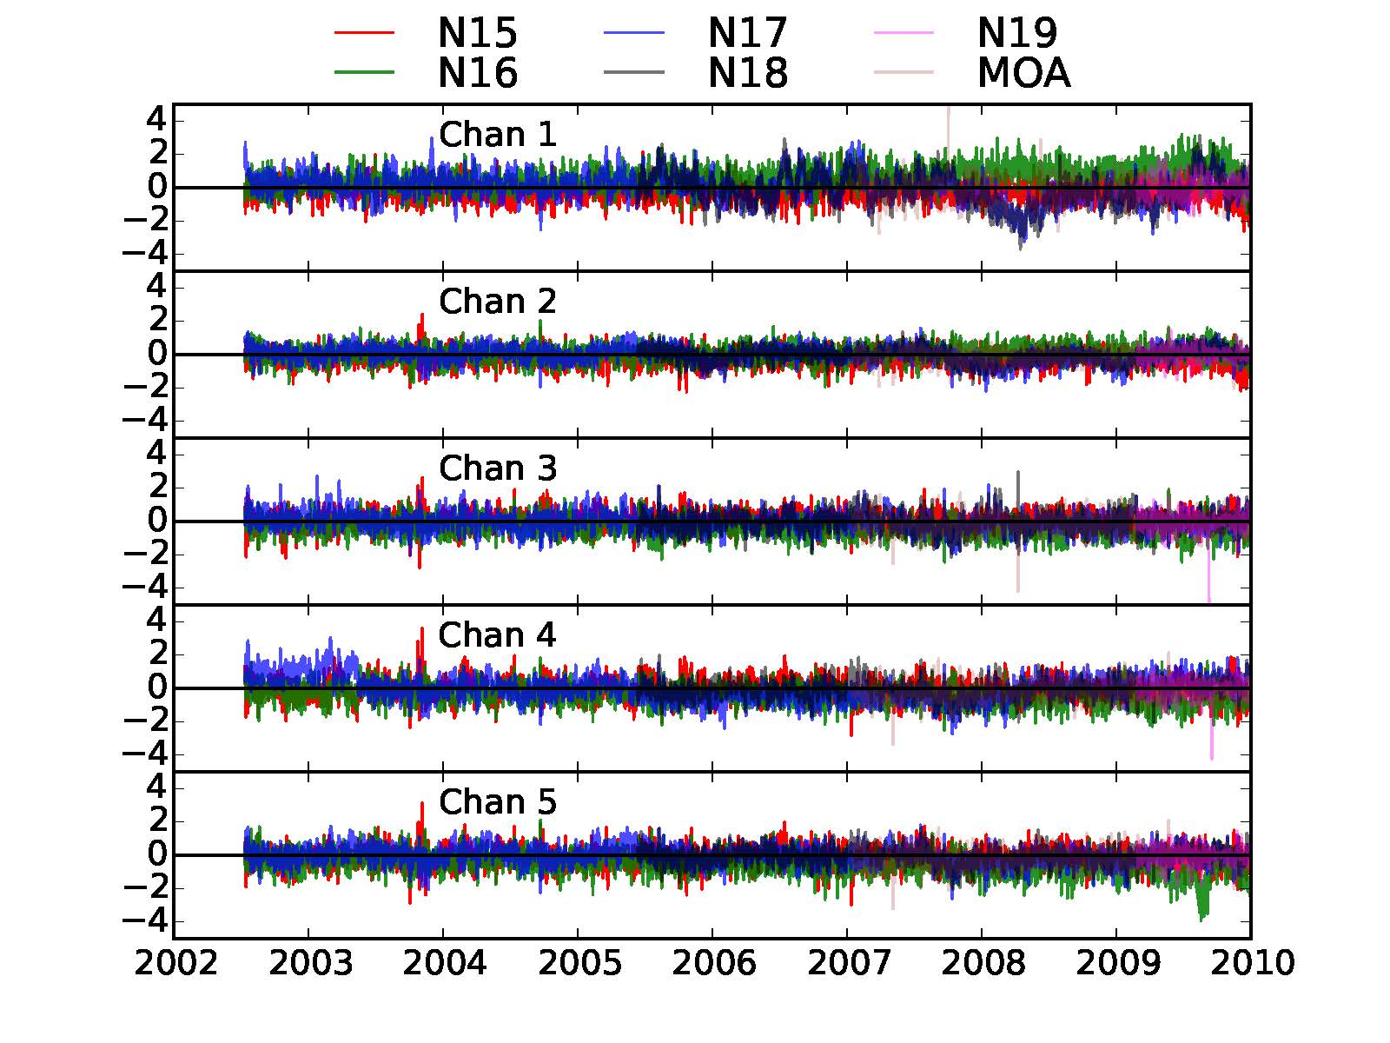
AMSU-B time series before (left) and after (right) correction

Slide 10
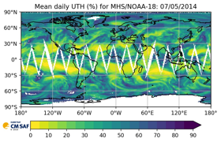
CMSAF UTH v1.0
Content: Global, daily averaged UTH and 183.31±1 GHz T_{b} on a regular lat/lon grid with 1°x1° resolution from ascending and descending satellite overpasses
Satellite missions:
  AMSU-B on NOAA15, NOAA16, NOAA17
  MHS on NOAA18, Metop-A, Metop-B
1 January 1999 to 31 December 2015
Data format: NetCDF4
Input data: Microwave FCDR
Evaluated against UTH calculated from the ERA-Interim reanalysis
Fulfils Global Climate Observing System (GCOS) requirements
Biases are less than 5% and decadal stability is less than 0.3% within ±60° latitude
Data and documentation available at:
  https://wui.cmsaf.eu/safira/action/viewDoiDetails?acronym=UTH_V001

Slide 11
FIDUCEO Microwave FCDR - Summary
Content: Recalibrated T_{b} for Microwave radiometers with uncertainty estimates on pixel level and with correlation length scales estimates
Satellite missions:
  SSMT2 on F11, F12, F14, F15,
  AMSU-B on NOAA15, NOAA16, NOAA17,
  MHS on NOAA18, NOAA19, Metop-A, Metop-B
Data Format: NetCDF4
File size (1 orbit): 7 MB, total FCDR: 2.2 TB
Input data: L1B data files from the NOAA CLASS archive
Novelties:
  Improved calibration with a measurement function approach
  metrologically traceable uncertainties for three classes of correlation behaviour: independent, structured and common uncertainties
  new quality checks and flags
  Equator-To-Equator files without overlap to adjacent ones
  The recalibrated MHS and AMSU-B instruments provide stable long time series of brightness temperatures, especially around the water vapour absorption line at 183 GHz.

Slide 12
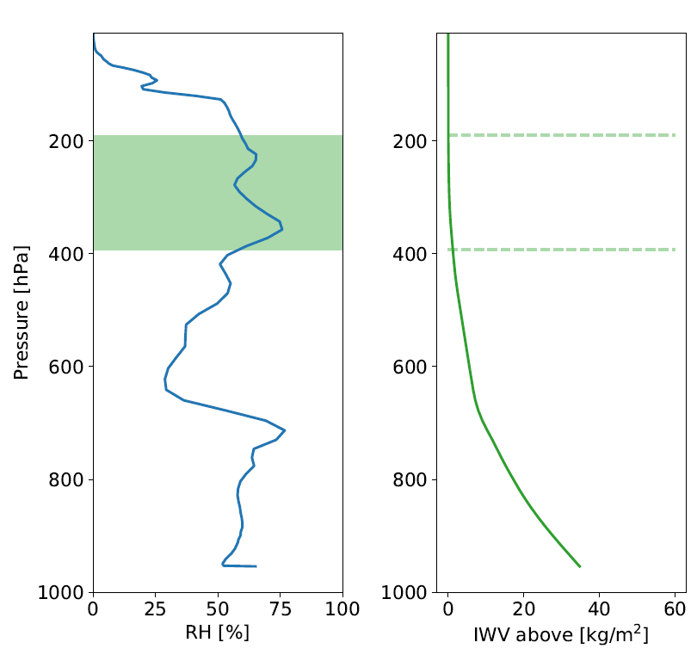
New UTH definition
UTH = vertical average of relative humidity in a layer between two characteristic water vapour columns:
In contrast to the Jacobian-based UTH definition,
The new definition is consistent for infrared and microwave observations and hence makes them more comparable
UTH can be directly calculated from model atmospheres without the detour via radiative transfer simulations
Future plans
Creation of a UTH CDR from the FIDUCEO HIRS FCDR. Together, both CDRs would cover a time span of almost 40 years.
Remaining problem:
T_{b} in a water vapour channel probing the upper troposphere depends on other factors than relative humidity, particularly on the pressure in the atmospheric emission layer. This pressure effect is particularly strong in the infrared T_{b} and can lead to artificial trends in long time series of UTH.
Possible solution:
Include pressure parameter into the transformation from UTH to T_{b}

Slide 13
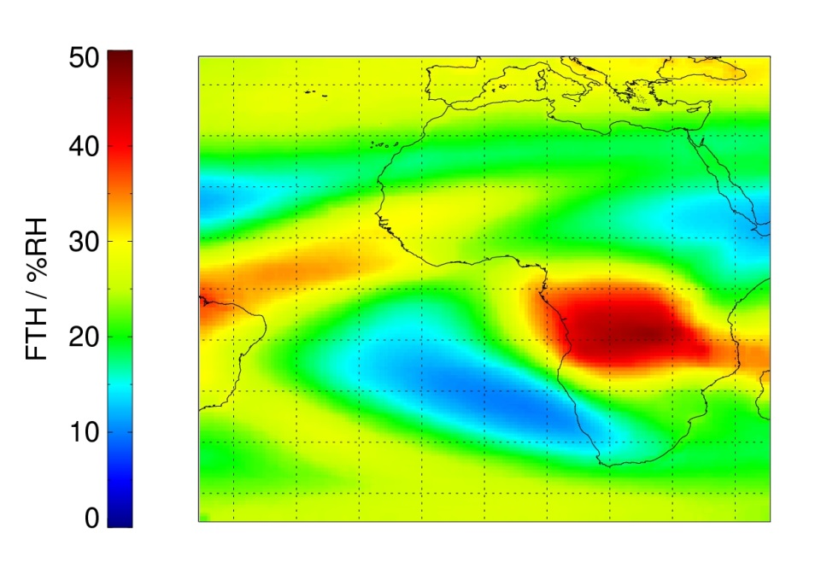
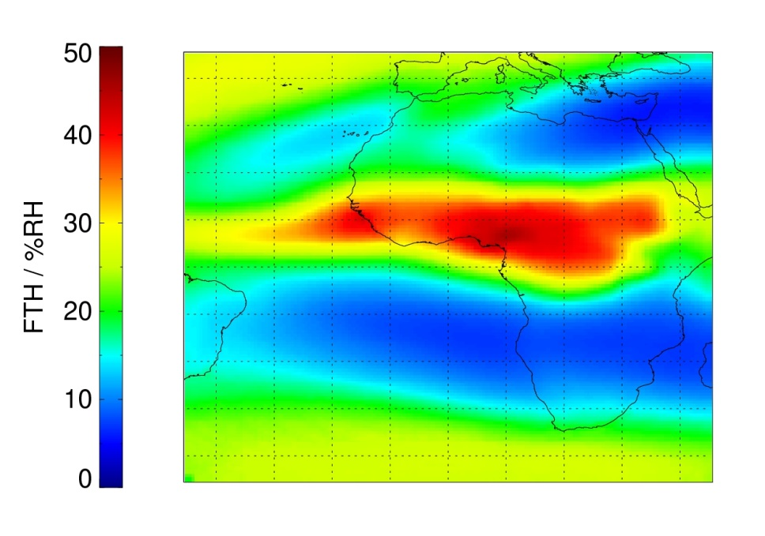
TCDR of
Free tropospheric humidity (FTH)
DOI: 10.5676/EUM_SAF_CM/FTH_METEOSAT/V001 , Schröder et al. (2014) in ACP
Instruments used: MVIRI + SEVIRI onboard METEOSAT 2-5, 7-9.
July 1983 – December 2009, Tropical Africa/Atlantic: 45°N/S/E/W in 0.625° spatial resolution, 3 hourlies, monthly averages.
Input: ISCCP radiances, SEVIRI radiances from DWD archive, ISCCP cloud mask and cloud top pressure, ERA-Interim.
Retrieval after (Schröder et al., 2014, Roca et al., 2009, Brogniez et al., 2006), homogenisation after Picon et al. (2003), inter-calibration after Breon et al. (2000).
DJF
JJA
Climatological averages of FTH.

Slide 14
User Community and Applications
User Community
  Academic Researchers, Climate Researchers, Climate Modelers, GEWEX Water Vapor Assessment, State of Climate section on upper tropospheric humidity.
Applications
  Long-term water vapor climate variability
  Evaluation of model-simulated and reanalysis-produced uppe tropospheric water vapor variability
  Large-scale atmospheric circulation study
  Tropical expansion study
  Tropical wave diagnostics and forecast

Slide 15
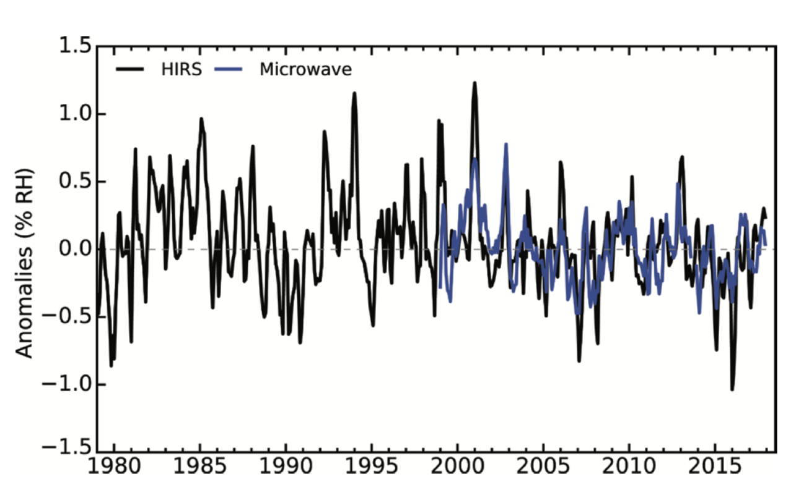
Time series of UTH anomalies (unit: % RH; reference period: 2001-2010) using HIRS and MW data sets. Time series are smoothed to remove variability on time scales shorter than three months.
Publication: John, V. O., L. Shi, E.-S. Chung, R. P. Allan, S. Buehler, and B. J. Soden (2018), Upper tropospheric humidity [in “State of the Climate in 2017”], Bull. Am. Meteor. Soc., 99, S27-28.

Slide 16
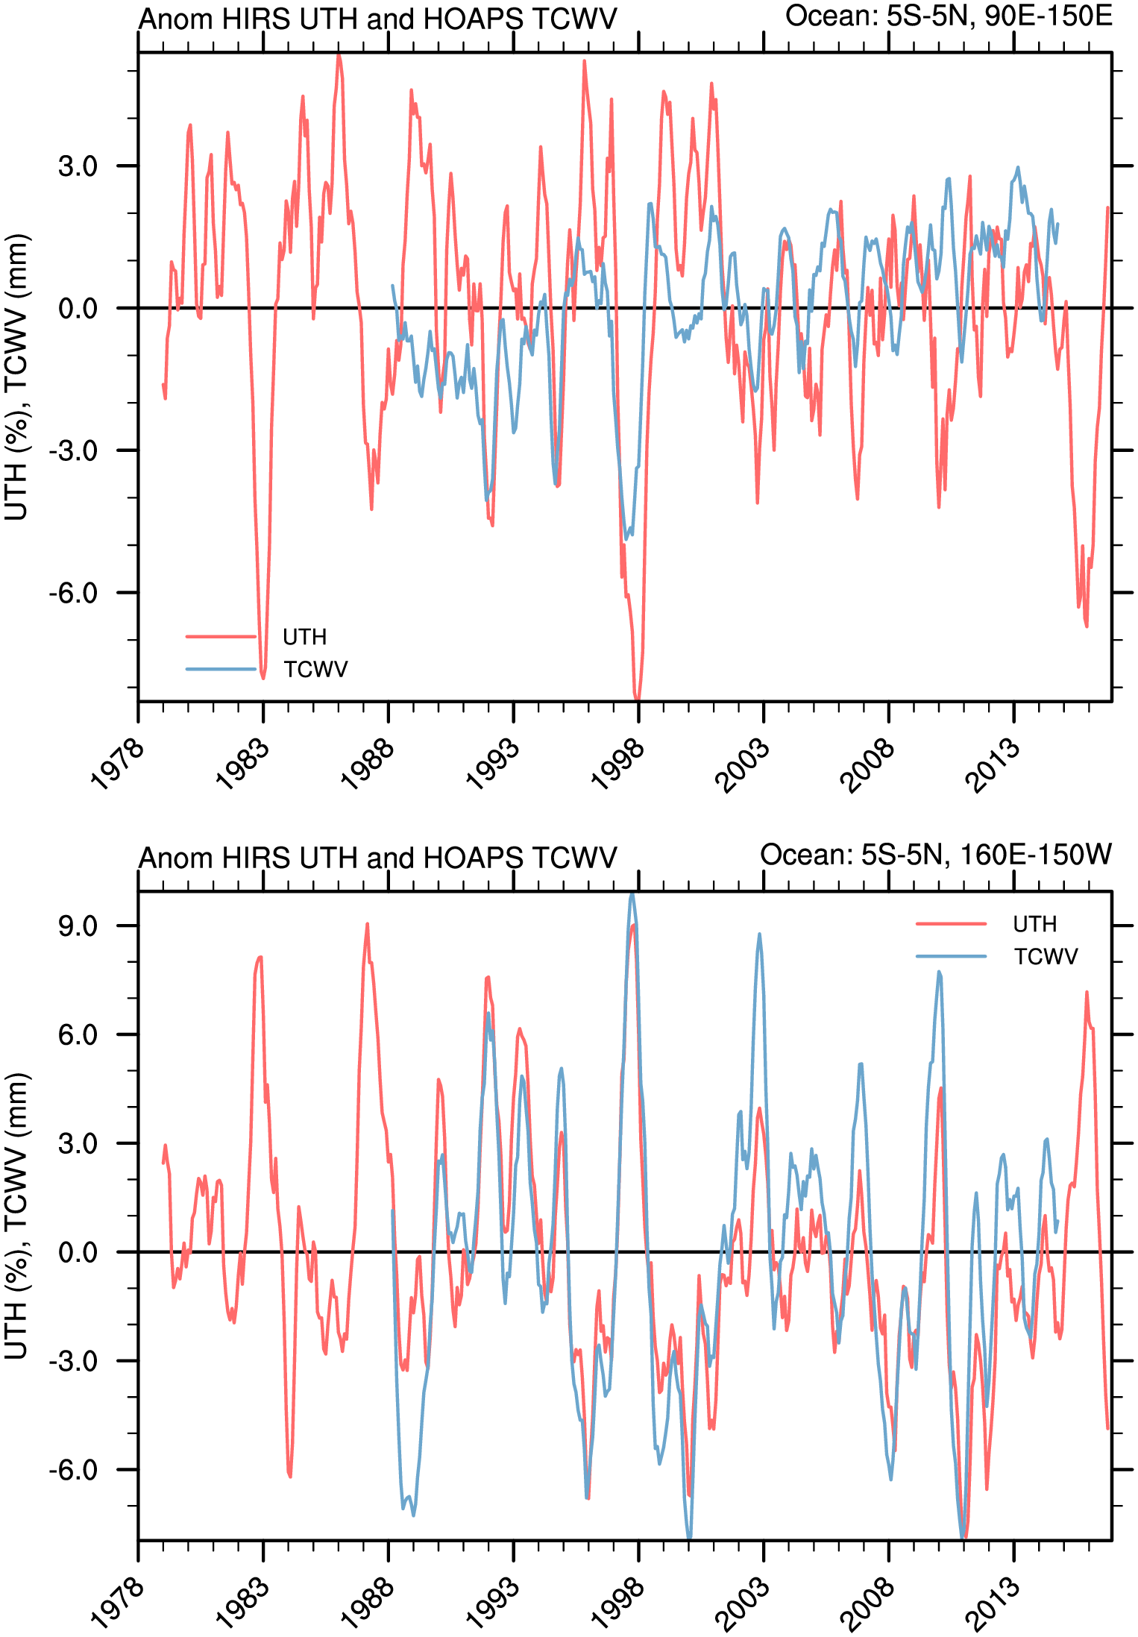
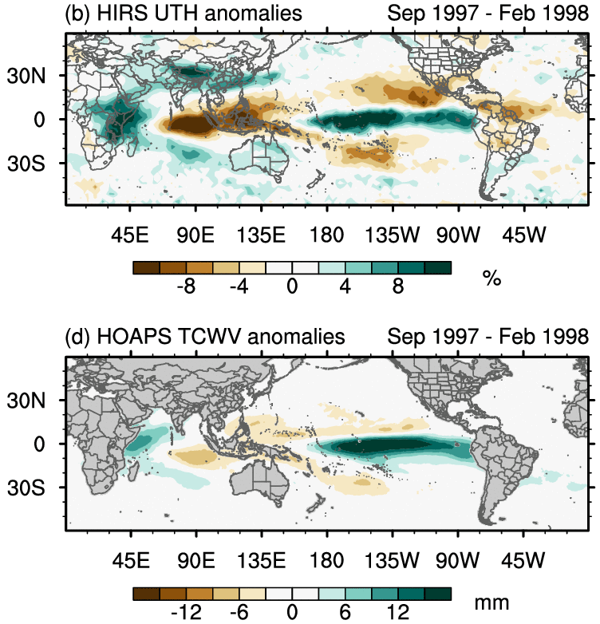
UTH and TCWV during El Niño
Shi, L., C. J. Schreck, and M. Schroder, 2018: Assessing the Pattern Differences between Satellite-Observed Upper Tropospheric Humidity and Total Column Water Vapor during Major El Nino Events. Remote Sens-Basel, 10.

Slide 17
Tropical Width
Evolution of tropical width. The dashed lines represent the 1993–2012 trend. The solid bold lines represent
the overall trend, and the solid thin lines represent the trend with the slope replaced by the values corresponding to the 95% confidence interval. The blue, black, and red colors represent OLR-AVHRR, OLR-HIRS, and brightness temperature, respectively.
Mantsis, D. F., S. Sherwood, R. Allen, and L. Shi, 2017: Natural variations of tropical width and recent trends. Geophys Res Lett, 44, 3825-3832.

Slide 18
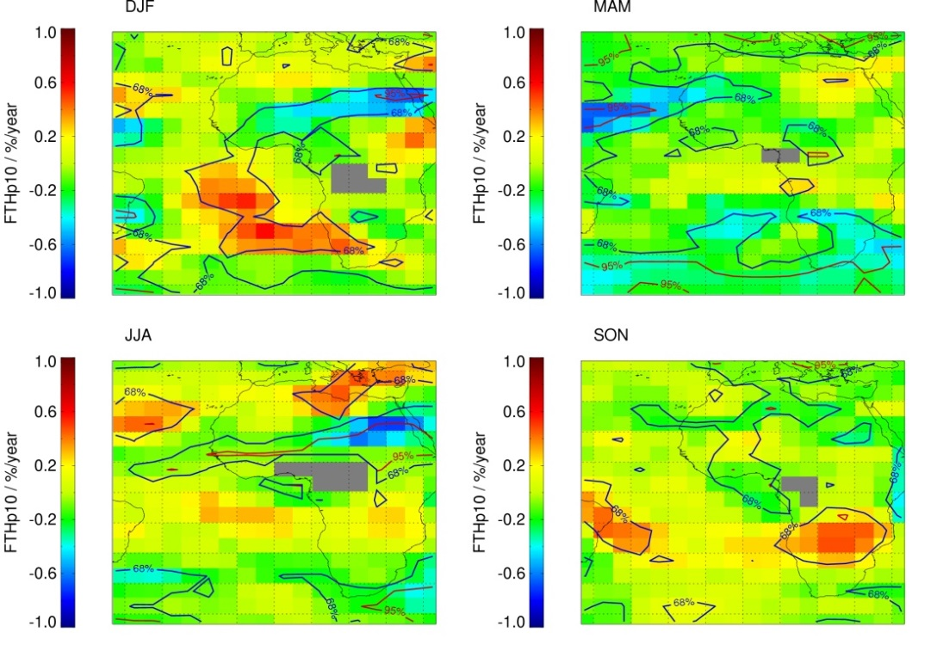
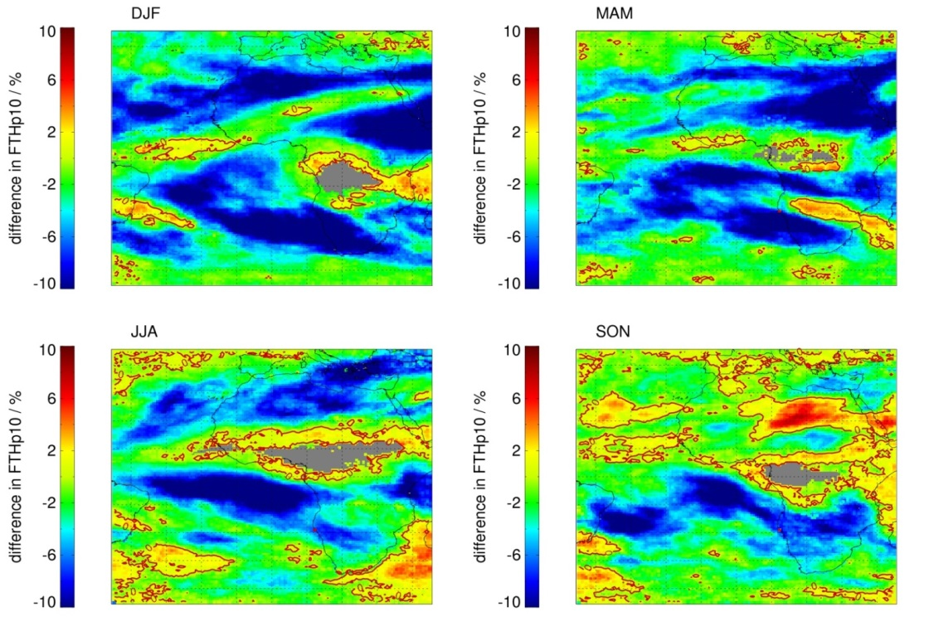
Trends and variability
(decadal, FTHp10)*
FTHp10: frequency of occurrence of FTH<10%
Positive trends largely coincide with dry regions but are hardly significant.
This caused mainly by interannual variability.
Correlation with El Nino and QBO is small and largely insignificant.
Difference between 1990-1999 and 2000-2009 FTHp10 climatology.
Generally larger FTHp10 in 2000-2009, in particular in the dry regions (blue areas).
Contour line: 0% difference, grey: small N.
Schröder, M., Roca, R., Picon, L., Kniffka, A., and Brogniez, H.: Climatology of free-tropospheric humidity: extension into the SEVIRI era, evaluation and exemplary analysis, Atmos. Chem. Phys., 14, 11129-11148, https://doi.org/10.5194/acp-14-11129-2014, 2014. .
Notes:
It means that the frequency of dry events is larger in the 2000s than in the 1990s.

Slide 19
New publications since last SEP update
Ferraro, R., B. Nelson, T. Smith and O. Prat, 2018: The AMSU-based hydrological bundle climate data record – description and comparison with other data sets. Remote Sensing, 10, 1640-1657. doi:10.3390/rs10101640.
John, V. O., L. Shi, E.-S. Chung, R. P. Allan, S. Buehler, and B. J. Soden (2018), Upper tropospheric humidity [in “State of the Climate in 2017”], Bull. Am. Meteor. Soc., 99, S27-28.
Moradi, I., J. Beauchamp, and R. Ferraro, 2018: Radiometric correction of observations from microwave humidity sounders. Atmos. Meas. Tech., 11, 6617-6626.
Schröder, M., and Coauthors, 2017: GEWEX water vapor assessment (G-VAP). WCRP Report 16/2017, 216 pp pp.
Shi, L., C. J. Schreck, and M. Schroder, 2018: Assessing the Pattern Differences between Satellite-Observed Upper Tropospheric Humidity and Total Column Water Vapor during Major El Nino Events. Remote Sens-Basel, 10.
Total of over twenty peer-reviewed publications in Phase II since 2013

Slide 20
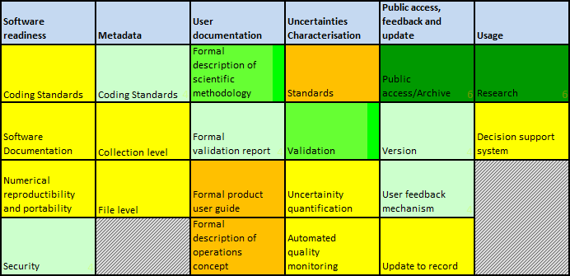
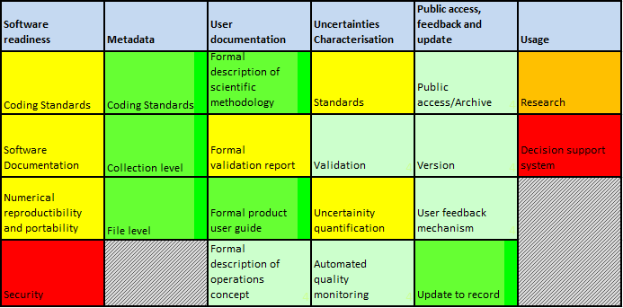
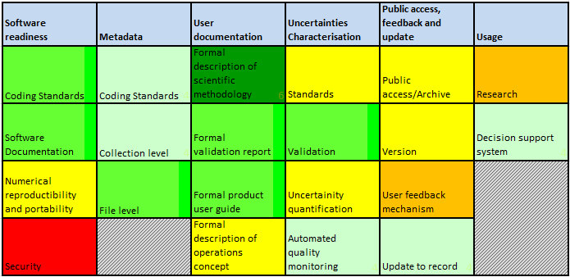
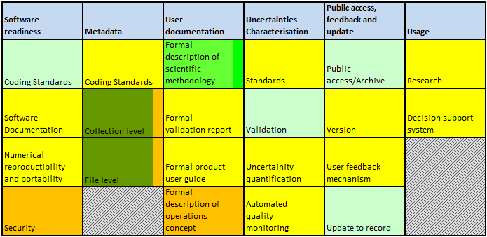
Maturity Matrix
HIRS
METEOSAT
MW (UMDNOAA)
MW (Umiami)

Slide 21
Guided by Maturity Matrix
Long-term upper tropospheric humidity (UTH) datasets are produced from HIRS, AMSU-B, MHS, and MVIRI/SEVIRI as climate data records
  Satellite records improved by bias correction and homogenization procedures
Developments are guided by Maturity Matrix
  Improvement in several maturity categories, especially under Usage
Redundancy of UTH records from multiple sensors is used to examine the homogeneity and stability of each satellite data record and to explain the differences among data records
  UTH records from different sensors show similar variability
  Differences between records are investigated

Slide 22
Next Steps (1 of 2)
Polar orbiting satellites (AMSU-B/MHS, University of Miami)
  Include ATMS data
Polar orbiting satellites (AMSU-B/MHS, University of Maryland / NOAA)
  Process and correct the new microwave observations from AMSU and MHS as data become available
  Developer both FCDR and TCDR and deliver the data to NCEI
  Validate both FCDR and TCDR, and document and publish the results
Polar orbiting satellites (AMSU-B/MHS, University of Hamburg)
  Creation of a UTH CDR from the FIDUCEO HIRS FCDR
  Include pressure parameter into the transformation from UTH to Tb

Slide 23
Next Steps (2 of 2)
Polar orbiting satellites (Infrared - HIRS)
  Add MetOp-B to the channel-12 time series and update processing codes on new operating systems
  Update C-ATBD and build Version 3.1 in operational environment
  Generate and maintain a CDR dataset of upper tropospheric humidity
METEOSAT (Infrared - MVIRI and SEVIRI)
  Utilise Meteosat FCDR from EUMETSAT and cloud information from MeteoSwiss
  Generate, validate and release new FTH data with improved coverage and resolution
Team collaboration
  Inter-compare UTH datasets
  Participation in the GEWEX Water Vapor Assessment

