Slide 1
SCOPE-CM Status and future
Werner Balogh
WMO Space Programme Office
2018 CEOS SIT Technical Workshop
EUMETSAT, Darmstadt, Germany 12 September 2018

Slide 2
Contents
SCOPE-CM Status and Future
Sustainable Development Goals
WIGOS and Central WMO Processes
Architecture for Climate Monitoring from Space
SCOPE-CM Next Steps

Slide 3
SCOPE-CM Status and Future
Where do we stand today with SCOPE-CM?
The (changing) environment and where should SCOPE-CM should fit?
What needs to be done next?

Slide 4
2030 Agenda for Sustainable Development
See https://sustainabledevelopment.un.org

Slide 5
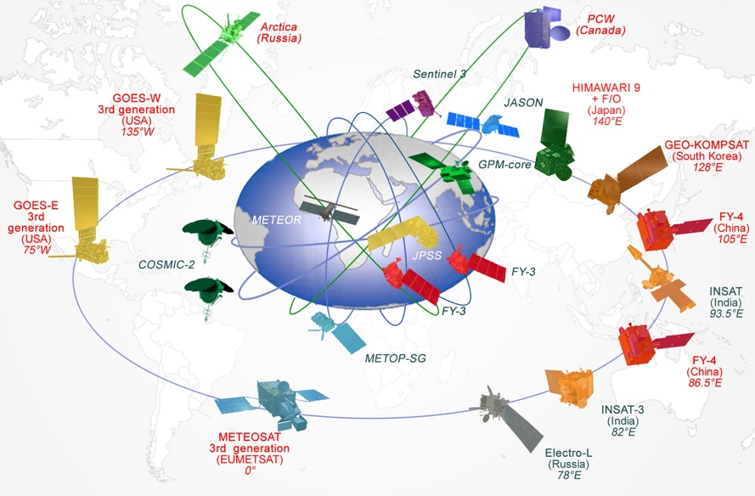
WMO Integrated Global Observing System
World Weather Watch (WWW), established in 1963.
Need to upgrade observation system in response to societal changes, addressing weather, water, climate and environmental issues:
WMO Integrated Global Observing System (WIGOS)
WMO Information System (WIS)
A common regulatory and management framework.

Slide 6
WMO Integrated Global Observing System
World Weather Watch
GAW
WIGOS
GCW
Hydro OS
GOS
GCOS
Partners
GDPFS
Co-sponsors
WMO Information System -WIS
GTS

Slide 7
WMO Application Areas
1) | Global numerical weather prediction
2) | High-resolution numerical weather prediction
3) | Nowcasting and very short range forecasting
4) | Seasonal and inter-annual forecasting
5) | Aeronautical meteorology
6) | Forecasting atmospheric composition
7) | Monitoring atmospheric composition
8) | Atmospheric composition for urban applications
9) | Ocean applications
10) | Agricultural meteorology
11) | Hydrology
12) | Climate monitoring
13) | Climate applications
14) | Space weather

Slide 8
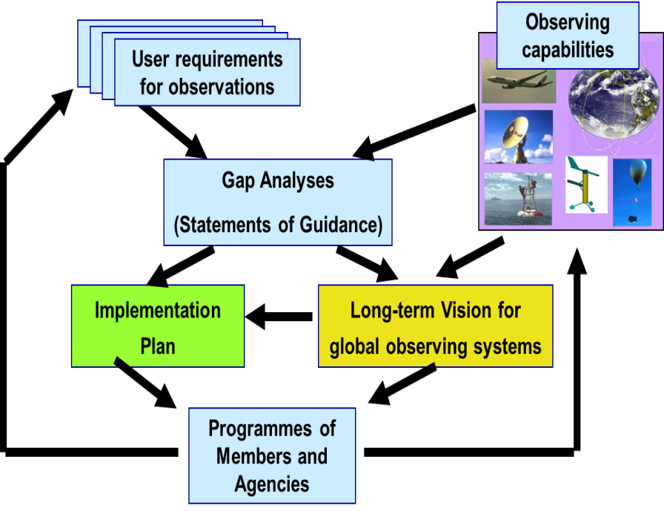
Rolling Review of Requirements (RRR)

Slide 9
Rolling Review of Requirements (RRR)
WMO Application Areas
WIGOS
WG Climate
WIGOS Vision 2040
Agenda 2030 Implementation

Slide 10
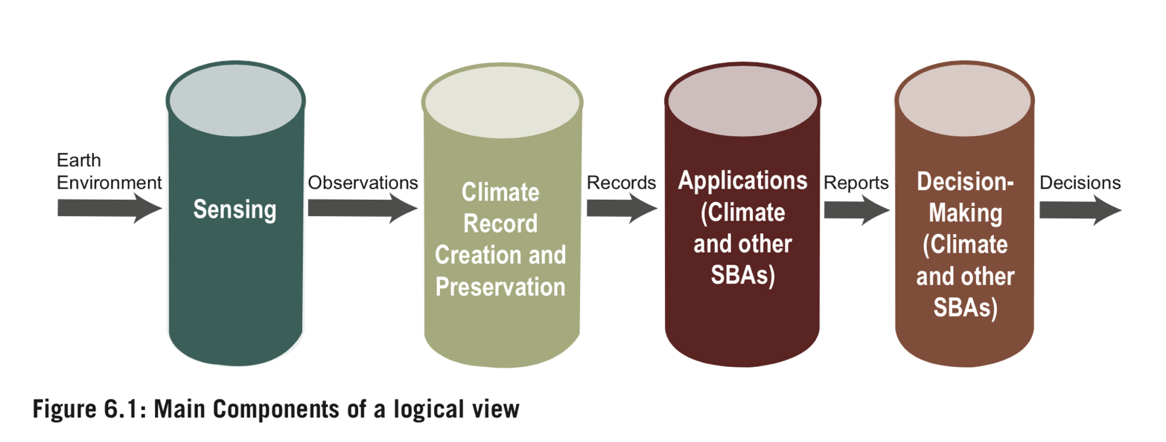
Architecture for Climate Monitoring
Different representations:

Slide 11
Architecture for Climate Monitoring
As depicted by WGClimate:

Slide 12
Architecture for Climate Monitoring
As depicted by WGClimate:

Slide 13
Global Framework for Climate Services

Slide 14
Global Framework for Climate Services
See http://www.wmo.int/gfcs//OM

Slide 15
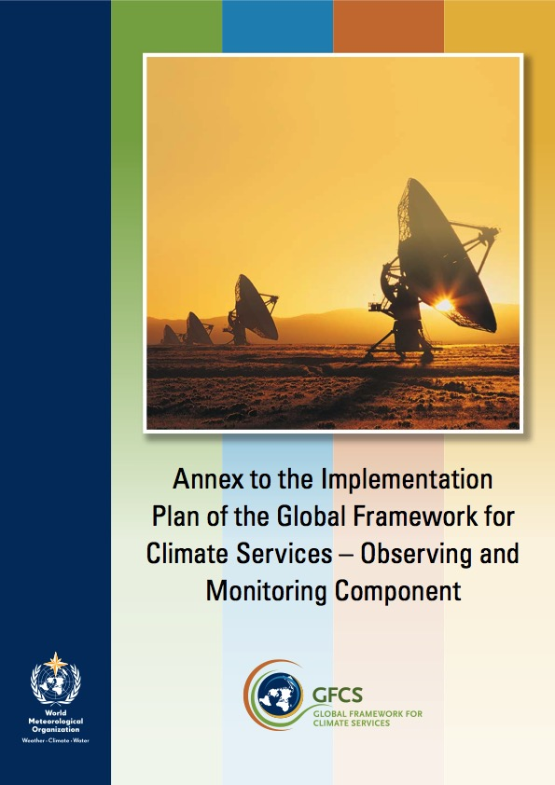
Global Framework for Climate Services
See http://www.wmo.int/gfcs//OM

Slide 16
SCOPE-CM Next Steps
How to conclude the Phase 2 projects?
What is the optimal future role/position/purpose for SCOPE-CM within this overall picture?

Slide 17
http://www.wmo.int/pages/prog/sat/index_en.php

