Slide 1
Sustained production of the International Satellite Cloud Climatology Project
(ISCCP) cloud products
Prepared by Ken Knapp, NOAA/NCDC
3/19/2015

Slide 2
Overview
ISCCP Background
Activities in 2014
Plans for 2015
Potential interactions with other SCOPE-CM projects

Slide 3
SCOPE-CM ISCCP Personnel
City College New York
  William Rossow
NOAA/NCDC
  Ken Knapp, Alisa Young
EUMETSAT
  Harald Rothfuss
JMA
  Hiroaki Tsuchiyama
CMA
  Liu Jian
INPE
  Nelson de Jesus Ferreira

Slide 4
Current Support
NOAA Climate Data Record Program
  Provides some funds to W. Rossow for transfer
Agency support
  Each agency has faithfully provided data

Slide 5
Motivation
Capture capability at NCDC to process ISCCP
Extend record of ISCCP Processing
  currently 1983-2009
  ~1981-2014
Increase ISCCP capability
  Higher spatial resolution than before
Maintain capability to extend record
  Develop processes to not only perform initial reprocessing but keep the record current

Slide 6
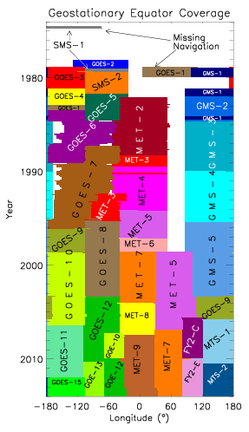
ISCCP is truly international
Requires international collaboration
  Image scene scheduling (3-hr full disk scans)
  Sharing of …
    Data
    Calibration results
    Processing
    Format requirements

Slide 7
NEW ISCCP DATA PRODUCTS
B1U Radiances
ANCILLARY:
  Lnd/Wtr Mask & Topography,
  Landcover, Ozone,
  Merged Snow-Ice,
  Atmospheric Temperature & Humidity
Pixel-scale products
  HXS: high-res, pixel (10 km), single-satellite (like old DX)
  HXG: high-res, pixel, global (global-DX reduced to common variables, in netCDF)
All gridded products in netCDF
  HGS: high-res, gridded (1°), single-satellite (DS-plus)
  HGG: high-res, gridded, global (like old D1, merged DS)
  HGH: high-res, gridded, hourly-monthly mean (like old D2)
  HGM: high-res, gridded, monthly-mean (like old D3)

Slide 8
Overview
ISCCP Background
Activities in 2014
Plans for 2015
Potential interactions with other SCOPE-CM projects

Slide 9
Progress during 2014
(through Feb. 2015)
Input data
  NCDC reprocessed atmospheric data (temperature and humidity profiles) for Rossow
  Rossow’s group has prepared all ancillary files for processing
Processing Capability
  Developed Quality Control (QC) Algorithm
  Ported code to run at NCDC
  Tested one initial month and verified
Progress (current status)
  QCing Geostationary and AVHRR files (nearly 2 decades complete)
  Testing production (nearly 1 decade complete)

Slide 10
Overview
ISCCP Background
Activities in 2014
Plans for 2015
Potential interactions with other SCOPE-CM projects

Slide 11
Plans for 2015
Continued Quality control
  Lots of issues with early GAC data.
  Filling gaps in the GEO B1 archive
H-series Production
Extension to pre-83 and post-09
  Possibly 1981 to 2014
Continued data provision from partners
Investigate how close to real time we can get
  Climate monitoring

Slide 12
Overview
ISCCP Background
Activities in 2014
Plans for 2015
Potential interactions with other SCOPE-CM projects

Slide 13
Progress during 2014
SCM-03: LAGS
  Require geostationary intercalibration of visible channel.
  Should compare ISCCP coefficients with LAGS calibration
SCM-06 IOGEO
  ISCCP performs IR and visible intercalibration
  So does IOGEO
  Should intercompare results
SCM-10: Clear Sky Radiances
  ISCCP will also produce similar clear sky values
  Inter-comparisons should be performed when complete.

Slide 14
The future of ISCCP:
New capabilities?
Currently almost 3 channels have global coverage:
  IR Window, Visible and Water Vapor*
Lots of new satellites coming, so potentially more channels will be global
  MSG – 12 channels (available now)
  Himawari 8 – 15 channels (launches this summer)
  GOES-R – 16 channels (launches in 2016)
*NOAA HIRS not actually at the HIRS/2 wavelength anymore, but could be simulated with AIRS and IASI

Slide 15
Summary
Plan to reprocess ISCCP by end of year
  Higher resolution
  Extended period of record
  More products
  New ISCCP production site
Requires continued collaboration
  Agencies that provide data
Need to plan for future capabilities
  New geostationary satellites may mean more coverage of other channels

