Slide 1
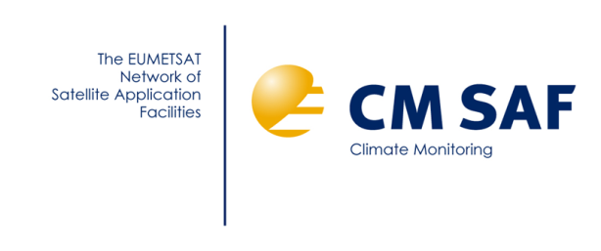
Advancing the AVHRR FCDR – a SCOPE-CM cooperation project between EUMETSAT, NOAA and ESA Status report for SEP-10 meeting, Geneva 23-24 March 2015
Karl-Göran Karlsson
SMHI, Norrköping, Sweden

Slide 2
Background
The historic AVHRR GAC dataset (1978➔present➔2025+ (?)) offers the longest data record of observations from a single high resolution multispectral passive sensor ➔ Highly interesting for climate change studies!
Several Thematic Climate Data Records (TDCRs) prepared in recent years (e.g. PATMOS-X and CLARA-A1)
During preparation of TCDRs several issues related to the quality of original radiances (FCDR) were identified ➔ SCOPE-CM project defined for achieving a long-term commitment for improving AVHRR GAC FCDR through international collaboration

Slide 3
Components of AVHRR FCDR project
Upgraded visible calibration corrections (MODIS Collection 6) (Andrew Heidinger)
Revised infrared calibration (new physical model) (Jon Mittaz)
Revised navigation based on image-retrieved (coast-line matched) update of orbital model (yaw, pitch,roll corrections) (Karl-Göran Karlsson)

Slide 4
Original timeplan and responsibilities
Upgraded visible calibration corrections (MODIS Collection 6)
Responsible partner: NOAA (A. Heidinger)
Planned end: August 2014
Tentative AVHRR FCDR Release 1
SEP 2014 VISIBLE CALIBRATION UPDATE

Slide 5
Achievements
Upgraded visible calibration corrections (MODIS Collection 6)
Responsible partner: NOAA (A. Heidinger)
A new visible calibration correction was delivered to the CMSAF project in October 2014
Implemented in PyGAC module (explained in following slides) and now used to produce the basic FCDR (Level1c) for both CMSAF (CLARA-A2 dataset) and ESA-CLOUD-CCI projects
Discussions ongoing if also resulting Level 1c dataset shall be officially released as a separate FCDR dataset in CMSAF

Slide 6
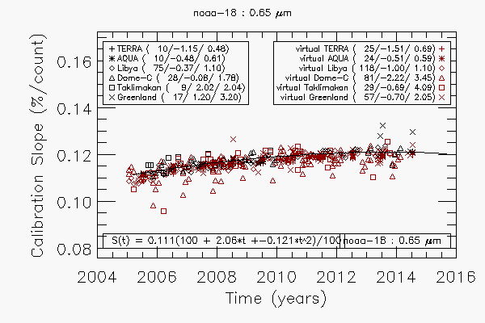
Achievements – example NOAA-18
Same method used as previously described in IJRS (2010) paper but with new ground targets (Greenland, Taklimakan) and additional satellites (NOAA-19, METOP-02 and METOP-02)

Slide 7
Achievements – summary of coeffs
Preliminary Calibration Results (9/29/2014)
Table shows coefficients for the quadratic equation for calibration correction
of instrument calibration slope. Estimations uncertain for some satellites (e.g., NOAA-08, NOAA-10 and METOP-01) due to insufficient data coverage.
Satellite | Channel 1 |  |  | Channel 2 |  |  | Channel 3a
 | S₀ | S₁ | S₂ | S₀ | S₁ | S₂ | S₀ | S₁ | S₂
noaa-06 | 0.087 | 22.164 | -0.935 | -0.059 | -395.058 | 117.103 | 0.000 | 0.000 | 0.000
noaa-07 | 0.114 | 5.492 | -0.585 | 0.126 | 6.801 | -0.761 | 0.000 | 0.000 | 0.000
noaa-08 | 0.056 | 249.052 | -103.086 | 0.130 | -11.614 | 47.920 | 0.000 | 0.000 | 0.000
noaa-09 | 0.108 | 6.657 | -0.082 | 0.120 | 5.340 | -0.473 | 0.000 | 0.000 | 0.000
noaa-10 | 0.103 | 12.183 | -2.010 | 0.134 | 3.679 | -0.270 | 0.000 | 0.000 | 0.000
noaa-11 | 0.112 | -0.876 | 0.270 | 0.118 | -0.238 | 0.225 | 0.000 | 0.000 | 0.000
noaa-12 | 0.129 | 1.593 | -0.130 | 0.151 | 2.958 | -0.255 | 0.000 | 0.000 | 0.000
noaa-14 | 0.118 | 5.493 | -0.549 | 0.150 | 2.349 | -0.044 | 0.000 | 0.000 | 0.000
noaa-15 | 0.123 | -0.633 | 0.031 | 0.139 | 0.248 | -0.010 | 0.000 | 0.000 | 0.000
noaa-16 | 0.112 | 0.427 | -0.003 | 0.117 | 2.392 | -0.269 | 0.120 | -12.115 | 4.462
noaa-17 | 0.117 | 0.199 | 0.093 | 0.132 | 3.635 | -0.322 | 0.124 | 2.040 | -0.123
noaa-18 | 0.111 | 2.058 | -0.121 | 0.124 | 2.655 | -0.155 | 0.000 | 0.000 | 0.00
noaa-19 | 0.108 | 2.247 | -0.317 | 0.121 | 1.693 | -0.132 | 0.000 | 0.000 | 0.000
metop-02 | 0.112 | 0.906 | -0.024 | 0.133 | 0.814 | 0.025 | 0.126 | 2.020 | -0.115
metop-01 | 0.119 | -7.442 | 2.828 | 0.116 | 10.222 | -3.271 | 0.141 | -27.970 | 10.925

Slide 8
A Merged AVHRR / HIRS FCDR
Achievements at NOAA/UW/CIMSS (1)
NOAA & UW/CIMSS developed a new merged FCDR from AVHRR and HIRS.
This provides a MODIS or SEVIRI-like spectral information in the IR (see image on right).
10 years of data exist now.
A 2nd and complete version will be done in 2015.
Uses SCOPE-CM Reflectance Calibration and NOAA GSICS IR calibration for HIRS.
Can implement SCOPE-CM IR calibration when available.
Co-located HIRS and AVHRR radiances provide addition FCDR quality checks.
Format is NetCdf.
tropical transmission spectra
AVHRR
channel response
AVHRR + HIRS
MODIS or SEVIRI

Slide 9
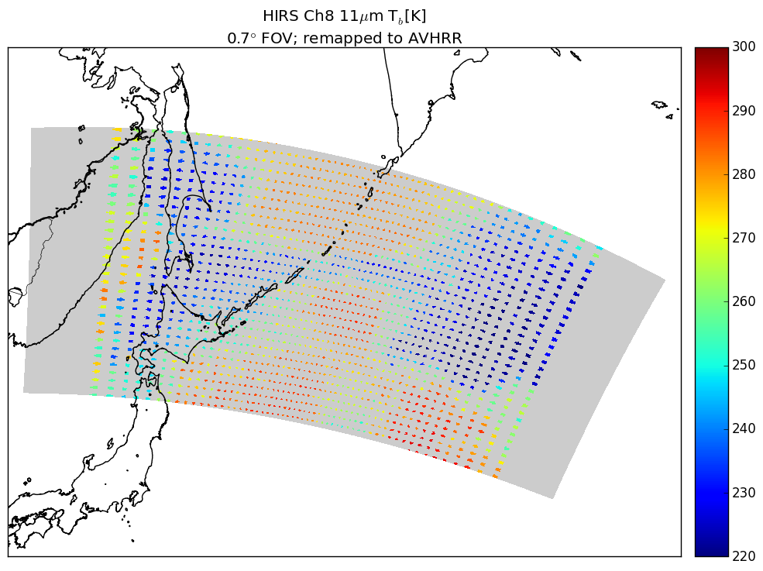
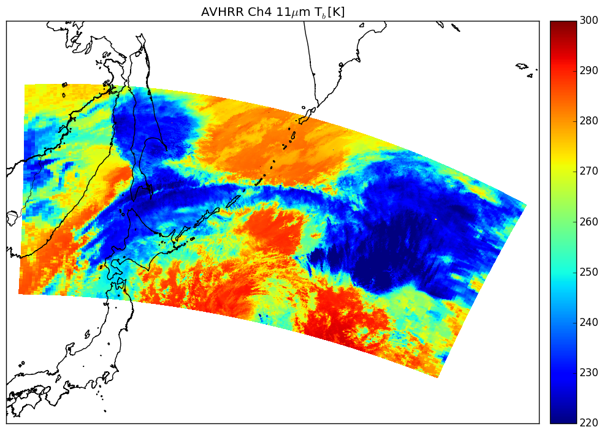
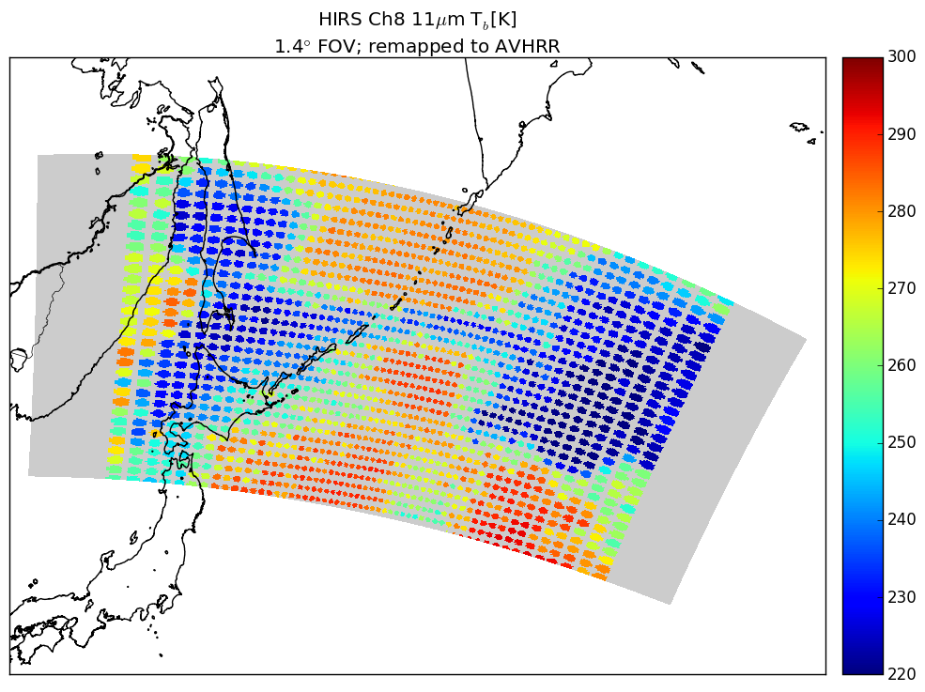
A Merged AVHRR / HIRS FCDR
Achievements at NOAA/UW/CIMSS (2)
Challenges:
Spatial coverage.
Collocation.
Sensor footprint.

Slide 10
Timeplan and responsibilities
Revised infrared calibration (new physical model)
Responsible partner: ESA (ESA-SST-CCI, Jon Mittaz)
Planned end: June 2015
Tentative AVHRR FCDR Release 2
Jul 2015 infrared CALIBRATION UPDATE

Slide 11
Achievements
Revised infrared calibration (new physical model)
Responsible partner: ESA (ESA-SST-CCI, Jon Mittaz)
Work is ongoing (described in following slides 12-16) but delayed with 4-5 months
Discussions with CMSAF/ESA-CLOUD-CCI on common software (PyGAC – see next two slides)
This part of the SCOPE-CM project on infrared calibration has been greatly enhanced lately by the approval of the EU Horizon 2020 project FIDUCEO (including a thorough revision of the AVHRR infrared calibration procedure)

Slide 12
Achievements – PyGAC link
Revised infrared calibration (new physical model)
PyGAC is a standalone Python module developed by CMSAF and ESA-CLOUD-CCI (A. Devasthale, SMHI) for transferring original AVHRR Level 1b data (counts) to Level 1c (radiances) applying the latest available inter-calibration methods (both visible and infrared)
Introduction available at https://pygac.readthedocs.org/en/pre-master/
New visible calibration implemented in PyGAC plus a revised infrared methodology (compared to method previously used in CMSAF CLARA-A1 dataset). However, still no input from revisions worked at in ESA-SST-CCI.

Slide 13
Achievements – PyGAC
Latest PyGAC and CMSAF development has addressed a long list of weaknesses and quality issues of the original Level 1b dataset: - Overlapping of GAC orbits (method for removing overlap) - Identification and removal of duplicated or corrupt Level 1b files - Errors in scan line numbering - Incorrect time stamps - Inconsistent PRT numbering and value range (threatening quality of infrared calibration) - Lack of roll, pitch and yaw (RPY) corrections for POD satellites - Time stamp mismatch in header and data - Spurious erroneous geolocation values - Saturation of channel 3b ➔ solving these issues + more accurate visible and infrared calibration (smoothing over 50 scanlines) have already greatly improved the AVHRR FCDR (Level 1c dataset) used by CMSAF

Slide 14
Achievements – ESA-SST-CCI project (1)
Revised infrared calibration (new physical model)
Within the ESA CCI SST project there are deliverables related to the update of the AVHRR Thermal (3.7-12 micron) channels
25% of J.Mittaz time covered so very limited manpower
Consists of a number of steps in the schedule
Obtain complete AVHRR data archive
Complete
Includes University of Miami extra orbits and extra NOAA-06 data from NOAA CLASS
Creation of satellite-to-satellite and satellite against in-situ (ocean)
Create new AVHRR calibration coefficients (fundamental) for well behaved periods of AVHRR
Use SNO like matchups
Primary set (A)ATSR-to-AVHRR when available
Before (A)ATSR use newest (closest to (A)ATSR) AVHRR as reference
None exist for NOAA-15
Will be problematic for the earliest AVHRRs
Determine time dependent bias
When (A)ATSR data available use as much as possible
Pre-(A)ATSR only have satellite-to-satellite matches at beginning/end of operational life for AVHRRs with matches equator crossing times
Can use other set (morning/afternoon) but even no AVHRRs have much less data for early satellites
Look into using RTM BTs as reference
Validate using modern AVHRRs

Slide 15
Achievements – ESA-SST-CCI project (2)
Revised infrared calibration (new physical model)
MATCHUP GENERATION
Undertaken by Brockmann Consuly for the ESA-CCI SST project
Creation of satellite-to-satellite and satellite against in-situ (ocean)
Matchup against in-situ (buoy) data
Clear sky only
Information of interest – RTM generated BTs
Creation of SNO like matchups
Clear and cloudy matchups included
BTs available where clear sky present
Will be done for
(A)ATSR vs buoy
AVHRR vs buoy
(A)ATSR vs AVHRR
AVHRR vs AVHRR
Current status
In-situ matches for (A)ATSR and AVHRR for post-1991 period complete
Waiting for SNO like matches for post-1991 period
Currently 1991-2005 complete
Work on pre-1991 matchups yet to start
Some code changes are needed
Should be done in next couple of months

Slide 16
Achievements – ESA-SST-CCI project (3)
Revised infrared calibration (new physical model)
RECALIBRATION
Just at point of starting to look at matchup data
Need to write code to interpret format of matches
SNO for NOAA-12,14 fully available
Will start analysing in next couple of weeks
SNO for NOAA-16 doesn’t yet cover important instrument thermal variations
Should be available In a couple of weeks
Investigate time dependent biases using AATSR matches
Validate possible use of RTM BTs for time dependent biases
Pre-1991 AVHRRs
More limited matches so need to assess accuracy of recalibration procedure
Simulation code already available to test uncertainty on calibration parameters
Time dependent method needs investigating
In current ESA CCI schedule this work is to take ~ 6 months real time (1.5 months available work as funded)

Slide 17
Achievements – AVHRR and FIDUCEO
Revised infrared calibration (new physical model)
FIDUCEO project kicks off in March 2015 (next month)
2 post-docs to cover both AVHRR and HIRS calibration
AVHRR recalibration to look at using HIRS as a reference for pre-(A)ATSR period
As part of AVHRR calibration training will probably get a post-doc to help with CCI recalibration work
One post-doc due to start April 2015
2nd post awaiting final reply from candidate
Will create a new AVHRR Level 1 format including uncertainty information
NPL work already started of estimates of AVHRR uncertainty

Slide 18
Timeplan and responsibilities
Revised navigation based on image-retrieved (coast-line matched) update of orbital model (yaw, pitch,roll corrections)
Responsible partner: EUMETSAT (CM SAF, K-G Karlsson) + ESA (ESA-CLOUD-CCI, M. Raspaud)
Planned end: June 2016
Tentative AVHRR FCDR Release 3
Jul 2016 navigation UPDATE

Slide 19
Achievements
Revised navigation based on image-retrieved (coast-line matched) update of orbital model (yaw, pitch,roll corrections)
Responsible partner: EUMETSAT (CM SAF, K-G Karlsson) + ESA (ESA-CLOUD-CCI, M. Raspaud)
Work ongoing (according to plan)
Available clock error corrections for POD afternoon satellites have been added to the PyGAC module

Slide 20
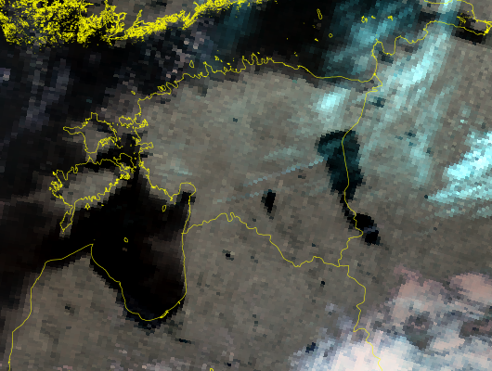
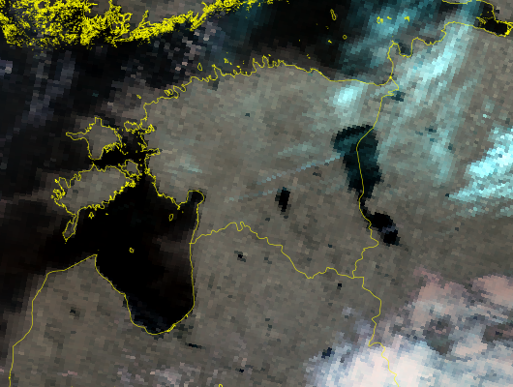
Achievements – clock error corrections
Example of clock-error adjusted AVHRR GAC scene
(Estonia, Baltic Sea) NOAA-14 15 July 1997 at 00:42 UTC.
Original
Clock-error adjusted

Slide 21
Planned additional activities + end goal
Creating white (useful) and black (corrupt) list of GAC orbits (Basically already achieved from work with PyGAC)
Investigating alternative approaches for visible calibration corrections Specific suggestion: Workshop on this subject should be arranged as soon as possible! (Still not realised)
Extended monitoring after inclusion of all corrections ➔
Tentative Final AVHRR FCDR Release
2018 consolidated final version
(Could still be considered as the end goal and now actually reinforced through the FIDUCEO initiative ending about the same time)

Slide 22
Plan for the next year
Upgraded visible calibration corrections (MODIS Collection 6) (Andrew Heidinger)
- Possible final adjustments of calibration correction + publication (?) - Use of upgraded calibration in next revision of PATMOS-X dataset
(- Extension of merged AVHRR + HIRS FCDR to 30 years)

Slide 23
Plan for the next year
Revised infrared calibration (new physical model) (Jon Mittaz)
- Covered in previous slides (last year of ESA-SST-CCI and first year of FIDUCEO)

Slide 24
Plan for the next year
Revised navigation based on image-retrieved (coast-line matched) update of orbital model (roll, pitch,yaw corrections) (Karl-Göran Karlsson)
- Prototyping method for image-retrieved (coast-line matched) corrections
- Testing feasibility of retreiving full RPY correction or whether correction will be limited to clock error correction

Slide 25
Considerations for long term plan
Should we consider incorporating HIRS into the planned FCDR (like done by UW/CIMSS?) (definitely interesting!)
Still no consensus about what is the best visible calibration (alternative methods under development). GSICS workshop?
Who takes responsibility for releasing the FCDR? (NOAA? EUMETSAT/CMSAF? FIDUCEO?)

Slide 26
Potential interactions
Connections to SCM-02 (Surface albedo from polar orbiters) and SCM-09 (ISCCP) are obvious. - Direct link already exists with SCM-02 via CMSAF Surface Albedo work for CLARA-A2 (using PyGAC) - No link yet with ISCCP although indirect links are already established with Andrew Heidinger (e.g. new paper by Rossow et al. to appear very soon in Journal of Atmospheric and Oceanic Technology comparing ISCCP and PATMOS-X visible AVHRR calibrations)
Connection with GSICS will probably be required to arrange proposed visible calibration workshop. Motivation is that there are still several (even within NOAA) methods proposed for inter-calibration of visible AVHRR radiances. Thus, how would we handle the fact that there are several FCDR versions?
Connection to EU Horizon 2020 project FIDUCEO is already established.

