Slide 1
SCOPE-CM Project: UTH
Sustained generations of upper tropospheric humidity Climate Data Records from multiple sensors with multi-agency cooperation

Slide 2
Team composition
John Bates, NOAA NESDIS National Climatic Data Center, Asheville, NC, USA
Stefan Buehler, Lulea University of Technology, Kiruna, Sweden and Meteorological Institute, University of Hamburg, Germany ‎
Shu-peng Ho, National Center for Atmospheric Research, Boulder, CO, USA
Viju John, Met Office Hadley Centre, Exeter, UK and EUMETSAT
Marc Schröder, Deutscher Wetterdienst, Satellite Based Climate Monitoring, Offenbach, Germany
Lei Shi, NOAA NESDIS National Climatic Data Center, Asheville, NC, USA
Brian Soden, University of Miami, Rosenstiel School of Marine & Atmospheric Science, Miami, FL, USA
Eui-seok Chung, University of Miami, Rosenstiel School of Marine & Atmospheric Science, Miami, FL, USA

Slide 3
Project Summary
Sustained generation of upper tropospheric humidity (UTH) (also named as free tropospheric humidity (FTH))
Datasets derived from HIRS since late 1978, from AMSU-B and MHS since late 1998, and from MVIRI and SEVIRI since 1983
Satellite records improved by bias correction and homogenization procedures
Redundancy of records from multiple sensors facilitates the examination of the homogeneity and stability of each satellite data record and to explain the differences among data records
Working to advance maturity levels established by the SCOPE-CM Maturity Matrix Model

Slide 4
UTH Data Sources
Three data sources
Global High Resolution Infrared Radiation Sounder (HIRS) since late 1978 (polar orbiting)
Global Advanced Microwave Humidity Unit-B (AMSU-B) and the Microwave Humidity Sounder (MHS) since late 1998 (polar orbiting)
Meteosat Visible and InfraRed Imager (MVIRI) and Spinning Enhanced Visible and InfraRed Imager (SEVIRI) for the domain 45°N/S/E/W since 1983 (geostationary)

Slide 6
Polar orbiting infrared
A Climate Algorithm Theoretical Basis Document (C-ATBD) is written for the inter-satellite calibrated HIRS channel 12 brightness temperature dataset. The document is submitted to NCDC’s CDR program and is made available for public access.
The time series of the HIRS channel 12 brightness temperature dataset is extended to the end of 2013.
The netCDF attributes for HIRS channel 12 brightness temperature dataset are updated to CF convention.
The HIRS channel 12 brightness temperature dataset is processed in an operational environment.

Slide 7
Polar orbiting infrared - Publications
Chung, E. S., B. Soden, B. J. Sohn, and L. Shi, 2014: Upper-tropospheric moistening in response to anthropogenic warming. P Natl Acad Sci USA, 111, 11636-11641.
Gierens, K., Eleftheratos, K., and Shi, L.: Technical Note: 30 years of HIRS data of upper tropospheric humidity, Atmos. Chem. Phys., 14, 7533-7541, doi:10.5194/acp-14-7533-2014, 2014.

Slide 8
Polar orbiting microwave
A study on "Characterization of SSM/T-2 radiances using ERA-Interim reanalyses" is carried out by a CMSAF visiting scientist to ECMWF (Shinya Kobayashi).
Plan to start a systematic microwave FCDR and CDR project.

Slide 9
Polar orbiting microwave- Publications
Chung, E.-S., B. J. Soden, and V. O. John, 2013: Intercalibrating Microwave Satellite Observations for Monitoring Long-Term Variations in Upper- and Midtropospheric Water Vapor. J Atmos Ocean Tech, 30, 2303-2319.
Chung, E. S., B. J. Soden, B. J. Sohn, and J. Schmetz, 2013: An assessment of the diurnal variation of upper tropospheric humidity in reanalysis data sets. J Geophys Res-Atmos, 118, 3425-3430.

Slide 10
Geostationary infrared
For the homogenised Meteosat FTH data record a draft ATBD is available (www.cmsaf.eu/docs).
The updated ATBD for the release will be under review in summer 2015.
The geo-ring FTH demonstrator record is available from CM SAF.
The format has not been adapted to the Meteosat FTH edition 1 format.
The geo-ring software was installed at Noveltis.
An assessment of the quality of the Meteosat FTH product as function of viewing angle has been started. First and interim results from comparison to ARSA and HIRS FTH/UTH products exhibit no significant dependency of the difference on viewing angle.
The impact of weighting functions on FTH has been assessed

Slide 11
Impact of weighting functions on FTH

Slide 12
Geostationary infrared - Publications
Schröder, M., R. Roca, L. Picon, A. Kniffka, H. Brogniez, 2014: Climatology of free tropospheric humidity: extension into the SEVIRI era, evaluation and exemplary analysis. Atmos. Chem. Phys., 14, 11129-11148, doi:10.5194/acp-14-11129-2014.
Chung, E. S., B. J. Soden, B. J. Sohn, and J. Schmetz, 2013: An assessment of the diurnal variation of upper tropospheric humidity in reanalysis data sets. J Geophys Res-Atmos, 118, 3425-3430.

Slide 13
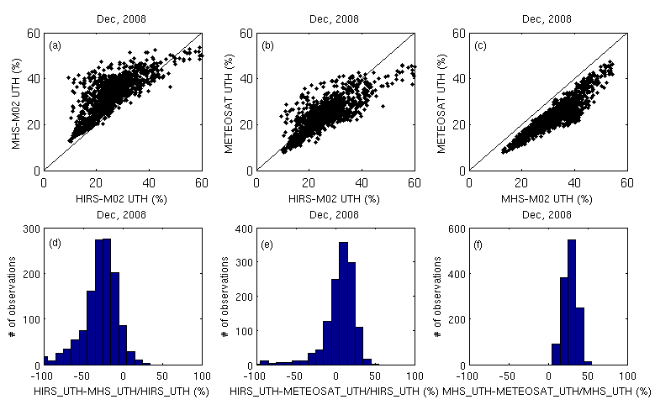
UTH Inter-comparisons among three data sources

